Slide 1

We are learning
To remind ourselves what a label is.
To write our own labels.

Slide 2
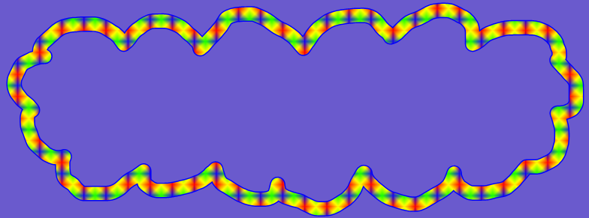
Can you remember what
a label is?

Slide 3
A label is one or two words that tell us what something is.
Can you think of any labels in our classroom?

Slide 4
I’m going to show you a picture of a cheetah.
I have added labels to show the different body parts of the cheetah.

Slide 5
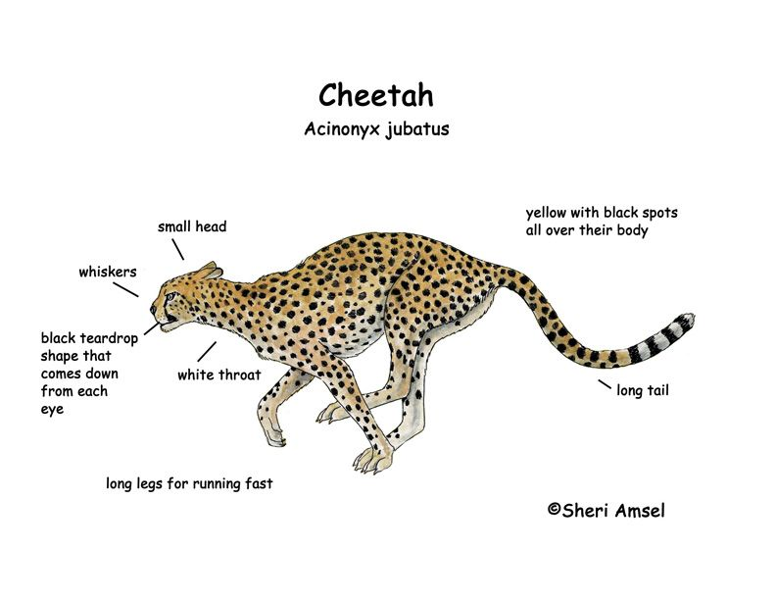

Slide 6
Do you remember the different things that adjectives can describe?

Slide 7
Adjectives can describe…….
The size of something
big
small large
tiny
massive

Slide 8
Adjectives can describe…….
The shape of something
round
square oval
curved

Slide 9
Adjectives can describe…….
The colour of something
red
gold light blue
dark green

Slide 10
Adjectives can describe…….
How something feels
hard
rough smooth
soft bumpy

Slide 11
I would like you to add labels to a picture of an elephant.
Use the word bank at the bottom of the sheet to help you.
Try and add an adjective to each of your labels.

