Slide 1

We are learning
To solve addition word problems.
To use a hundred square to help us.

Slide 2
We will be reading and solving word problems today.
Word problems are just like calculations except that the calculation is hidden within a sentence.
It’s our job to find the calculation and solve it.

Slide 3

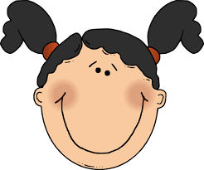
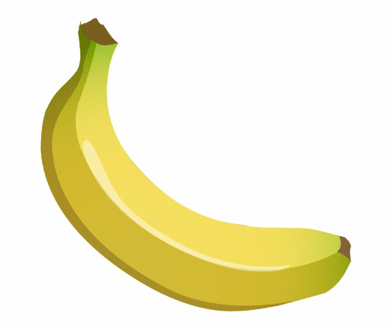
Tom has 5 bananas.
Jill has 3 bananas.
How many bananas are there altogether?
Tom Jill
5 + 3 = 8

Slide 4

Tom has 7 bananas.
Jill has 5 bananas.
How many bananas are there altogether?
Tom Jill
7 + 5 =

Slide 5
Tom has 9 bananas.
Jill has 4 bananas.
How many bananas are there altogether?
Tom Jill
9 + 4 =

Slide 6
That is the end of our lesson today.
Now it is your turn to solve addition word problems on your own.
I have typed some up for you. Draw pictures to solve them or use your hundred square.
Don’t forget to turn the numbers in the word problem, into a calculation.

