Slide 1

We are learning
To write our weekend news.
To use and to extend our sentences.

Slide 2
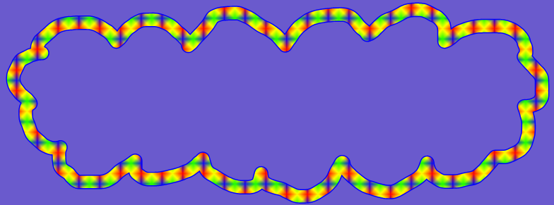
What did you do at the weekend?

Slide 3
I had a great weekend. I took Logan and Roxy for walks in Virginia Water. I got a bit cross with Roxy because she rolled in something very smelly so I had to give her a bath when we got home.

Slide 4
On Sunday I decided to make something new for dinner. I’ve not made ‘toad in the hole’ before but I gave it a go and it turned out really well. I was very pleased with myself.

Slide 5
In the evening I wanted to watch a film but I couldn’t find one I liked so I listened to some music instead. It was very relaxing.

Slide 6
I would like you to write your weekend news.
Can you remember the things we must include in our writing?

Slide 7
full stops
ABC
capital letters
went
letters on the line
letter tails under the line
fgjpq
and
and to extend sentences

