Slide 1

We are learning
To solve addition calculations.
To use a hundred square to help us.

Slide 2
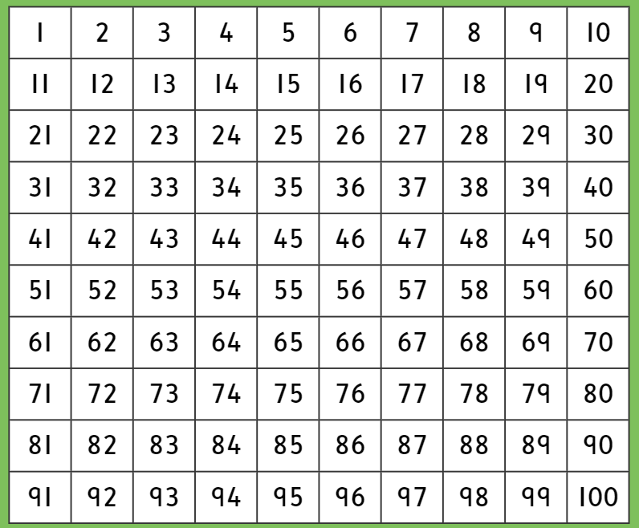
Here is a hundred square. I’m sure you recognise it.

Slide 3
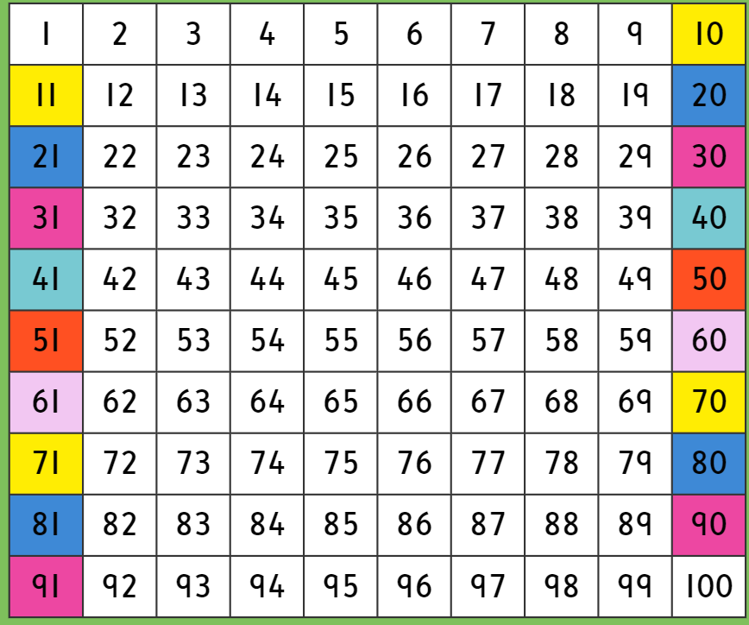
Have a look at how I have painted the numbers on the hundred square. They show you which number to go to once you have reached the end of a line. Follow the colours.

Slide 4
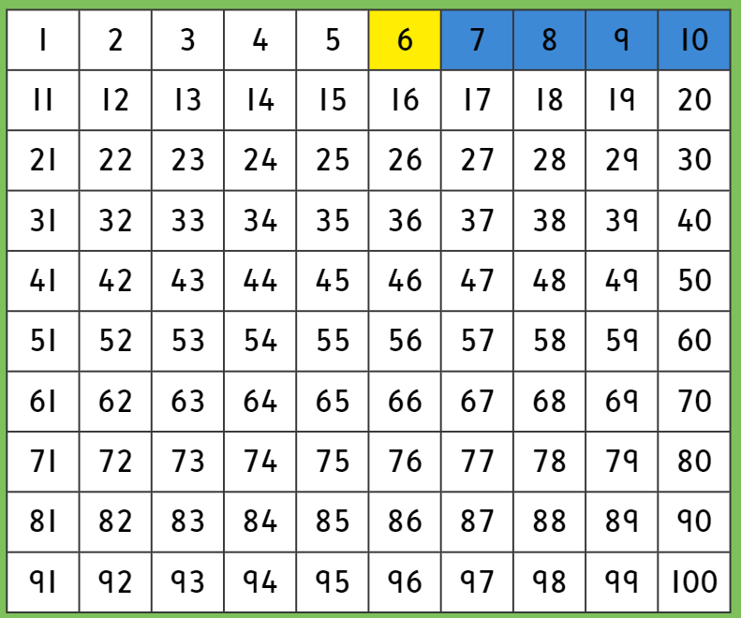

Read this addition calculation with me……
6 + 4 =
TOP TIP
Remember that when you add on a hundred square. You jump forwards (to the right)

Slide 5
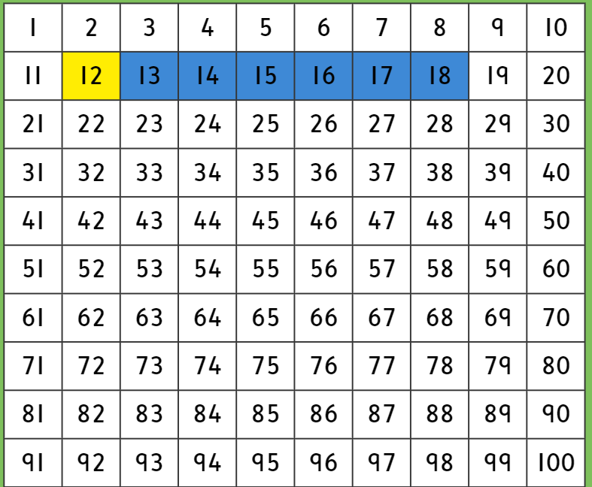
Read this addition calculation with me……
12 + 6 =

Slide 6
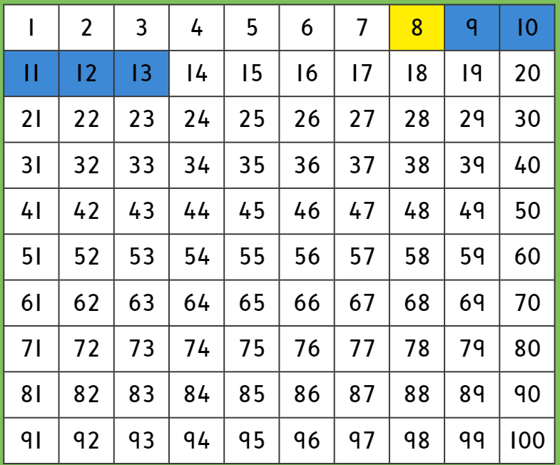
Read this addition calculation with me……
8 + 5 =

Slide 7
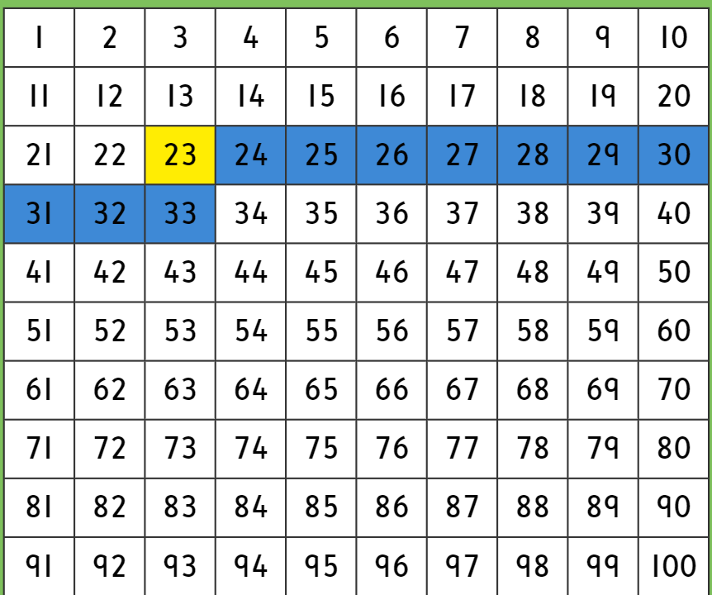
Read this addition calculation with me……
23+10=

Slide 8
It’s time to solve some addition calculations on your own. The calculations are on a piece of paper.
Don’t forget………………………….
No backwards numbers!

