Slide 1


Geography
Homes around the World

Slide 2
We are learning
To learn about the different types of homes that people live in.
To identify what type of home I live in.

Slide 3
Today we will look at the different types of homes that people live in.

Slide 4
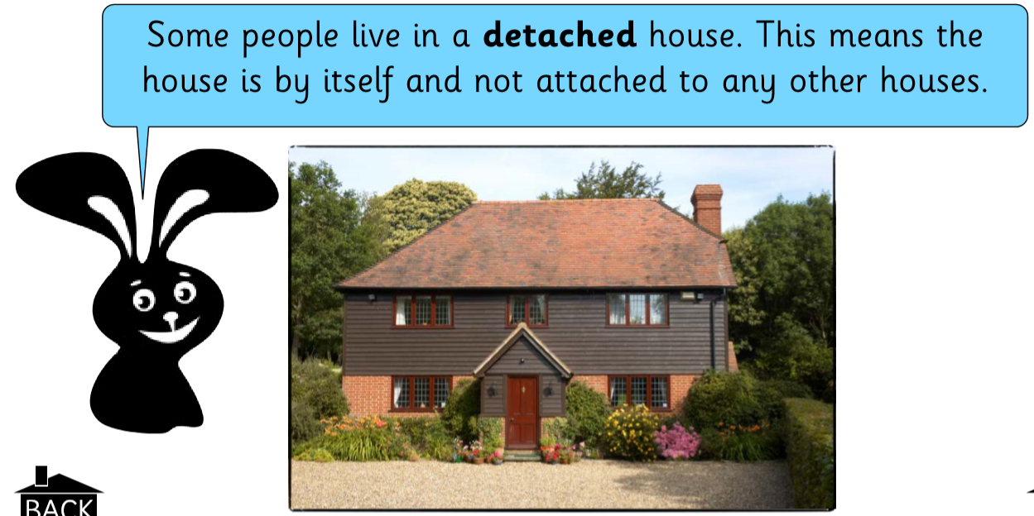

Slide 5
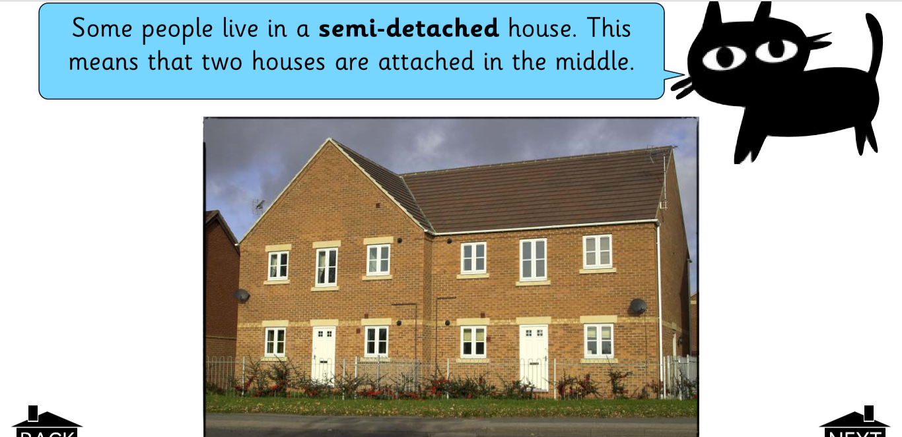

Slide 6
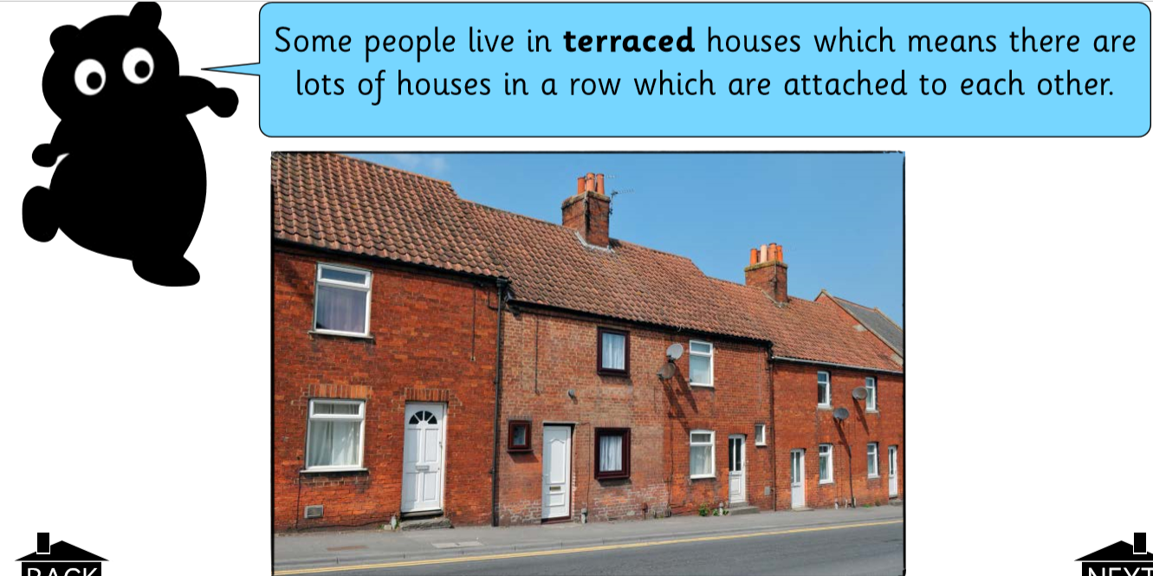

Slide 7
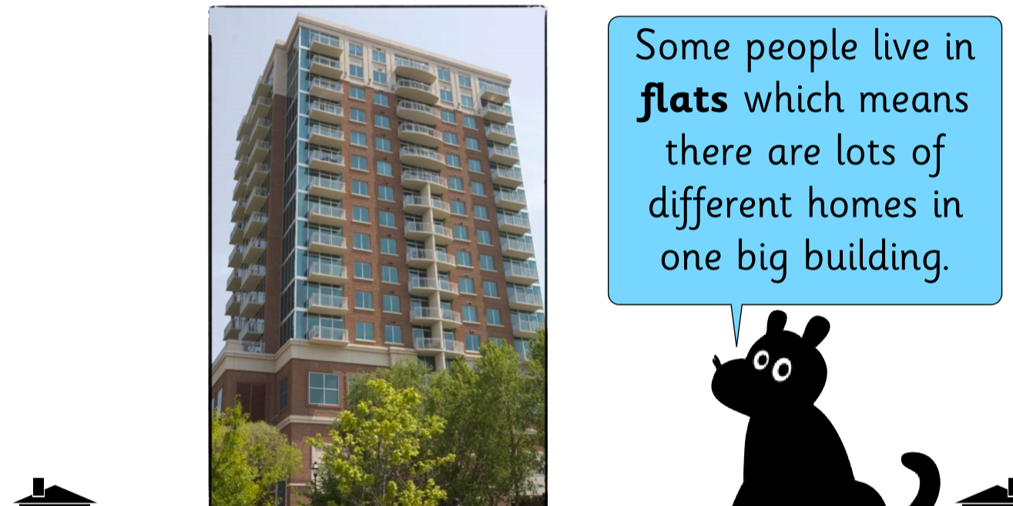

Slide 8
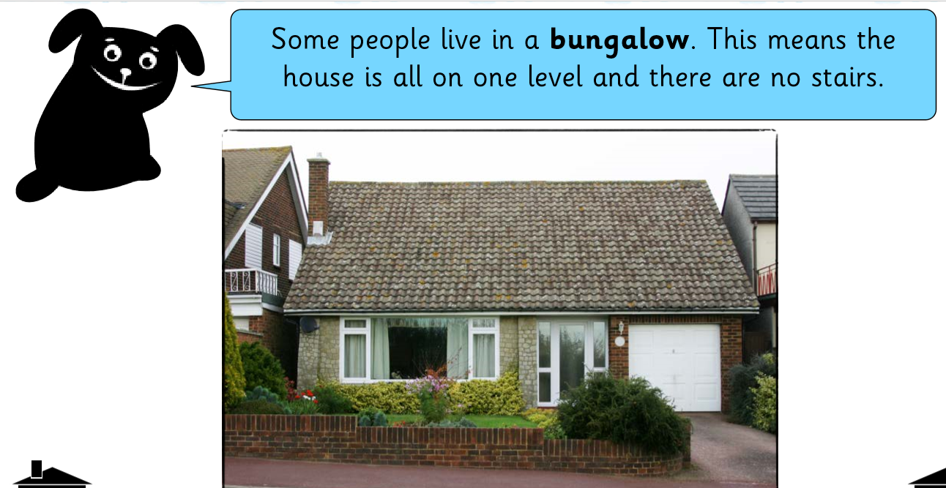

Slide 9
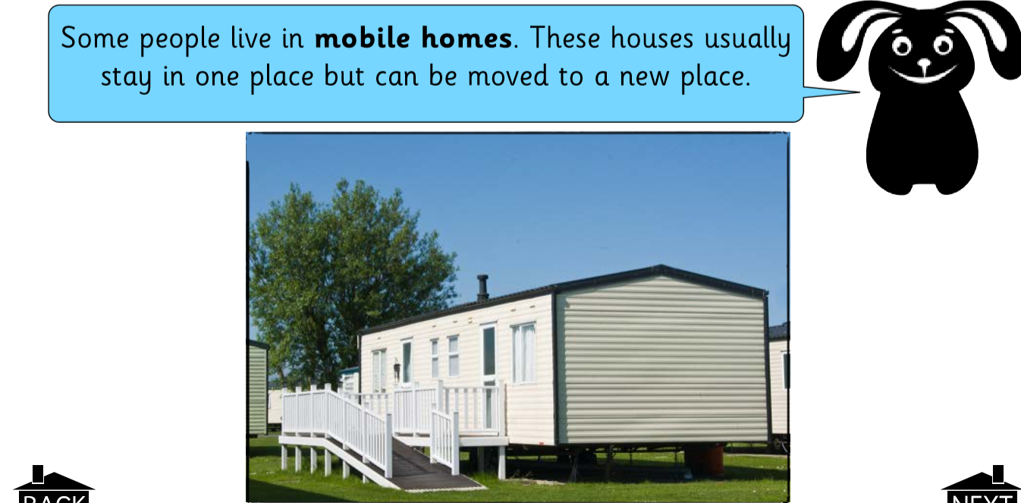

Slide 10
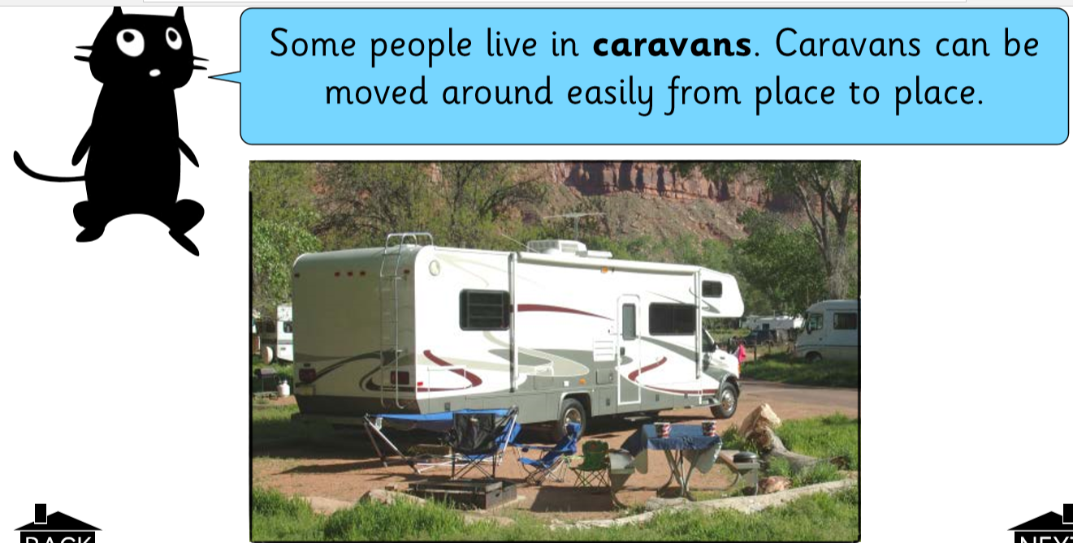

Slide 11
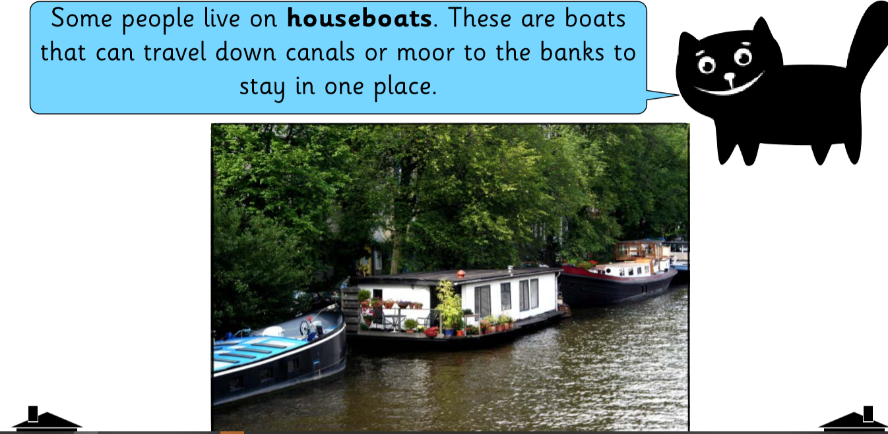

Slide 12
What type of home do you live in?
I’d like you to draw a picture of your home and answer some questions about it.

