Slide 1
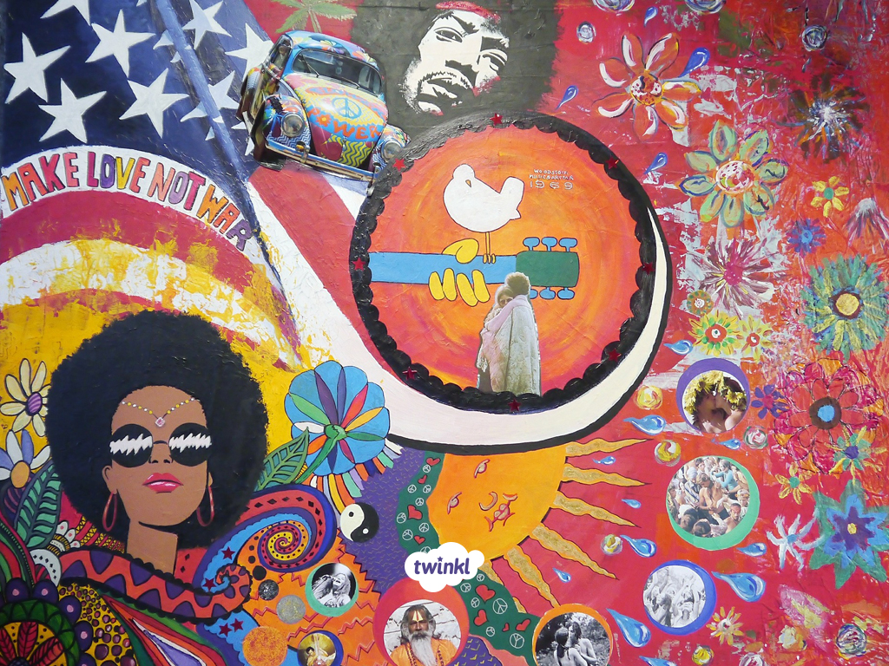

Dancing Through the Decades
Dancing in the 1960’s

Slide 2
Learning Objective
To appreciate the context of the 1960s through key action content, shaping a social dance sequence for performance.
Success Criteria
To explore the movements of social dances performed in the 1960s, discovering them practically through experimentation.
To develop choreographic skills linking and using set phrases to create dance sequences
To perform a 1960s-inspired dance sequence with an emphasis on starting and finishing positions.

Slide 3
Contents
Introduction to the 1960s: Placing the
Lesson in Context
1960s-Inspired Warm-up
Learning Set Phrases of Movement
Creating Your Own 1960s Inspired Sequence
Performing Your 1960s Sequence

Slide 4
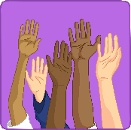



Introduction to 1960s: The Timeline
1963: Martin Luther King Jr. gives his famous "I Have a Dream" speech
1963: The first episode of the iconic television show "Doctor Who.“
1966: The first episode of "Star Trek" airs.
1966: The Beatles pop band claimed to be “bigger than Jesus.”
1967: The first successful human heart transplant operation.
1967: Che Guevarra (a very well-known figure in
the Cuban Revolution) was captured and killed.
1969: Neil Armstrong and Buzz Aldrin become the first people
to arrive on the Moon during NASA's Apollo 11 mission.
The Vietnam war continued throughout this decade.

Slide 5
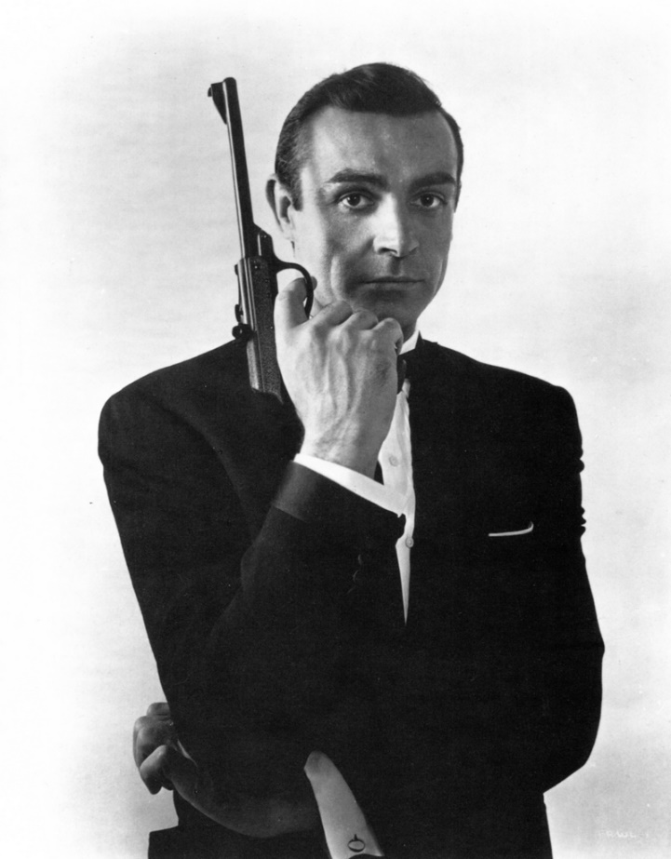
Introduction to 1960s Movies
The Sound of Music
West Side Story
Mary Poppins
Breakfast at Tiffany’s
The Beatles ‘Hard Day’s Night’
The Great Escape
The Planet of the Apes
Oliver
The Pink Panther
Easy Rider
Photo courtesy of classic film scans (@flickr.com) - granted under creative commons licence
James Bond films, e.g. ‘Dr. No’ (1962) and ‘Goldfinger’ (1964)

Slide 6
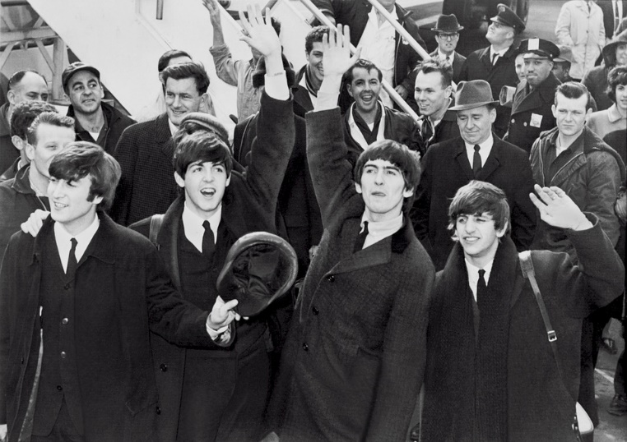
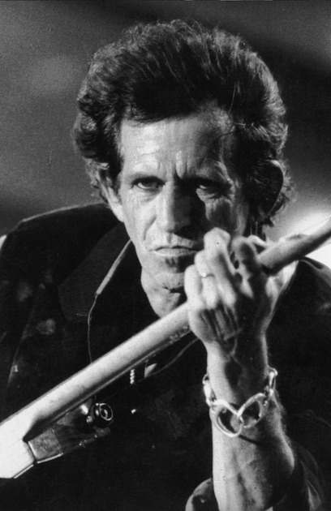
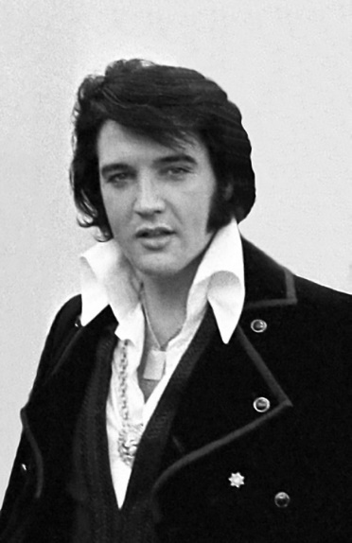
Introduction to 1960s Pop Stars
The Beatles
The Mamas and Papas
The Kinks
Simon and Garfunkel
Aretha Franklin
Elvis Presley
The Byrds
The Rolling Stones
The Supremes

Slide 7
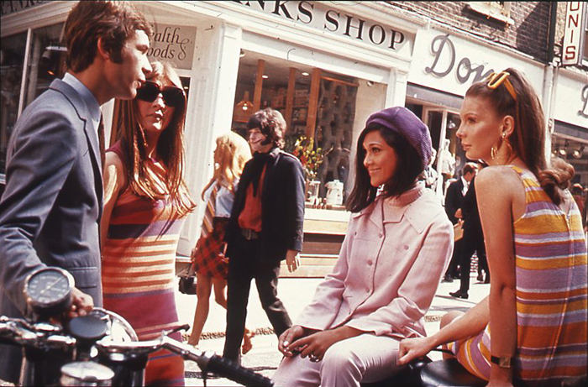
Introduction to 1960s: The Timeline
The 1960s were an era of fashion extremes. The early part of the decade continued to express the conservative, constrained aesthetic of the 1950s, promoting clothes in traditional silhouettes and styles. The later part of the decade, however, was the total opposite. Young people were rejecting the social restrictions of the past, the post-war ‘baby boomers’ were growing up and wanted their own style and many embraced peace, love and freedom through outlandish styles and bright colours.
Photo courtesy of The National Archives UK (via wikimedia commons) granted under creative commons licence

Slide 8
The Dance Moves
Name of ‘Dance Move’ | The Movements
Swimming Forwards | Gesture with the arms alternately as doing the breast stroke forwards
Pony Step | A run either travelling or on the spot with the knees high and the hands in front of the body
Fosse Step with Hand Twists | Stepping forwards and turning a half turn, arms outstretched to the side with hands in a fist shape circling
Fosse Arms Behind Back | Waving arms side to side behind back, stepping on bended knees forward
Chicken Head | Isolating the head forward to the beat of the music
Circling the Arms – Side, Side then Circle (Small) | Stepping sideways with the hands circling close to the hips, the ribs isolating forwards and backwards
The Twist | On both or alternate legs twisting the legs, hips and body from side to side
Swimming Backwards | Bring the arms back over the head alternately as if doing the backstroke

Slide 9
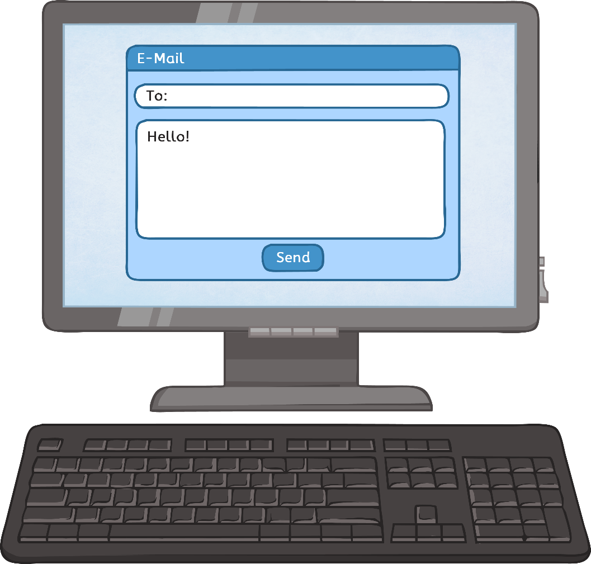
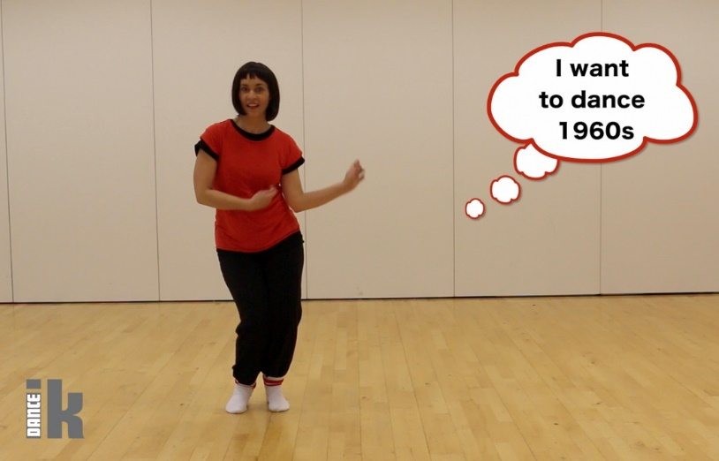
Learn the moves with the video
Link: https://vimeo.com/204336221

Slide 10

Make your 1960s sequence
Use the 1960s dance phrase and pick the movements that you want to use and decide an order. You may want to use them all in that order, or repeat some of the actions e.g. the travelling steps.
Create a 32 (4 lots of 8)count sequence or longer
Use the next slide to help you find 2-3 formations to use in your sequence.
Use the travelling steps, e.g. Pony step, Fosse arm circles, to change the formations through out your dance.

Slide 11

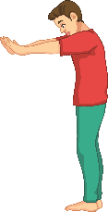

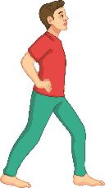
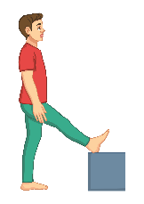
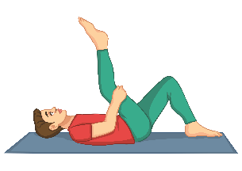

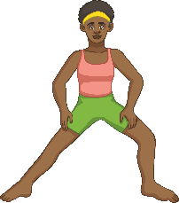
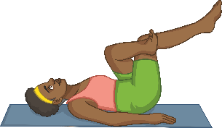


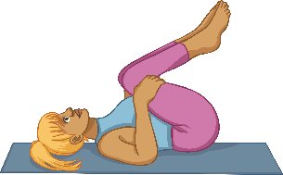
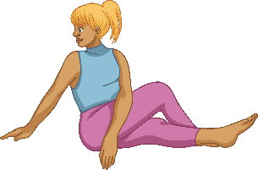
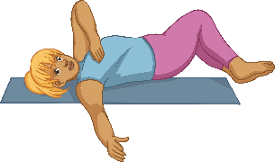
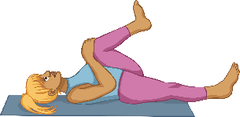
Plenary: Stretch and Reflect
Sitting in a circle, everyone should offer one thing that they have learned or been reminded of today.
Students can also use this time to evaluate their performances today and link their choreography to what they have learned about dance in the 1960s.
Use this time to complete a full-body stretch and cool-down.

Slide 12
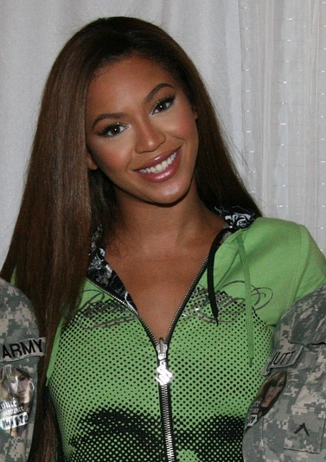
Plenary: Beyoncé and Fosse
Beyoncé created ‘Single ladies’ with movement taken from a piece Bob Fosse choreographed for his wife Gwen called ‘Mexican Breakfast’. Her music video for ‘Get Me Bodied’ is also based on Fosse’s choreography for ‘Rich Man’s Frug’ from Sweet Charity.
Watch one of Beyoncé’s videos.
Describe the dance moves being used.
Discuss any similarities to any of the moves learned in class.
Point out any similarities to Bob Fosse’s choreography.

Slide 13


