Slide 1
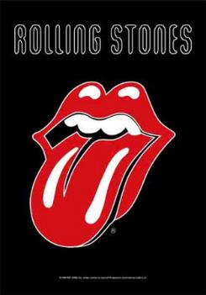
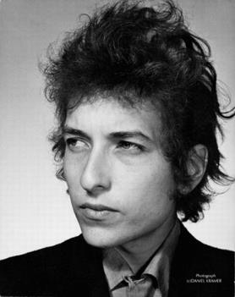
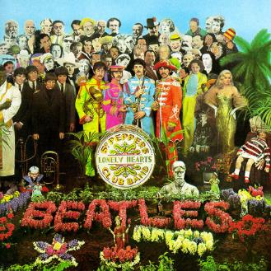

1960’s Popular Music
Who were the most important bands?
What were the most famous songs?

Slide 2
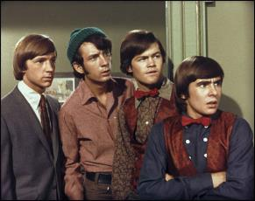
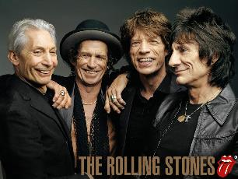
Know the key features of 1960s Pop Music.
Know and be able to recognise the verse-chorus structure.
Identify the influence of Blues and Rock n Roll on 1960s Popular Music,

Slide 3
Key Features
Influenced by Blues and Rock n Roll.
British bands were very popular and successful all around the world.
Songs based on Verse- Chorus Structure.
The main singer was supported by backing singers, singing in harmony.
Main Instruments: Electric Guitars, Bass Guitar, Drums, Piano.

Slide 4
The Beatles
The Beatles were the most popular and successful band of the 1960s.
The music combined lots of different styles- Rhythm and Blues, Rock n Roll, Folk and later some classical and world music influences.
Their music was especially popular among young girls who would scream loudly at their concerts, but people of all ages and countries enjoyed their music.
They were the first British band to be popular in America. Watch this clip from the Beatles playing Shea Stadium (NYC 1965)
https://www.youtube.com/watch?v=M6DfG7sml-Q
Their music has influenced song styles, songwriters and bands ever since.

Slide 5
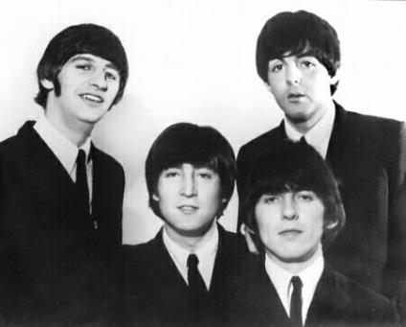
What made the Beatles’ songs popular?
They wrote songs about everyday life about Liverpool e.g. Penny Lane.
The lyrics were about love usually in rhyming couplets making them very catchy for younger audiences.
John Lennon and Paul McCartney were the main song writers but George Harrison (guitar) and Ringo Starr (drummer) helped write some songs too.
Watch this clip from the Beatles playing Shea Stadium (NYC 1965)
https://www.youtube.com/watch?v=M6DfG7sml-Q

Slide 6
1960s Pop song structure
The songs are based on a Verse-Chorus structure. The intro would start off the song with something catchy.
Verses tended to be 8 or 16 bars long, same music different lyrics.
Choruses were 8 or bars long, the same music and same lyrics and is the most catchy.
A middle 8 (8 bars long) or Bridge would be different chords and melody in the middle.
Intro | Verse 1 | Chorus | Verse 2 | Chorus | Middle 8 or Bridge | Chorus or Outro

Slide 7
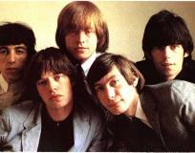
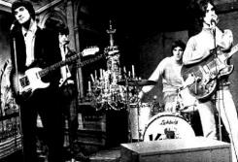
1960s Rock n Roll
The Kinks and the Rolling Stones were two successful British Bands who started to use riffs as an important part of the song.
A Riff is a repeated melody played by the electric guitar and bass
Watch The Rolling Stones performing Get Off of My Cloud in 1965 https://www.youtube.com/watch?v=qUDMzhlefMs
Watch The Kinks Waterloo Sunset 1967
https://www.youtube.com/watch?v=kqLoYQx8BXo
And this version by Ray Davis the lead singer of The Kinks at Glastonbury Festival in 2010
        https://www.youtube.com/watch?v=4vRURpe6FXE

Slide 8
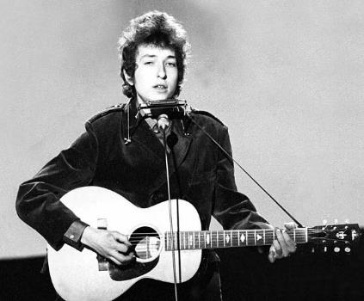
Bob Dylan
Bob Dylan was an American folk singer, who would write songs about politics and would protest against the war.
He tended to write ballads (stories) in strophic form.
He would play an acoustic guitar and harmonica.
Watch Bob Dylan from 1964
https://www.youtube.com/watch?v=OeP4FFr88SQ

Slide 9
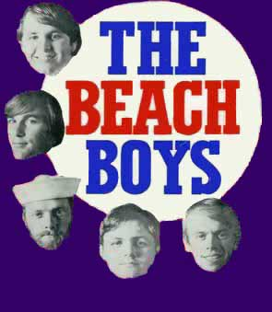
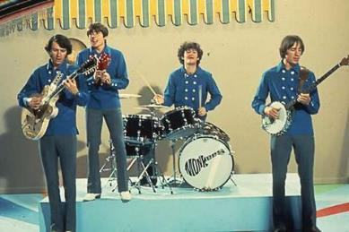
American 1960s Pop
Although the Beatles and Rolling Stones had become very popular in the US, the Beach Boys and the Monkees were two successful bands.
The Beach Boys style is very easy to recognise because of the high falsetto backing vocals and lyrics about surfing.
https://www.youtube.com/watch?v=vsDKMkPCOeA
The Monkees were formed for a TV series and were successful as a group.
Watch the theme tune to the TV show https://www.youtube.com/watch?v=AKs43dHBSWA

Slide 10
Quiz!
What are the main instruments used?
Name two American bands.
What did the guitar and bass play in the songs of the Kinks and Rolling Stones?
What made Bob Dylan’s music different?

Slide 11
Your work
Create fact files about each of the Beatles (you will need to do your own research).
Use the fact file sheets.

