Slide 1

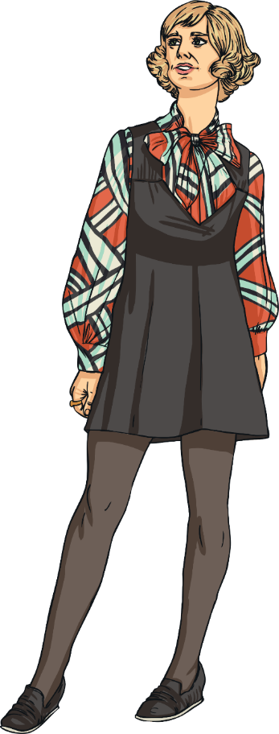

1960s fashion materials
Fashion
We are now going to learn about the changes in materials for clothes in the 1960’s.

Slide 2
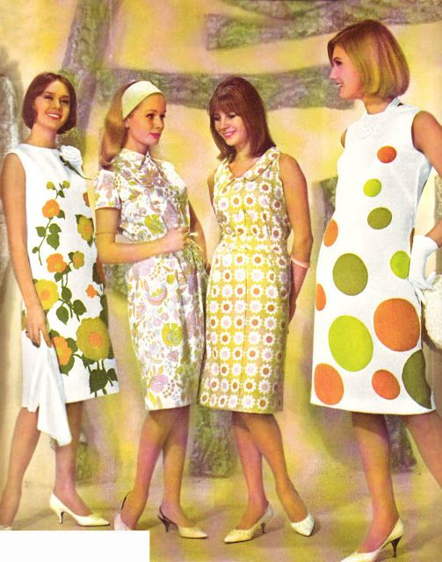
The 1960s fell in love with new, man-made materials, with young designers keen to find new angles on established forms.

Slide 3
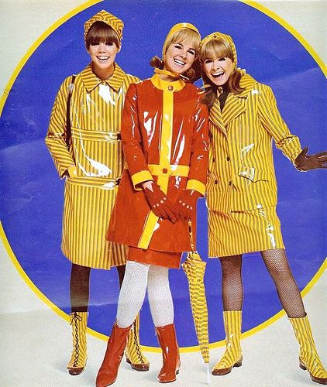
They saw the potential of modern plastics and synthetic fibres – Perspex, PVC, polyester, acrylic, nylon, rayon, Spandex, etc. – to create easy-care outfits that were eye-catching and fun.

Slide 4
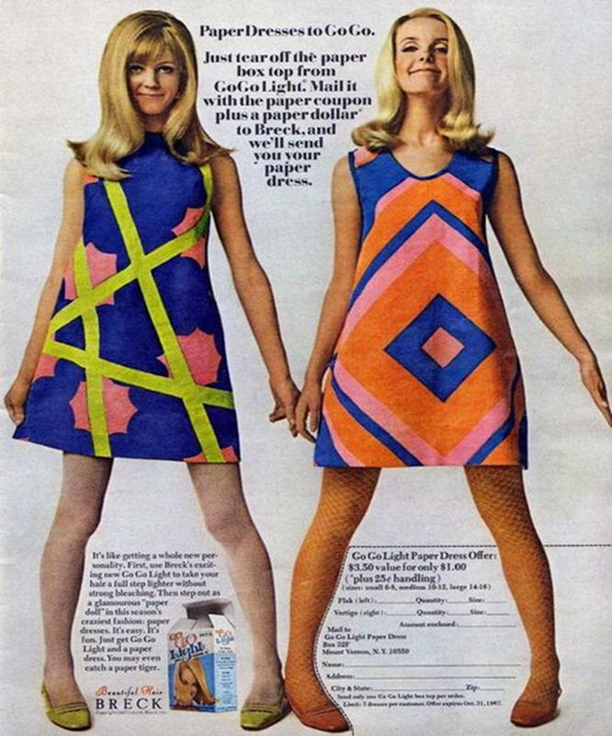
The quest for a truly modern form of clothing was epitomised by the 'paper dress'.

Slide 5
Research!
Can you research what materials they used to make clothes during the 1960’s? Why did they begin to use these materials? What did the clothing made of these materials look like? Report your findings back to us.

