Slide 1
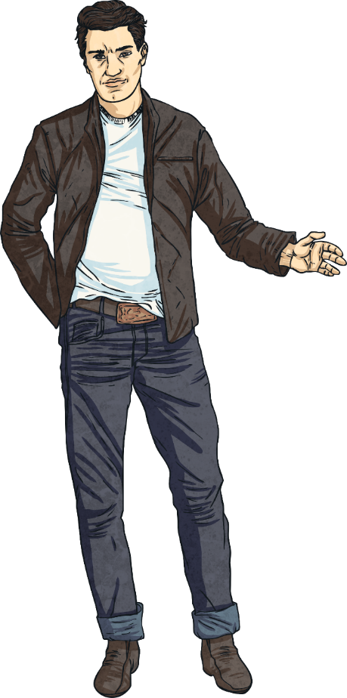
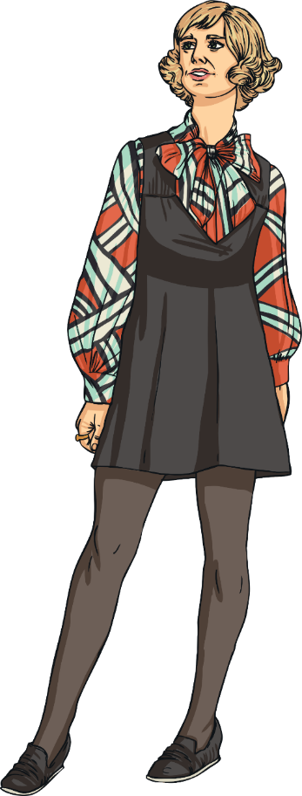

1960s fashion
Fashion
Today we are going to be learning about the different fashion trends during the 1960’s!

Slide 2
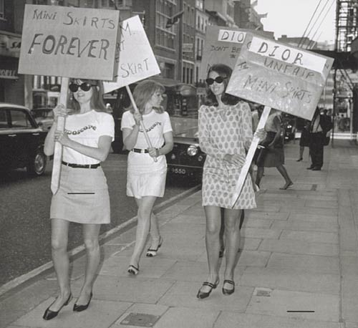
The big fashion craze of the 60s for women was the mini-skirt. Many people from older generations were scandalised by the length of these skirts and dresses! Young women considered the mini skirt as a representation of a new wave of feminism.

Slide 3
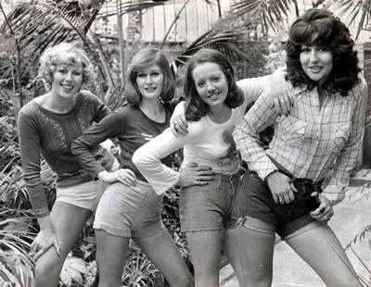
Towards the end of the decade, hot pants (very short shorts) were coming in to fashion.

Slide 4
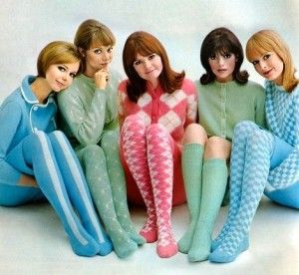
Tights had started being sold in the 1950s and were becoming more popular. Over-sized bows and collars on dresses and blouses were popular.

Slide 5
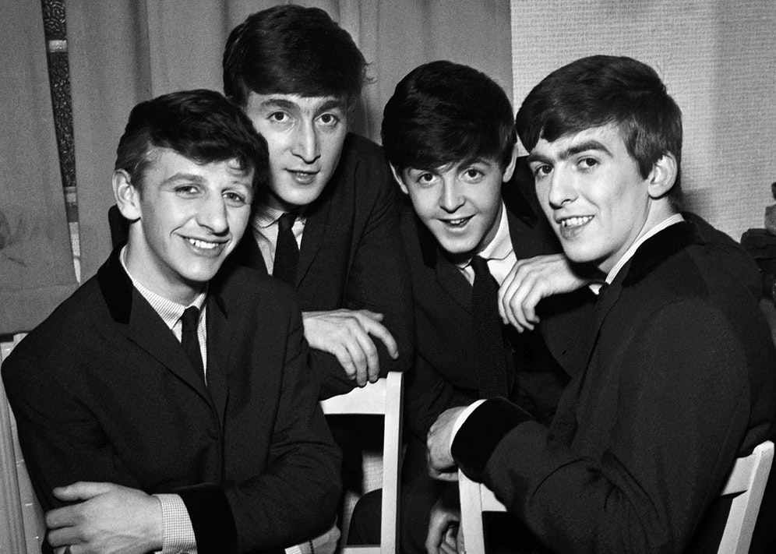
Inspired by groups such as The Beatles, men’s fashion was still often fairly formal, with suits and ties being popular.

Slide 6
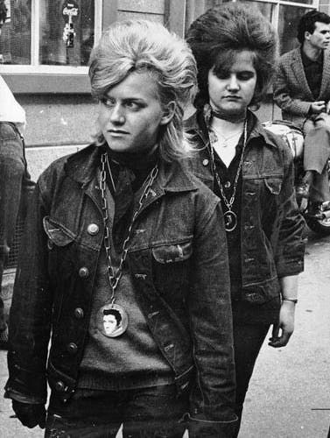
There were groups known as ‘Rockers’ who wore jeans, t-shirts and denim jackets.

Slide 7
Research!
Can you research any other fashion trends during the 1960’s? What were any famous designers during the 1960’s? What types of colours and patterns did people wear? Report your findings back to us.

