Slide 1

Food in the 1960s

Slide 2
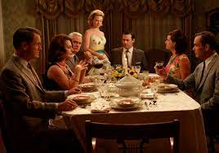
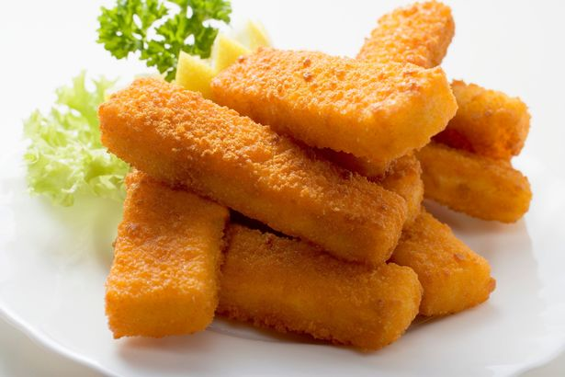
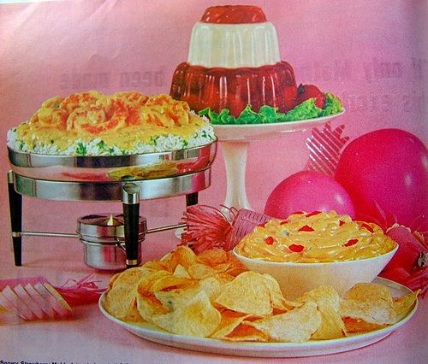
A 1960s dinner party .....
Food at home….
Party food

Slide 3
These are the DT key skills that are relevant to today
Confidently plan a series of healthy meals based on the principles of a healthy and varied diet
Use information on food labels to inform choices
Research plan and prepare and cook a savoury dish applying their knowledge of ingredients and their technical skills

Slide 4
Your mini project for today:
Food in the 1960s
Find out what foods were popular (you will need to do your own research)
Find out what foods children and families liked.
What is the same as now for family food? What is different?
Create a family menu for tonight’s meal at home and then (if you want to and if your family can help) that could be the meal at home this evening.
Note: If the ingredients are not in the cupboard or the fridge, you will need to ask your “servants” – (adults, elder siblings) to go to the shop and get the ingredients.
If you can, help prepare the meal this evening.
USE THIS VIDEO to learn how to chop vegetables safely as recommended by Jamie Oliver
https://www.jamieoliver.com/videos/how-to-teach-your-kids-to-chop-safely/
And watch this one for some “hacks” from Buddy Oliver on how to prepare vegetables
https://www.jamieoliver.com/videos/hack-shack/?playlist=how-to#play
To send us evidence, you can send a photograph of your work. You can make a short film and send that, you can prepare a paper project and send photos of that.
We hope you have fun and we look forward to seeing what you have found out.

