Slide 1


Slide 2
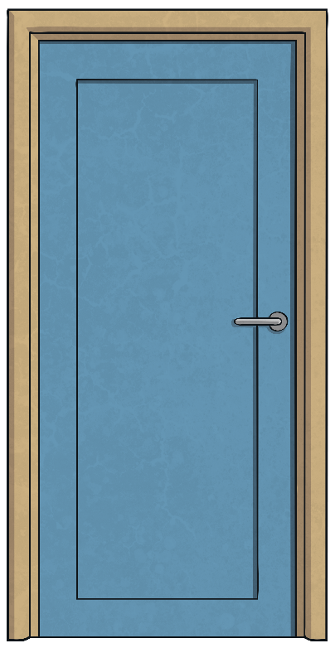
Lost in the Library
You are having a wonderful time reading and exploring books in the library. You found some really interesting books.
As the time to leave approaches, you realise all the librarians have left the library. You try the door and it is locked!
Luckily, an adult in your group has a plan of the library with a set of clues that will give the code to open the door.
Solve the clues and puzzles to discover the passcode number
needed to unlock the door to find your way out of the library.
The clues could be anywhere, so you need to keep your eyes peeled and your
mind sharp!

Slide 3

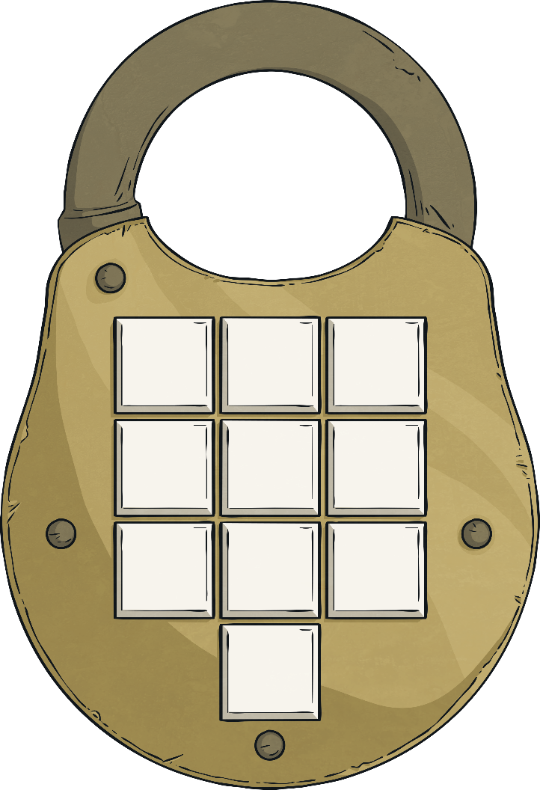
Lost in the Library
Unlock
Unlock
Unlock
Unlock
Unlock
Unlock
Unlock
Unlock
Unlock
Unlock
?
Unlock
Click on a to check your answers.
When you have all the digits for
the code, you can press the
button to unlock the door
and escape the library!
Unlock
Digit 1
Digit 2
Digit 3
8
6
0
?
?
?
Digit 4
Digit 5
Digit 6
7
?
?
?
7
4
It’s still locked.
It’s still locked.
It’s still locked.
It’s still locked.
It’s still locked.
It’s still locked.
It’s still locked.
It’s still locked.
It’s still locked.
Digit 7
Digit 8
Digit 9
?
?
?
4
2
2
Digit 10
?
8

Slide 4


Clues for Digit 1
A book on algebra provides the first clue. Solve each equation to find the value of the missing number.
The solution found most frequently provides the first clue.
2a + 4 = 20
a = 8
b = 7
4b - 13 = 15
40 - 3c = 16
c = 8
d = 7
5d - 14 = 21
6 + 2e = 24
e = 9
f = 9
f - 10 = -1
20 - 3g = -4
g = 8
The first digit of the code is
8
Reveal answer

Slide 5

Clues for Digit 2
In a dictionary, a set of verbs are listed. Convert each word using the suffix –ant or –ent.
The number of words using the suffix –ant provides the second clue.
recur
recurrent
observe
observant
differ
different
expect
expectant
resident
reside
consult
consultant
please
pleasant
hesitant
hesitate
assist
assistant
persist
persistent
-ant
-ent
6
4
The second digit of the code is
6
Reveal answer

Slide 6
Clues for Digit 3
A book on shapes provides the third clue:
Find the area of all of these shapes.
7
84
11
121
36
12
11
6
3
27
6
3
Areas are 84, 27, 121, 16, 30, 30, 36, 77, 30
30
2
15
Put the areas in order
8
30
6
Order is 16, 27, 30, 30, 30, 36, 77, 84, 121
16
30
12
10
11
4
77
5
7
The area in the 5th place and the digit in the ones place gives the third clue.
0
Reveal answer

Slide 7
Clues for Digit 4
bright
curious
A thesaurus provides the fourth clue.
How many of the words are synonyms for mysterious?
puzzling
familiar
normal
mystifying
cryptic
comprehensible
known
weird
The number of words that are synonyms for the word mysterious provides the fourth clue.
baffling
tangible
clear
regular
apparent
perplexing
Reveal answer
7

Slide 8

Clues for Digit 5
The library has a shelf of books that have been purchased at a discount.
20% off £3.35
25% off £2.80
Find the discount for each book:
30% off £3.50
15% off £5
15% off £5 = 75p
25% off £2.80 = 70p
30% off £3.50 = £1.05
20% off £3.35 = 67p
Find the digit used most frequently in the answers. This will reveal clue 5.
75p, 70p, £1.05, 67p
Reveal answer
7

Slide 9
Clues for Digit 6
The sixth clue is in an adventure story. How many adverbial phrases are in this paragraph?
The children explored the library as carefully as possible, looking for clues as to how to escape. They knew that time was short. The first clue was found on the bottom shelf.
The number of adverbial phrases is the sixth clue.
The children read the clue several times to understand it better. Having solved the first clue, they began searching high and low for the next one. The dictionary that contained it was located on a shelf alongside several encyclopaedias and dictionaries.
as carefully as possible
on the bottom shelf
understand it better
high and low
Reveal answer
4

Slide 10
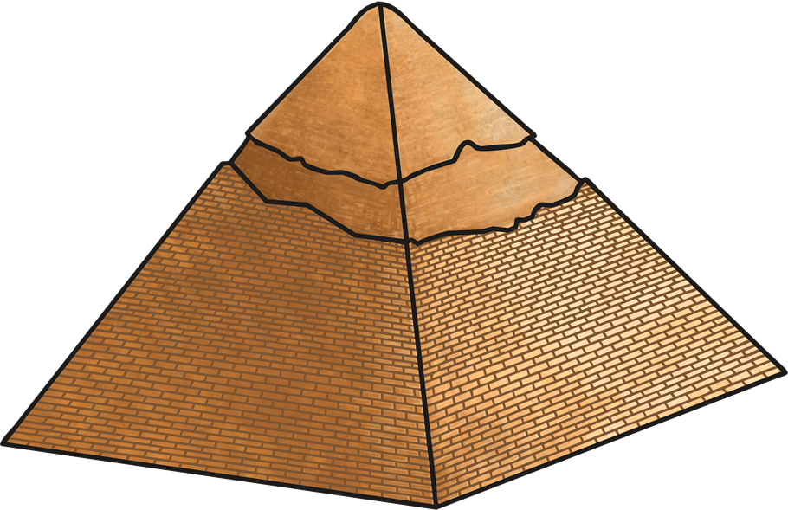
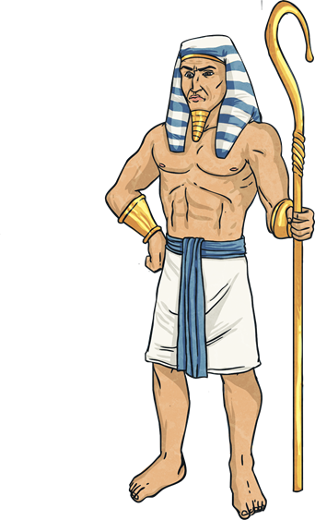
Clues for Digit 7
Clue number 7 is found on a poster in the library, which shows a pyramid with the following numbers. Look at the relationship between the three decimal fractions in the bottom left hand corner, and use that to complete the pyramid.
^{6.327}
^{2.616}
^{3.711}
^{0.573}
^{2.043}
^{1.668}
^{0.17}
^{0.403}
^{1.64}
^{0.028}
Find the common digit in the shaded boxes for the seventh clue.
Reveal answer
2

Slide 11
Clues for Digit 8
Each word, except one, matches a homophone in the sentences.
Clue number 8 is found in a notebook which has a set of words and a set of sentences.
I can sew two pieces of cloth together.
A female sheep is a ewe.
The car was bought with a loan.
Painkillers can lessen the discomfort of a headache.
1. you
2. lone
3. lesson
The number next to the word that does not have a homophone will give you the next number in the code.
4. male
5. find
6. so
The driver was fined for driving too fast.
The athlete may not win the race.
Reveal answer
4
The eighth digit of the code is

Slide 12
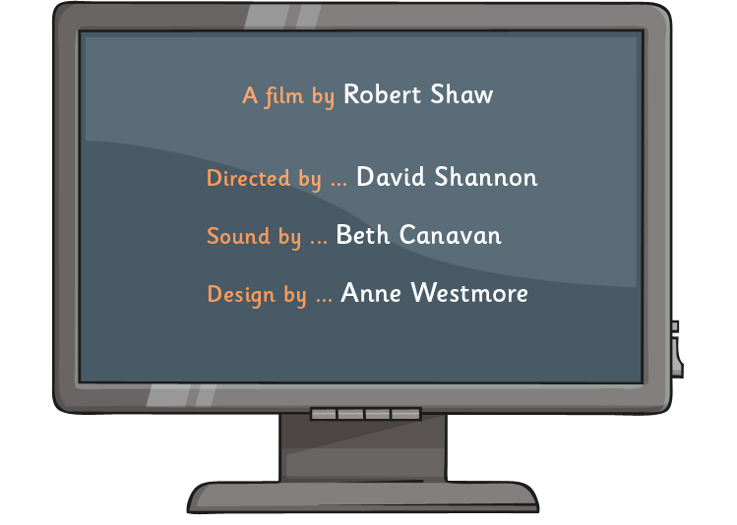
Clues for Digit 9
The ninth clue appears on a computer screen, which shows a pie chart.
The chart shows the number of children who have a different number of pets, taken from a survey of 12 children.
4 pets
No pets
3 pets
1 pet
Find the mean number of pets of the 12 children.
2 pets
No pets 1 pet 2 pets 3 pets 4 pets
0, 1, 1, 1, 1, 2, 2, 2, 3, 3, 4, 4
Mean = 24 ÷ 12 = 2
Reveal answer
2

Slide 13
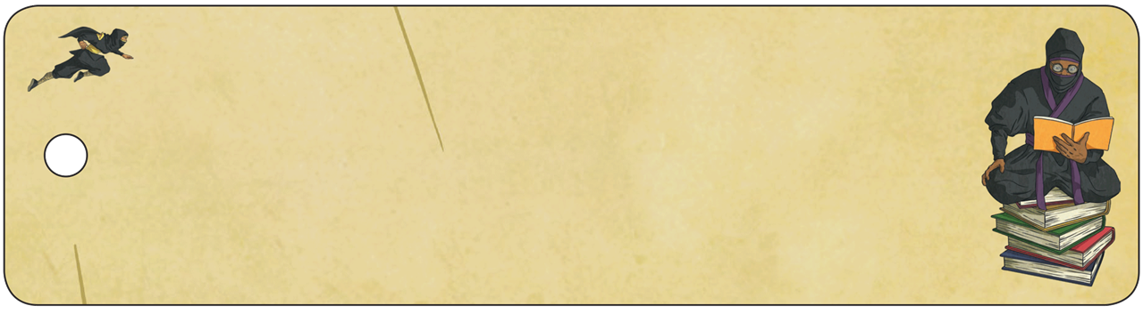
Clues for Digit 10
The final clue is found on a bookmark with a list of anagrams. (Anagrams are words where the letters are mixed up, usually to make a new word or words).
Solve these anagrams.
twelve one
shore
eleven two
______ ___
horse
large
_____
glare
dice
_____
here come dots
iced
____
the Morse Code
___ _____ ____
The first letter of each answer gives the last number.
eleven two iced glare horse the Morse Code
Reveal answer
8
eight

Slide 14











You unlocked the door!

