Slide 1

English comprehension

Slide 2
What are the top tips for comprehension
1. Don’t panic.
2. Read the questions carefully.
3. Look back in the text for the answer.
4. If you cannot find the answers, look again in the text.
5. If you really cannot find the answer, go on to the next question.

Slide 3
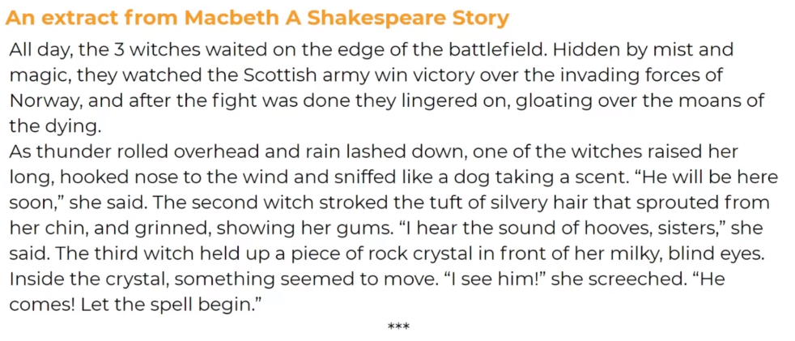
Macbeth

Slide 4
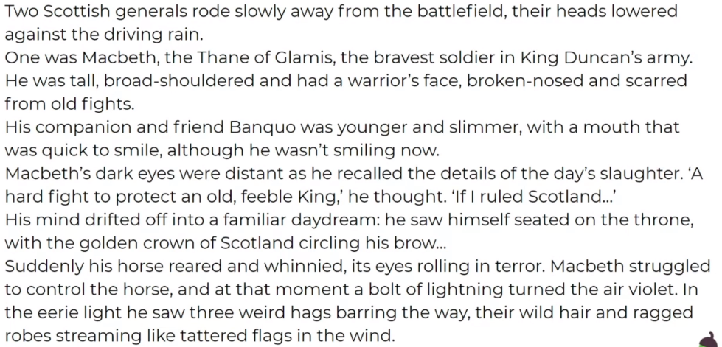

Slide 5
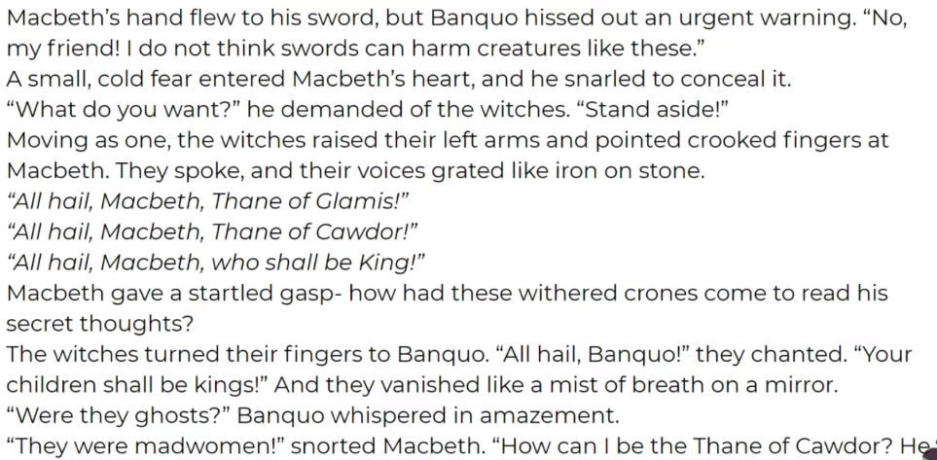

Slide 6
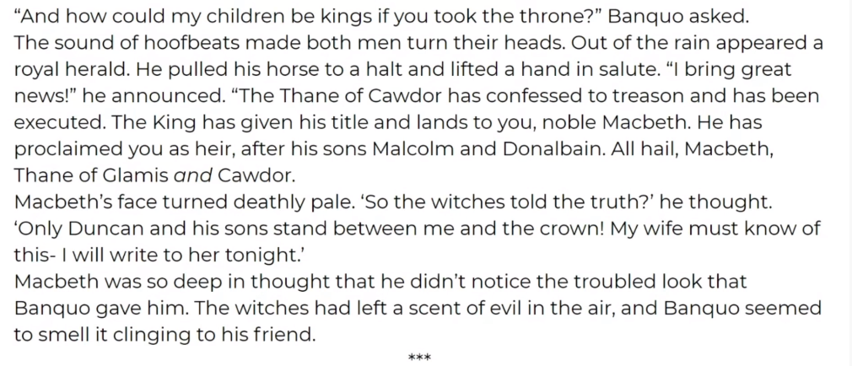

Slide 7
Your turn
Answer the questions on the bottom of the extract.
Then create your own questions.

