Slide 1

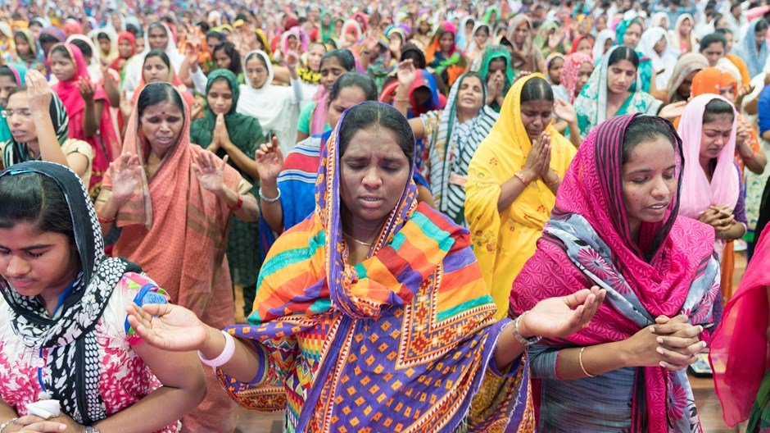
L.O: To begin to investigate if Christianity is still a strong religion 2021 years after Jesus was on Earth.
Starter
Why might they be wearing head scarves?
Where are these people?
What religion might they be?
What are they doing?
Why are they all women?

Slide 2
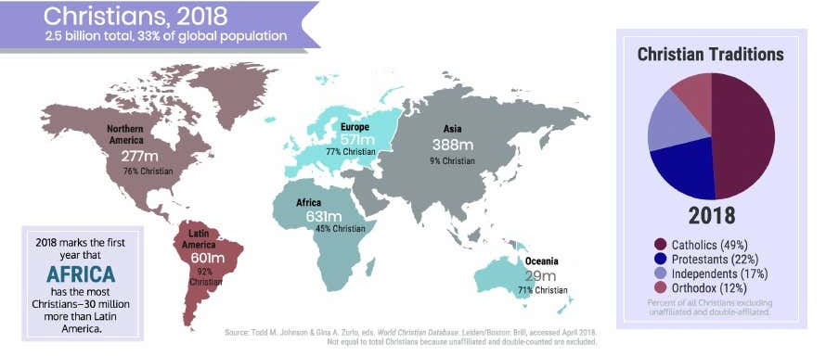
They are Christians. Are you surprised? Christians can be found all over the World.

Slide 3

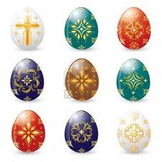
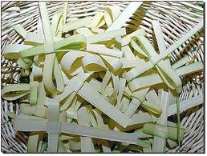
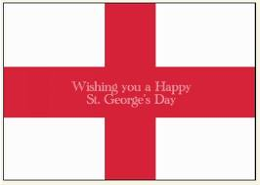
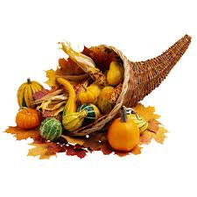
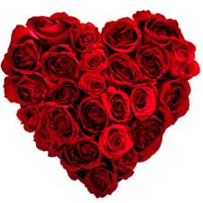

L.O: To begin to investigate if Christianity is still a strong religion 2019 years after Jesus was on Earth.
What Christian festivals can you name that are celebrated in the UK?

Slide 4
Christian Festivals and Symbols
Palm Sunday
St Valentine's Day
St George's Day
Mothering Sunday
Easter
Harvest
Christmas

Slide 5

What is the significance of this symbol?
Jesus Christ told His disciples in Matthew 4:19: ​“Follow me, and I will make you fishers of men.” ​As the early Christians followed Christ's command ​to follow Him and lead others to the Lord, the fish symbol became a natural extension of Christ's command and also a way to recognize and identify others who knew the symbol's meaning.
Greek Ichthus means fish

Slide 6
The Greek word for fish is "ichthys."
Christians made an acrostic from this word: Iesous Christos Theou Yios Soter, i.e. Jesus Christ, Son of God, Savior.
The fish has plenty of other theological overtones as well, for Christ fed the 5,000 with 2 fishes and 5 loaves (a meal recapitulated in Christian love-feasts) and called his disciples "fishers of men." W
Greeks, Romans, and many other pagans used the fish symbol before Christians. Hence the fish, unlike, say, the cross, attracted little suspicion, making it a perfect secret symbol for persecuted believers. When threatened by Romans in the first centuries after Christ, Christians used the fish mark meeting places and tombs, or to distinguish friends from foes. According to one ancient story, when a Christian met a stranger in the road, the Christian sometimes drew one arc of the simple fish outline in the dirt. If the stranger drew the other arc, both believers knew they were in good company. Current bumper-sticker and business-card uses of the fish hearken back to this practice.

Slide 7
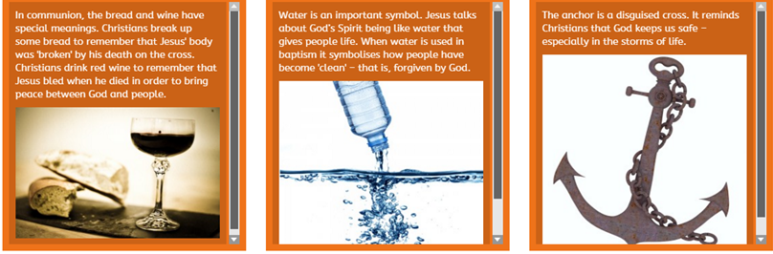

Slide 8
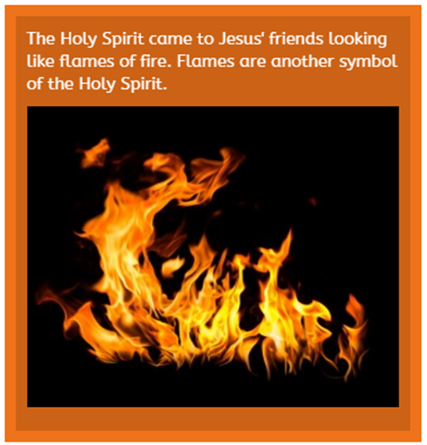
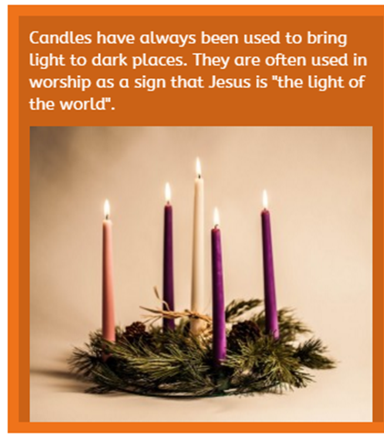
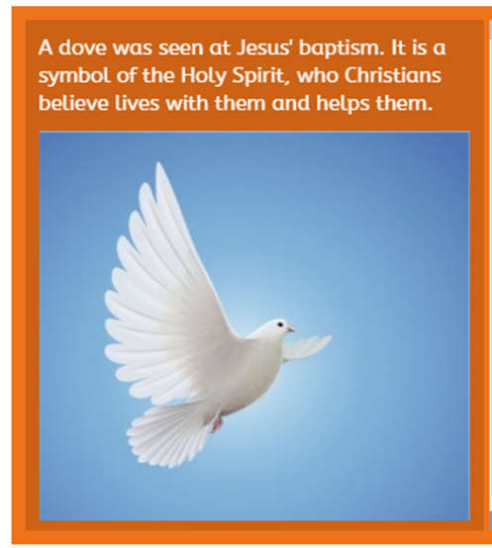

Slide 9
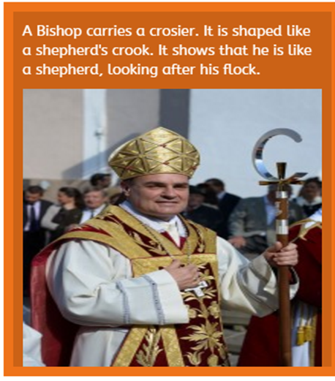
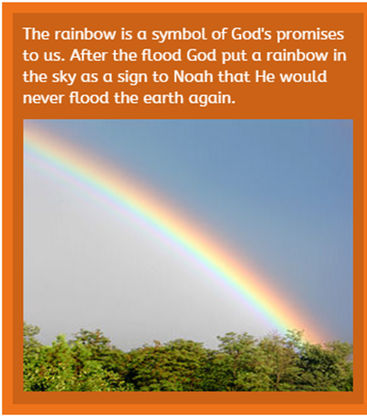

Slide 10
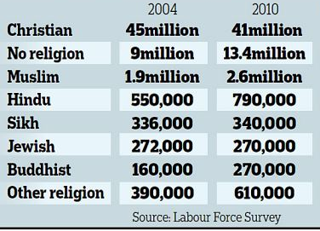
Do festivals and symbols show that Christianity is still a strong religion?
  Millions of people participate in Christian festivals in Britain each year. Millions ​of people also wear or adopt Christian symbols.
  Does this mean that Christianity is a strong religion in this country at this time?
  Religious affiliation in Britain

Slide 11
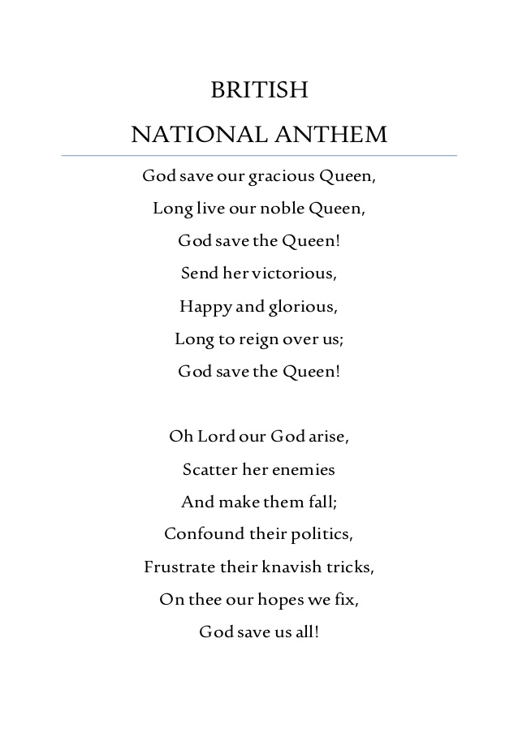



Where else in British society do we see the influence of ​Christianity?
Taking an oath in court, swearing on Bible
In school calendars – Easter & Christmas holidays
Legal System - 10 commandments? No death penalty.

Slide 12
Research a country of your choice
Find out:
How many Christians there are in that country
What is different about how they practice Christianity
What is the same about how they practice Christianity

