Slide 1


Suspense Story Writing Day 5

Slide 2
LO I can finish writing my suspense story
To finish your story…
Let’s look at a WAGOLL

Slide 3
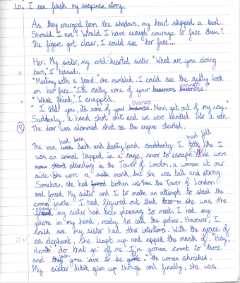
LO I can begin to write my suspense story

Slide 4
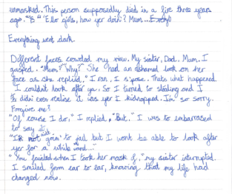
LO I can begin to write my suspense story

Slide 5
LO I can finish writing my suspense story
S.C. To include the techniques discussed in the suspense story toolkit for each paragraph
Reminder of what we have looked at today
A WAGOLL of a suspense story written by a Datchet St Marty’s pupil
How does this help you?
Magpie. Magpie. Magpie!
By which I mean use the ideas and change them to fit your own stories

Slide 6
LO I can finish writing a good suspense story
LO I can finish writing a great suspense story
LO I can finish writing an exceptional suspense story
SC
Use your plan (and add to it)
Read over what you wrote last Thursday (this ensures that what you write today flows on from it and makes sense)
Magpie from my ideas today
Use the checklist

