Slide 1

LO To recognise the features of acrostic poems
Success Criteria
I know that acrostics have a topic word hidden in the first letter of each line.
I can look for the poem’s theme by reading the first letters vertically.
I understand that acrostics don’t have to rhyme.

Slide 2

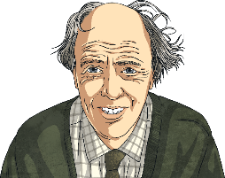
Acrostic Examples
What is each poem about?
R
O
A
L
D
D
A
H
L
Revolting rhymes
Oompa-Loompas
Angry farmers
Lazy aunts
Dangerous witches
Dream blower
Adventurous animals
Horrible headteacher
Lickable wallpaper
I
C
E
C
R
E
A
M
It’s my favourite food
Cold as the inside of a fridge
Every sunny day
Can’t wait
Running to the van
Empty out the money
‘Any sauce on that, love?’
Mmmmmm, yummy!

Slide 3
Acrostic Features
What did you notice?
Poetic devices may be used.
The first letter of each line spells out the poem’s theme vertically – what’s this one about?
alliteration
simile
I
C
E
C
R
E
A
M
It’s my favourite food
Cold as the inside of a fridge
Every sunny day
Can’t wait
Running to the van
Empty out the money
‘Any sauce on that, love?’
Mmmmmm, yummy!
Lines can be different lengths

Slide 4



Let’s Try It!
How can we write an acrostic poem?
First, we need to choose a theme. I know, let’s have…
fireworks!
Then, we think of lots of words or phrases associated with that theme…
night
spectacular
smoke
bonfire
pop
bang
fizz
noise
crackle
rocket
stars
explosion
sparkle

Slide 5


Let’s Try It!
How can we write an acrostic poem?
Next, we write the letters of our theme word(s) vertically
down the page in CAPITAL LETTERS…
F
I
R
E
W
O
R
K
S
fireworks

Slide 6
Let’s Try It!
How can we write an acrostic poem?
Finally, we use our list of words and phrases to create each line. Don’t worry if you can’t think of them in order – it’s fine to go back and add any missing lines afterwards.
F
I
R
E
W
O
R
K
S
lames flicker in the bonfire
watch the sparks fly up
ockets zoom into the night
verywhere the smell of smoke
aiting for the next explosion
ohh... Ahhh… Wow!

Slide 7
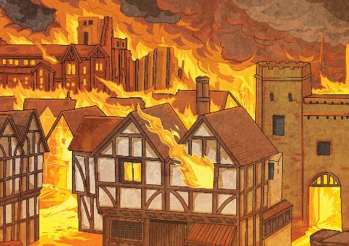
Your Turn!
Plan the words/phrases associated with the Great Fire. Here are some to get you started: flickering flames, bakery, Pudding Lane…
Create your acrostic poem using the words/phrases from your plan.
**Challenge – can you include alliteration or similies?

