Slide 1


Suspense Story Writing Day 4

Slide 2
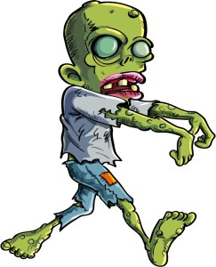
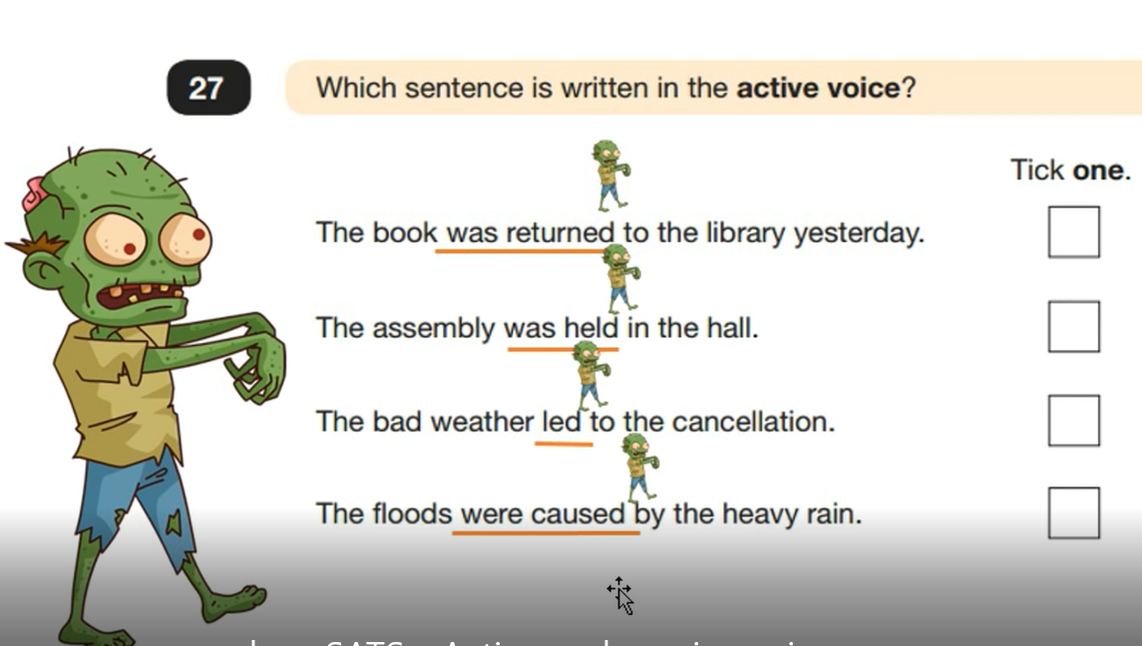
Warm up .......
The passive voice....
The by zombies rule
The cat moved upstairs.
Subject
Verb
Object
Upstairs the cat was moving.
Upstairs there was movement, it was the cat.

Slide 3
Passive voice ideas for the suspense story…. (WRITING TARGET T15)
Upstairs there was movement.
A noise was heard.

Slide 4
Suspense writing
1Long/Big build up
2Ellipses ...
3
Rhetorical questions
What was it ?
3a Short sentences
4. Show not/don't tell
showing emotions without telling
His heart skipped a beat.
My heart sank.
with a sinking heart.
her heart gave a terrified leap.
she leapt off the bed, trembling from head to foot
she lay frozen with fear
she said with hate

Slide 5
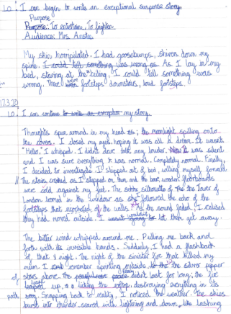
LO I can begin to write my suspense story

Slide 6

LO I can begin to write my suspense story

Slide 7
LO I can begin to write my suspense story
S.C. To include the techniques discussed in the suspense story toolkit for each paragraph
Reminder of what we have looked at today
Use of the passive
Use of show not tell (for emotions)
WAGOLL
How does this help you?
Magpie. Magpie. Magpie!
By which I mean use the ideas and change them to fit your own stories

Slide 8
LO I can begin to write a good suspense story
LO I can begin to write a great suspense story
LO I can begin to write an exceptional suspense story
Purpose: To entertain. To scare
Audience: __________________
SC
Use your plan (and add to it)
Magpie from my ideas today
Use the checklist

