Slide 1


Suspense Story Writing Day 3

Slide 2
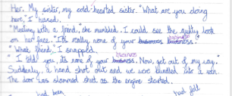
Warm up
Need to ensure we are doing something special with dialogue in our writing (and know what we are doing)
Look at the writing targets you had in yesterday’s learning pack
Look at
T8 I can include dialogue to convey character
T9 I can include dialogue to advance the action

Slide 3
LO: I can plan the problem, resolution and ending of a suspense story
S.C. For a suspense build up to be effective, you could include:
preposition (where, when) sentence starters
* show not tell
* repetition
*ellipses . . .
* -ed, -ing, -ly sentence starters
    Startled by the noise,
    Climbing up,
    Suddenly,
* short sentences
* rhetorical questions
* use all the senses ( what can the character, see, hear, taste, smell)

Slide 4
LO: I can plan the problem, resolution and ending of a suspense story
Story mountain structure for suspense stories
Problem
The build up will be longest
Resolution
Build-up
Opening
Ending

Slide 5
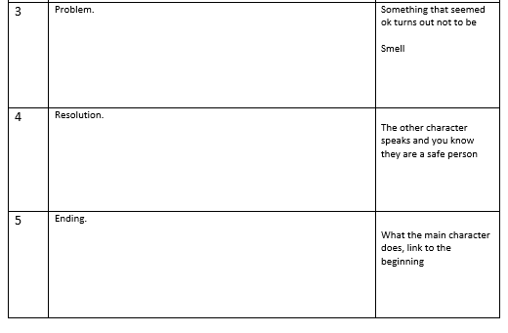
LO I can plan the problem, resolution and ending of a suspense story

Slide 6
LO: I can plan the problem, resolution and ending of a suspense story
To be successful:
LO I can finish planning an exceptional suspense story
Re-read your plan.
Include features from checklist:
Short sentences.
Rhetorical questions.
Ellipses.
Repetition.
Show don't tell.
Prepositional sentence starters
-ed, - ing, -ly
Use all the senses.
LO I can finish planning a great suspense story
LO I can finish planning a good suspense story

