Slide 1


Suspense Story Writing Day 2

Slide 2
Warm up
If we were in class we would discuss with our talk partners what could cause ....
I heard a thump upstairs,
If you are at home, ask a parent or brother or sister to discuss this with you

Slide 3
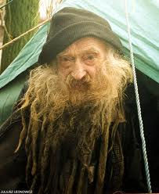
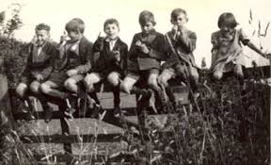
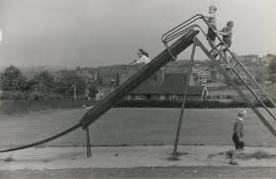
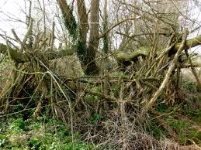
LO: I can plan the introduction and build up of a suspense story
S.C. Use toolkit
Use planning frame

Slide 4
LO: I can plan the introduction and build up of a suspense story
S.C. For a suspense build up to be effective, you could include:
* preposition sentence starters
* show not tell
* repetition
*ellipses
-ed, -ing, -ly sentence starters
  (Startled by the noise,
  Climbing up,
  Suddenly,
* short sentences
* * rhetorical questions
*use all the senses ( what can the character, see, hear, taste, smell
Setting ideas – house, garden, by the river
cellar (under the house)
Under the stairs
an alley
Under the bed
In a shed at the bottom of the garden
Thing causing the suspense – what is the Thing?
Where is the thing? cellar (under the house)
Under the stairs
an alley
Under the bed
In a shed at the bottom of the garden

Slide 5
c
LO: I can plan the introduction and build up of a suspense story

Slide 6
Story mountain structure for suspense stories
The build up will be longest
Problem
Build-up
Resolution
Opening
Ending

Slide 7
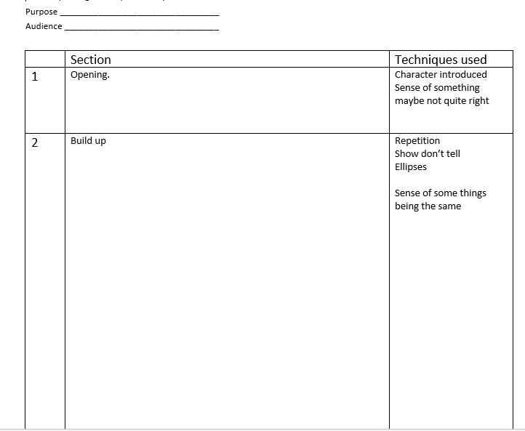
LO I can plan the opening and build up of an exceptional suspense story
LO I can plan the opening and build up of a great suspense story
LO I can plan the opening and build up of a good suspense story
SC
Think: what is the THING?
Think: where is the THING?
Use toolkit
Use planning frame
Use all of the sense – what can your character hear, see, smell, taste and touch

