Slide 1

Changing Circuits
Learning Objective:
To investigate ways in which the brightness of a bulb or the speed of a motor is changed.
NEXT
www.planbee.com

Slide 2
How could
we make the bulb in this circuit
brighter?
BACK
NEXT
www.planbee.com

Slide 3

Batteries give out a certain voltage of power. If you were to add more batteries to the circuit, you would be adding more power and so the bulb would be brighter. When batteries
power a circuit, the voltage is shared bet ween the components it is powering. If a battery has 5V (5 volts) and there are t wo lightbulbs in a circuit, each bulb will receive 2.5V. This means
the bulbs will be dimmer than if there was just one bulb in the circuit. If t wo 5V batteries were powering a circuit with t wo lightbulbs, each bulb would receive 5V of power and would be brighter than if there was just one battery.
Make sense?! Have a look at the circuits on the next slides. Which sets of bulbs will be brightest?
BACK
NEXT
www.planbee.com

Slide 4
Watch this video:
https://www.bbc.co.uk/bitesize/clips/z6qd7ty

Slide 5



Which of these sets of bulbs do you think would shine the brightest and why?
BACK
NEXT
www.planbee.com

Slide 6
Which of these sets of bulbs do you think would shine the brightest and why?
BACK
NEXT
www.planbee.com

Slide 7


Which of these sets of bulbs do you think would shine the brightest and why?
BACK
NEXT
www.planbee.com

Slide 8



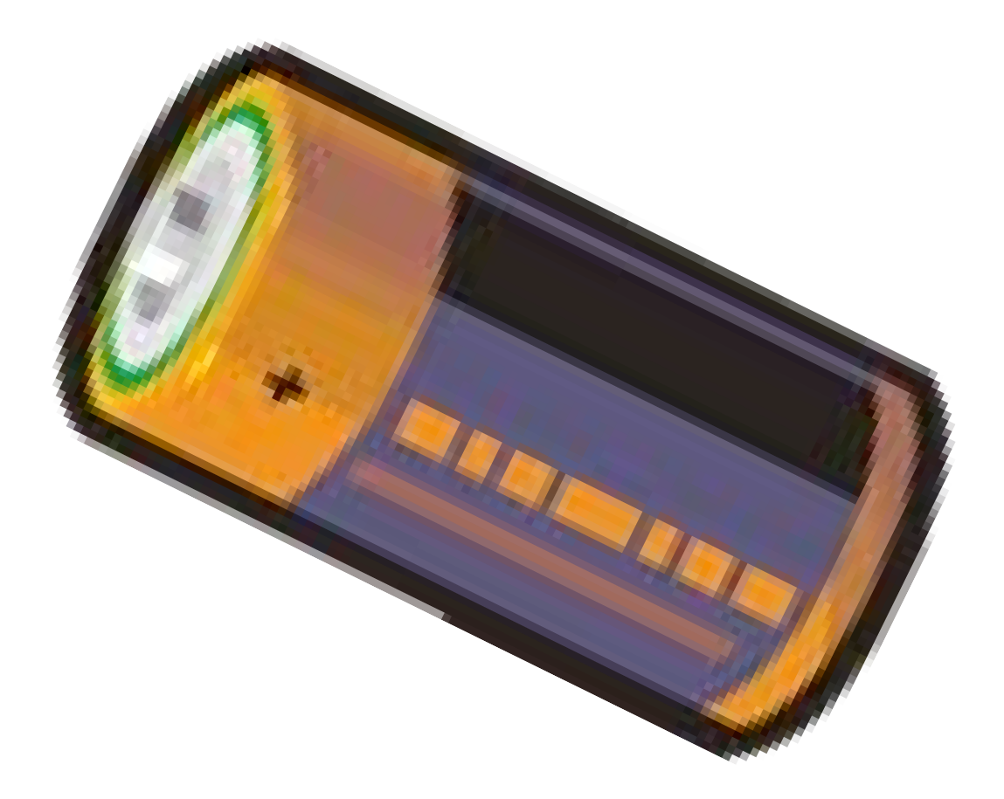

What do you think would happen if we had 10 batteries in a circuit and just one bulb? Why?
BACK
NEXT
www.planbee.com

Slide 9




Lightbulbs and other components, such as buzzers and motors, are designed to only take a certain voltage. If there are too many volts running to the component it will blow out. This is why you need to be careful when creating a circuit. If you
exceed the voltage for a component, it will break.
This diagram shows a 5V bulb and 1.5V batteries. Will the bulb blow out or not? Why?
1.5V
1.5V
1.5V
BACK
NEXT
www.planbee.com

