Slide 1

Changing Circuits
Learning Objective:
To recap knowledge of electricity and circuits.
NEXT
www.planbee.com

Slide 2

What do you already know about electricity?
ELECTRICITY
BACK
NEXT
www.planbee.com

Slide 3
Watch this video: https://www.bbc.co.uk/bitesize/clips/zq3fb9q

Slide 4
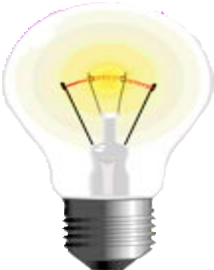
Can you think of a definition for each of these electricity-related words?
volt
circuit
current
insulator
conductor
motor
battery
component
BACK
NEXT
www.planbee.com

Slide 5
Volt
A volt is a unit of measurement that shows the rate at which energy is drawn from a source that produces the flow of electricity in a circuit.
Circuit
A closed path along which electrical current can flow.
Current
The flow of electrical charge around a circuit. Current is usually measured in amperes.
Insulator
A material that does not allow electricity to flow through it.
Conductor
A material that does allow electricity to flow through it.
BACK
NEXT
www.planbee.com

Slide 6

Component
A component is a part of the whole electrical circuit. Wires, bulbs, motors and batteries are all components.
Battery
A container containing cells in which chemical energy is converted into electricity and used as a power source.
Motor
A machine charged by electricity that causes movement.
How close were your definitions?
BACK
NEXT
www.planbee.com

Slide 7

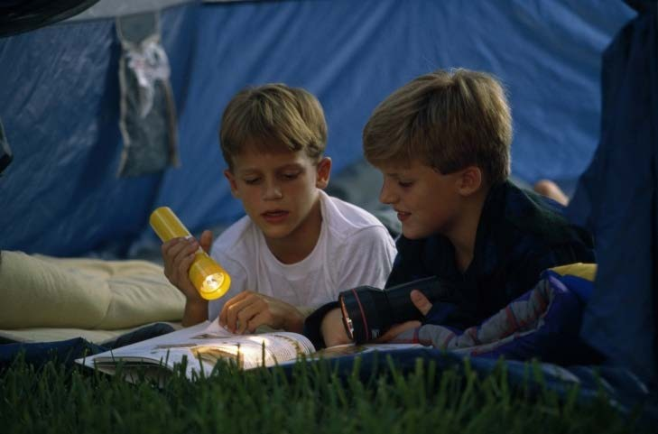

What components do these torches need in order to light up?
Discuss your ideas.
BACK
NEXT
www.planbee.com

Slide 8




The components a torch needs to work are: Wires
Battery Bulb
Switch
These components all need to be connected in a circuit so that the electricity powered by the battery can flow around the circuit.
BACK
NEXT
www.planbee.com

Slide 9




What is the difference bet ween these t wo
circuits?
BACK
NEXT
www.planbee.com

Slide 10
Watch this video: https://www.bbc.co.uk/bitesize/clips/zpj34wx

Slide 11


This is a SERIES CIRCUIT. A series circuit has just one path for the electricity to flow around. If one of the bulbs in this
circuit was to blow, the circuit would break and the other bulb would turn off too. Series circuits are generally only used when there is one component, such as one lightbulb or one buzzer. A torch would use a series circuit.
BACK NEXT
www.planbee.com

Slide 12


This is a PARALLEL CIRCUIT. Parallel circuits provide more than one path for the electricity to flow around. If one of the bulbs in this circuit were to blow, the other would still work because there is another complete circuit for the electricity to flow around. Christmas tree lights use parallel circuits so that if one lightbulb blows out, the others will stay lit.
BACK NEXT
www.planbee.com

