Slide 1

Lesson 1: How music makes us feel
Save a copy
Year 2 – Creating Media – Making Music
Notes:
This resource is available online at ncce.io/cm2m-1-s. Resources are updated regularly — please check that you are using the latest version.
This resource is licensed under the Open Government Licence, version 3. For more information on this licence, see ncce.io/ogl.

Slide 2
Objectives
Lesson objective: To be able to compare 2 pieces of music and describe how they make you feel.
Success Criteria
I can identify simple differences in pieces of music
I can listen with concentration to a range of music
I can tell you how music makes me feel, e.g. happy or sad

Slide 3
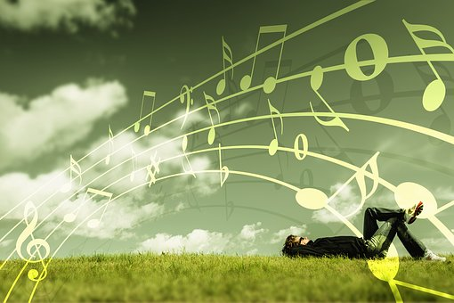

To say how music makes us feel
Introduction
Listen to the these two pieces of music.
What do you notice about them?
Notes:
Mars music: archive.org/details/Holst-ThePlanets/Marte.mp3
Venus music: archive.org/details/Holst-ThePlanets/Venus.mp3
Image source: https://pixabay.com/illustrations/music-grass-man-boy-think-dreams-4058677/

Slide 4
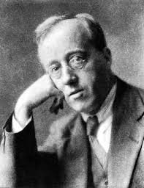
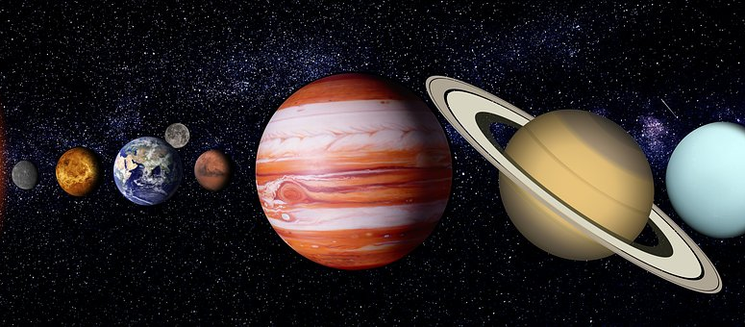
The Planets
Activity 1
Gustav Holst wrote music to make us think and feel different things.
He named his pieces of music after the planets.
Notes:
Image sources:
Gustav Holst picture: https://commons.wikimedia.org/wiki/File:Gustav_Holst.jpg
Solar System picture: https://pixabay.com/illustrations/sky-stars-planets-space-moon-star-3880590/

Slide 5
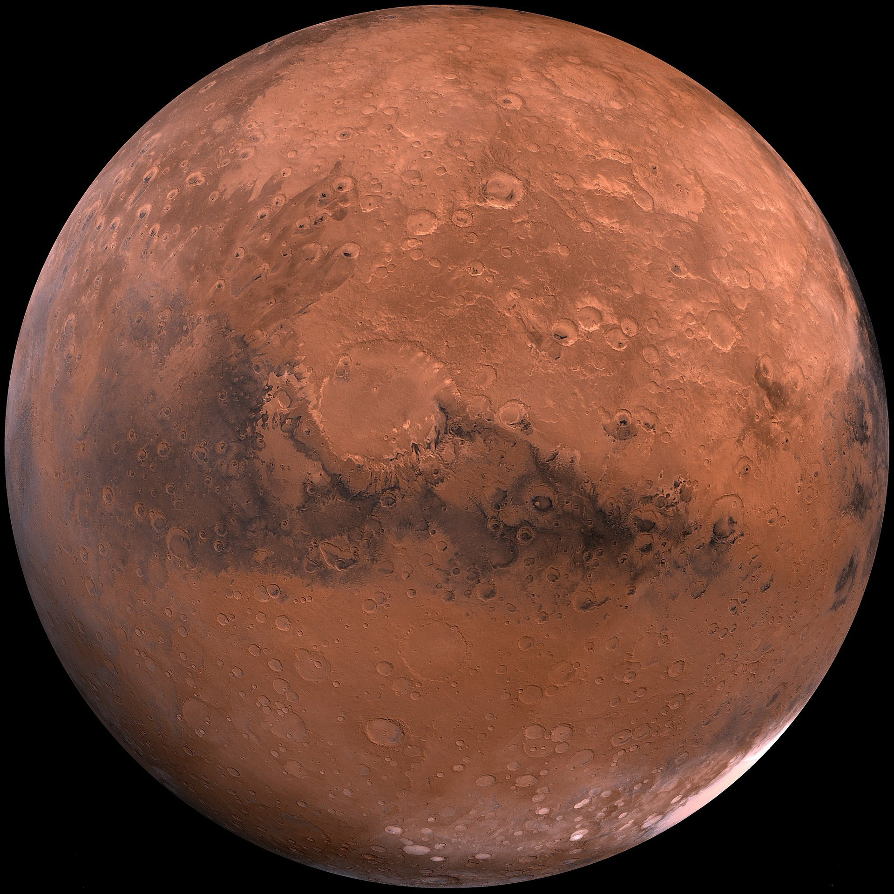
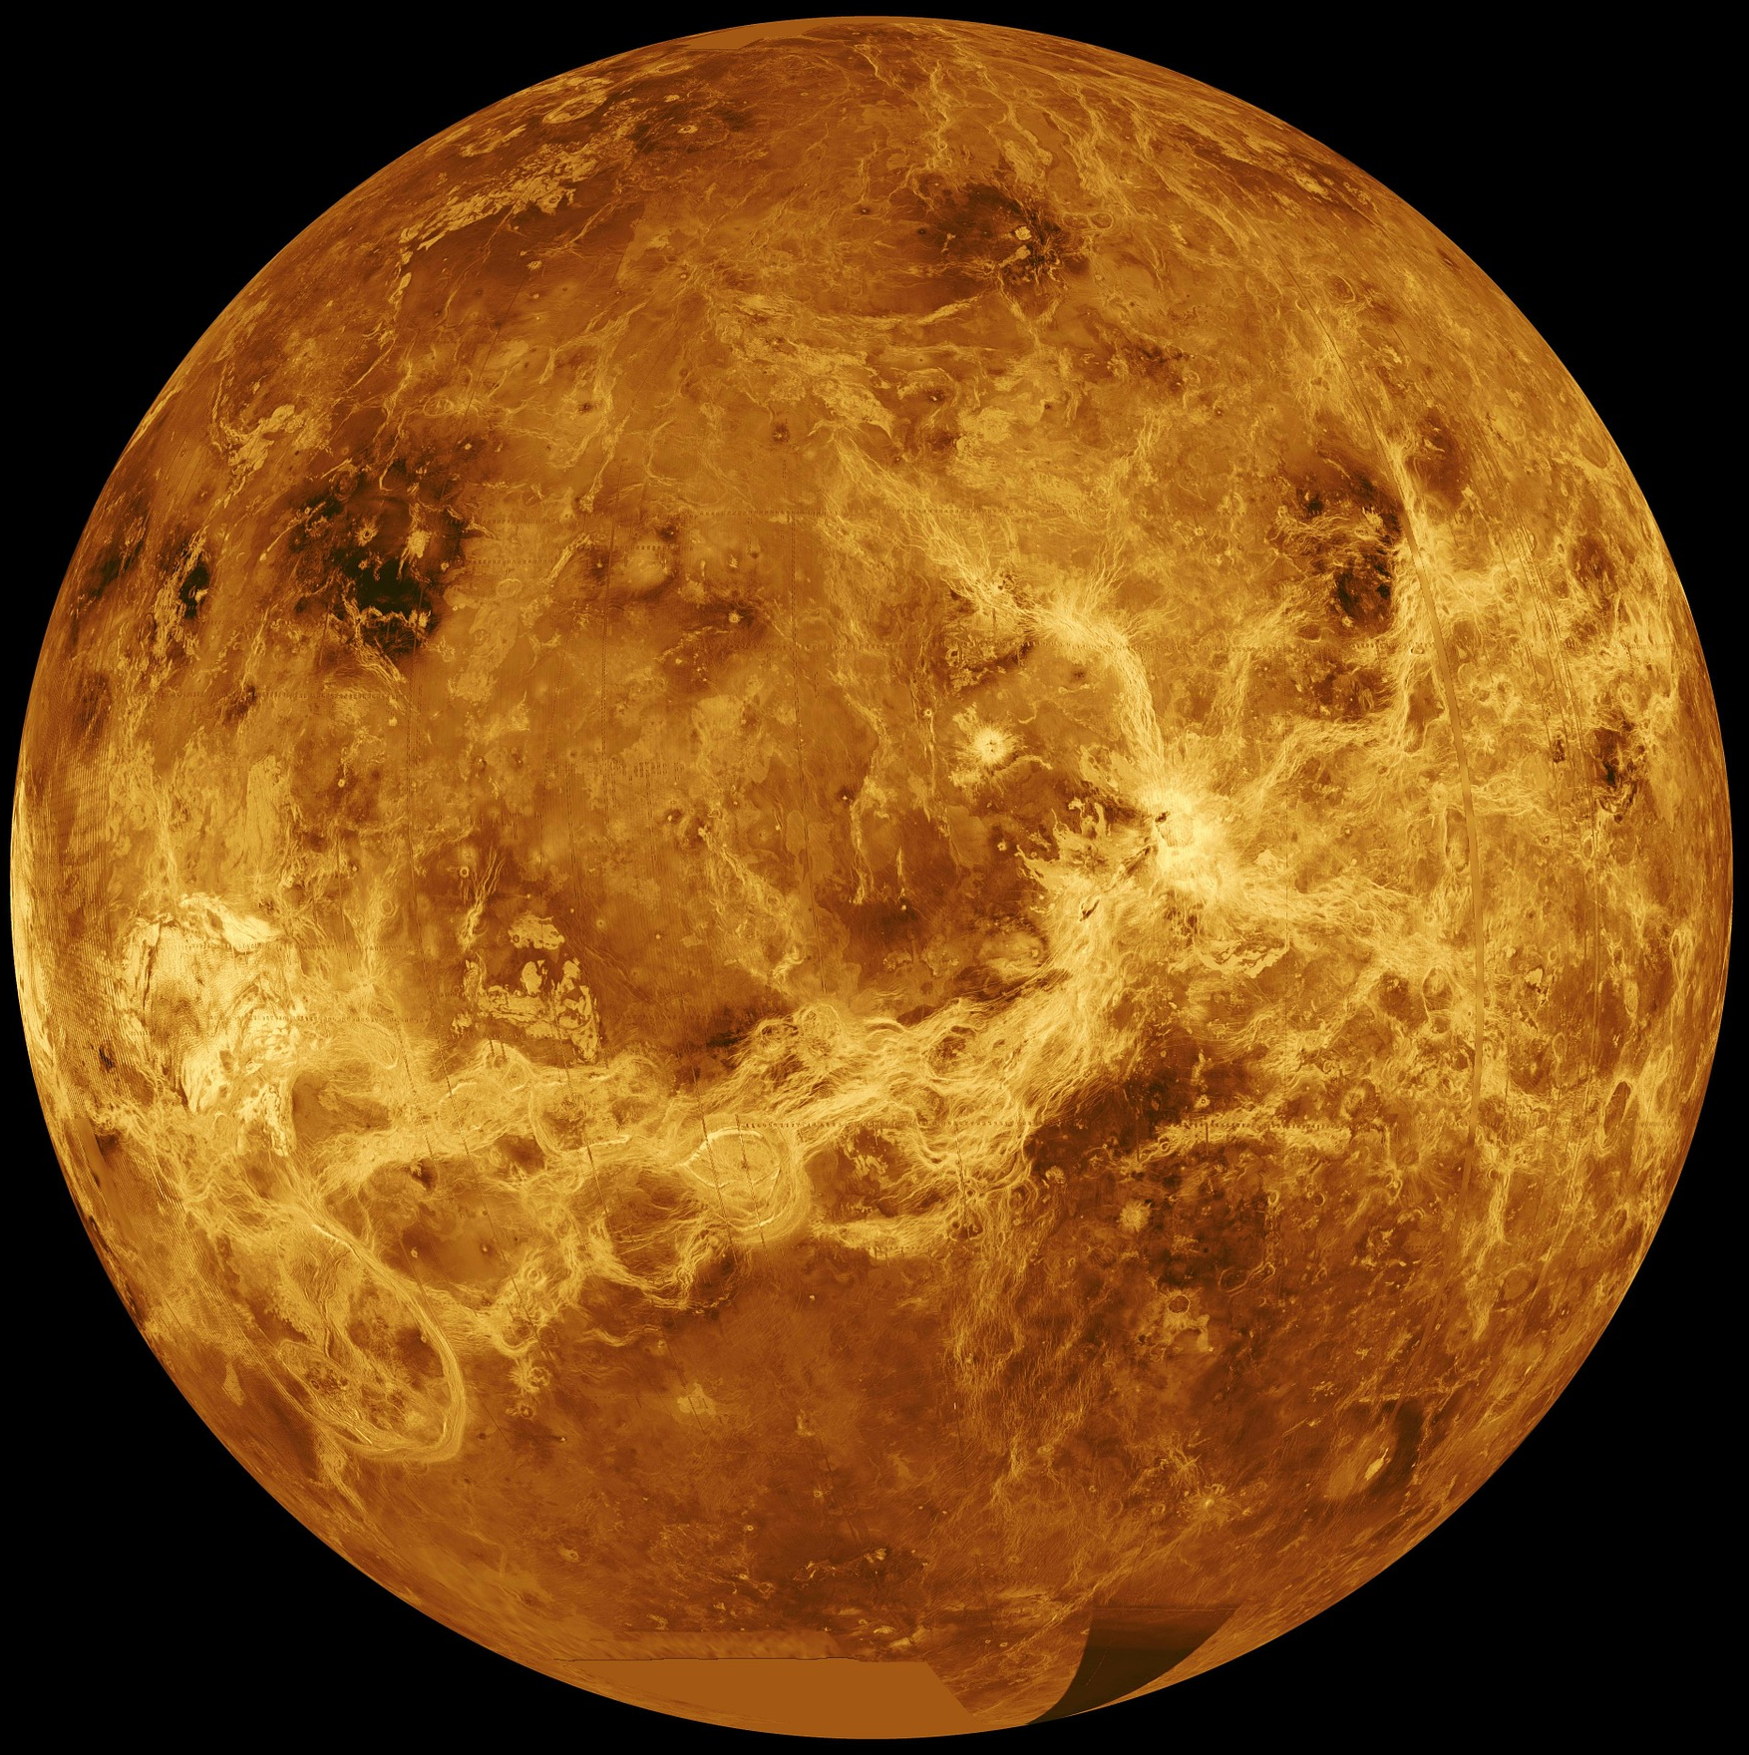
The Planets
Activity 1
Mars, the Bringer of War was written about Mars, who is the Roman god of War.
Venus, the Bringer of Peace was written about Venus, who is the Roman goddess of love and beauty.
Which piece is which?
What clues help you?
Notes:
Image sources:
Mars: https://pixabay.com/photos/mars-red-planet-planet-starry-sky-11012/
Venus: https://pixabay.com/photos/venus-surface-hot-heat-planet-11022/

Slide 6
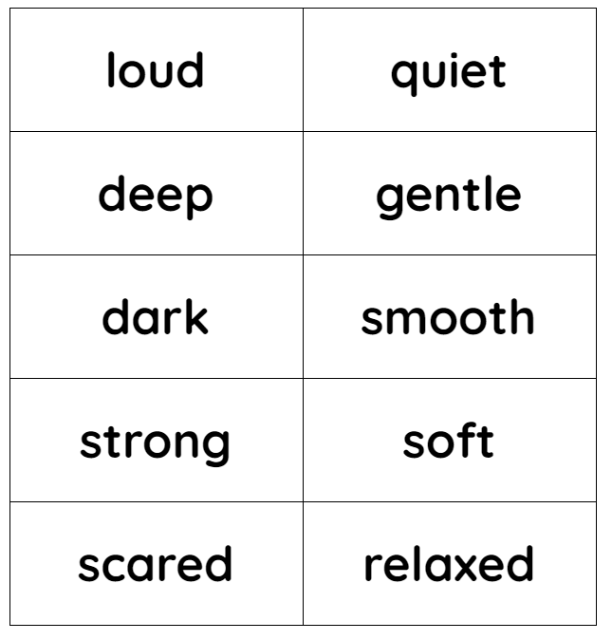
To say how music makes us feel
Activity
Activity.
Cut out the words
Sort the words into 2 piles to describe Venus and Mars music
Glue words on to the worksheet
Or you can draw your own planets and write the words on if you are unable to print ☺
Challenge
Can you say why you have chosen these words?
Can you add any of your own words?
Notes:
Image sources:
Mars: https://pixabay.com/photos/mars-red-planet-planet-starry-sky-11012/
Venus: https://pixabay.com/photos/venus-surface-hot-heat-planet-11022/

Slide 7
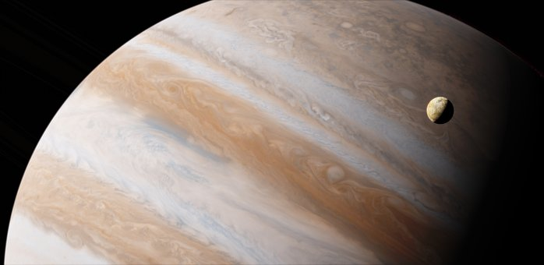
Jupiter
Activity 3
Named after Jupiter, the Roman god of sky and thunder
Could any of your words describe this piece?
How is it similar or different to the other pieces?
Notes:
Jupiter music: archive.org/details/Holst-ThePlanets/Jupiter.mp3
Jupiter: https://pixabay.com/photos/io-jupiter-planet-astronomy-2773533/

Slide 8
Which piece of music do you like the most?
Activity 4
Mars
Venus
Jupiter
I like______because_____________________________
I do not like______because_____________________________
Notes:
Jupiter music: archive.org/details/Holst-ThePlanets/Jupiter.mp3
Jupiter: https://pixabay.com/photos/io-jupiter-planet-astronomy-2773533/

Slide 9

How confident are you? (1–3)
Assessment
I can identify simple differences in pieces of music
I can listen with concentration to a range of music
I can describe how music makes me feel, e.g. happy or sad
3 - Very confident
2 - Unsure
1 - Not confident
Notes:
Image source: https://pixabay.com/vectors/thumb-up-hand-like-confirm-go-top-307176/

Slide 10
Next lesson
Summary
In this lesson, you...
Listened to different pieces of music and thought about how it made you feel.
Next lesson, you will…
Listen to different pieces of music and use a computer to create different musical rhythms.

