Slide 1

How can we respect other people’s creations on the internet?
©
MUSIC
software
IMAGES
This presentation is part of the Know IT All Secondary Toolkit created by Childnet with the support of :
The TDA, BECTA and UKCCIS

Slide 2
In this lesson you will…
LO: begin to understand what copyright is and the consequences of breaking copyright law
LO: consider the importance of copyright on the internet
LO: begin to understand strategies to acknowledge online ownership of content

Slide 3
What do you know about copyright?
Copyright, Designs and Patents Act 1988
The law gives the creators of literary, dramatic, musical, artistic works, sound recordings, broadcasts, films and typographical arrangement of published editions, rights to control the ways in which their material may be used.
It is an offence to perform any of the following acts without the consent of the owner:
Copy the work.
Rent, lend or issue copies of the work to the public.
Perform, broadcast or show the work in public.
Adapt the work.
http://www.copyrightservice.co.uk/copyright/p01_uk_copyright_law

Slide 4
Virgin to trial filesharing monitoring system
26th November 2009
http://www.theregister.co.uk/2009/11/26/virgin_media_detica/
Online copyright infringement will cost the UK music sector
an estimated £200m in 2009
http://www.bpi.co.uk/digital-music/article/online-faqs.aspx
Illegal file-sharers face fines after copyright case
Thousands of gamers who illegally share files on the internet face large fines
after a woman was ordered to pay out £16,000 for distributing a pinball simulator
without permission.
http://www.telegraph.co.uk/news/2583041/Illegal-file-sharers-face-fines-after-copyright-case.html
Pub Landlord Fined £8000 For Customer’s Pirate Download On Wi-Fi
http://www.zath.co.uk/pub-landlord-fined-8000-for-pirate-downloads-on-wi-fi/

Slide 5
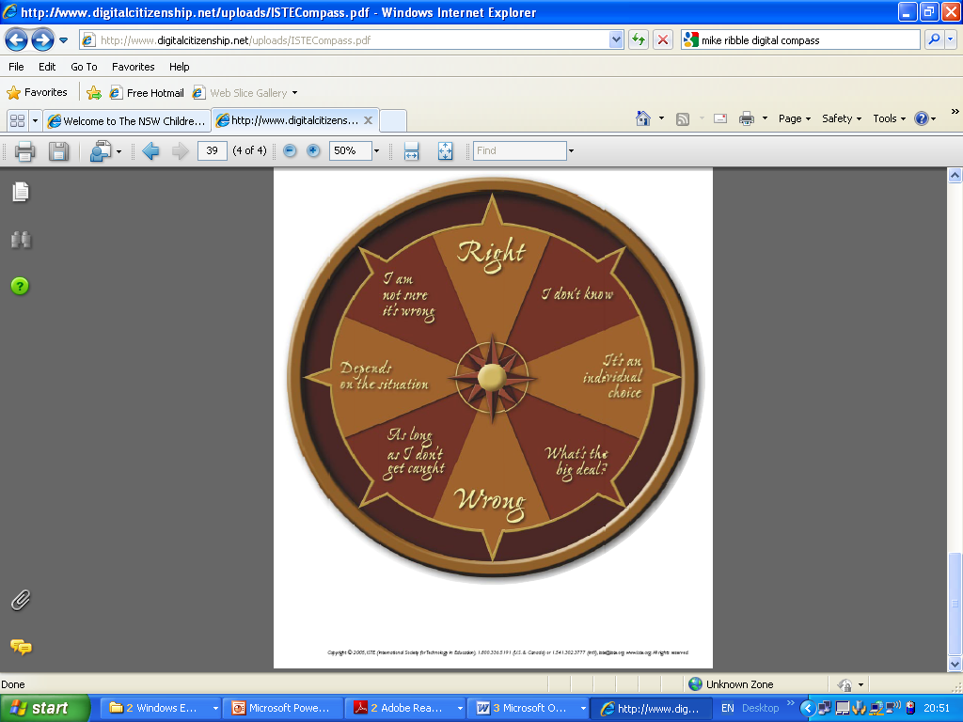
In the next few slides you are going to think about what it means to own something online. Use your digital compass to consider if an action is Right, Wrong or needs some thinking about. Discuss with your classmates…how can we respect others people’s creations and content online?

Slide 6
Scenario 1
Michelle is a photographer. She is able to pursue her interest because she receives a small amount of money from a website where she sells some of her photos. The website clearly shows that the photos belongs to her and all of her photographs have the copyright symbol under them.
Phil is looking for images to use in a play at school. He finds a perfect image on Michelle’s site. What should he do next?

Slide 7
Scenario 2
Framer5 are a relatively new band. Their dream is to work on their music full time. A number of their tracks are available to download from itunes.
Jay has downloaded the Framer5 tracks. He then uploads the music and shares it through a filesharing service ( peer to peer). Is this fair use of this content? Does it respect the copyright of this music?

Slide 8
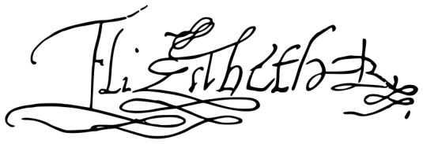
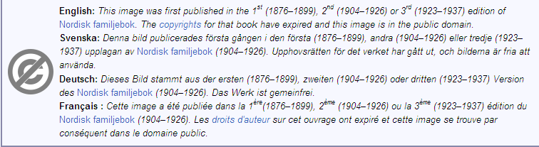
Scenario 3
Sahra is doing a presentation on Elizabeth the First and is looking for images to make her presentation more interesting. She goes to Wikipedia and finds this image.
When she clicks on this image she finds this information. Can she use the image in her presentation?

Slide 9
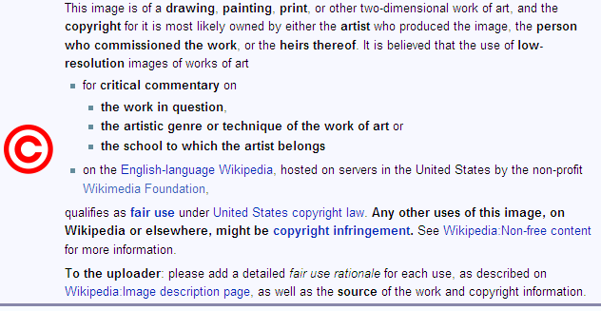
Scenario 4
Jamie is searching for images to add to her presentation about her favourite artist. She finds a useful image on Wikipedia that has this message. Can she use the image?

Slide 10
Scenario 5
Hana is searching the internet for useful images. She does an image search and finds some she would like to use. Hana looks on the website and can see the owner’s email address.
What should her next steps be to avoid breaking copyright law?

Slide 11
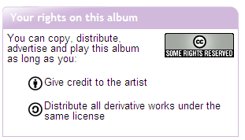
Scenario 6
Sal is searching for some music to accompany an art installation she has created.
She searches online and finds a track she really likes. Sal wants to make sure she is not infringing copyright law. This message is attached to the webpage – can Sal use the music?

