Slide 1
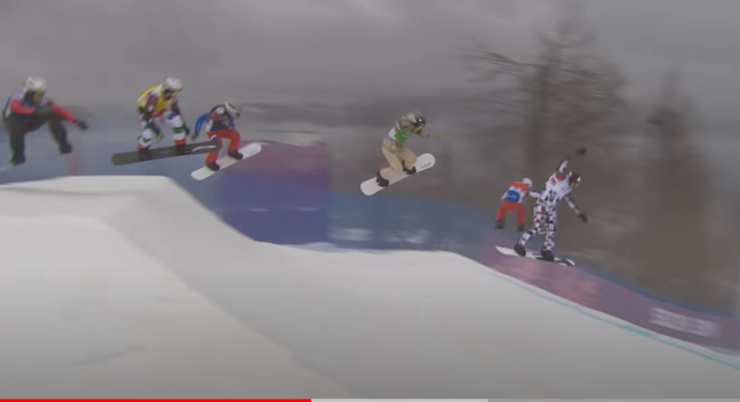

Newspaper Report Editing Tuesday 9th January
This is such an exciting picture.
The colours of the outfits.
The six competitors in the midst of jumps.
Are they going to crash?
Also, you can see the what sort of dull, misty weather was on that day

Slide 2
LO I can edit to improve my work
1. Read over your own work to make sure it makes sense. (Check verbs agree - we were, we are, I was, they were).
2. Read for punctuation.
3. Read for spellings.
4. Improve with adjectives/adverbs/ complex sentences. (Similes, personification)
5. Use the checklist.
6. Underline in pink any words that you have magpied.
7. Improve what you have not already done.

