Slide 1
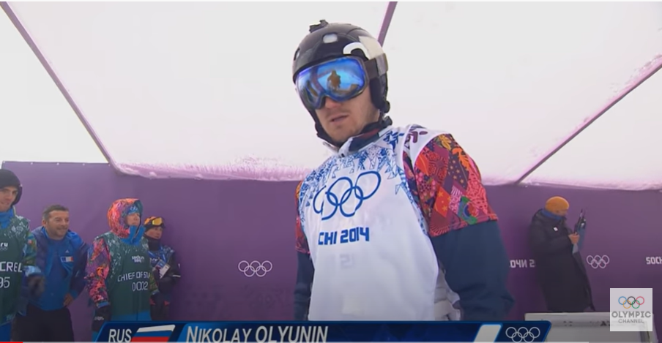
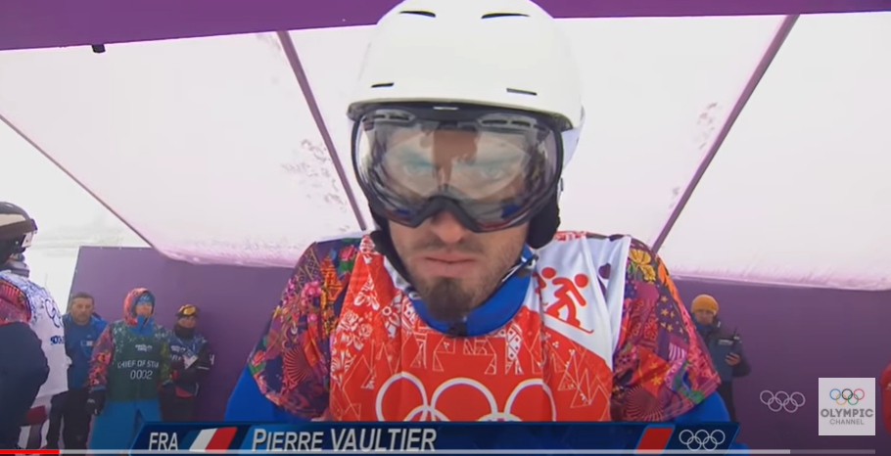
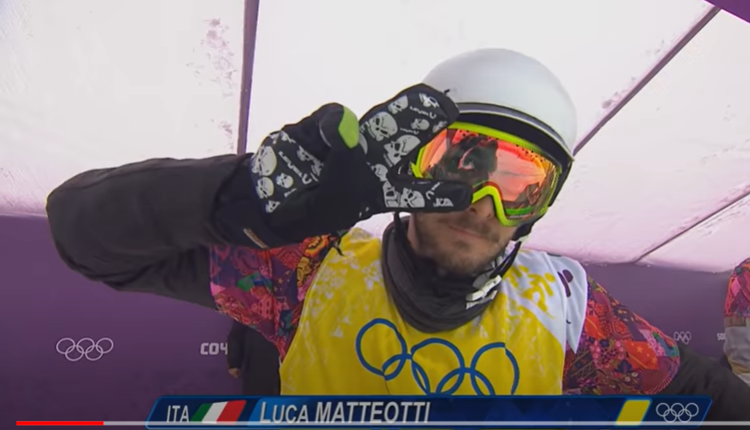
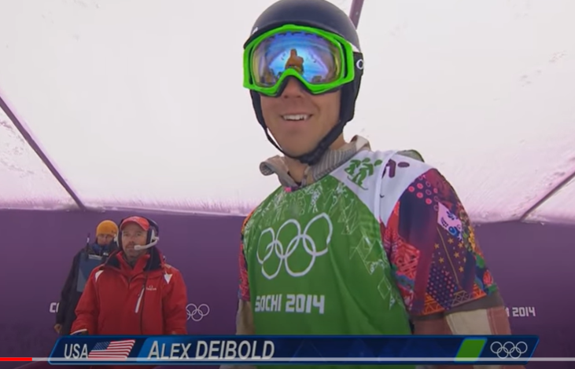
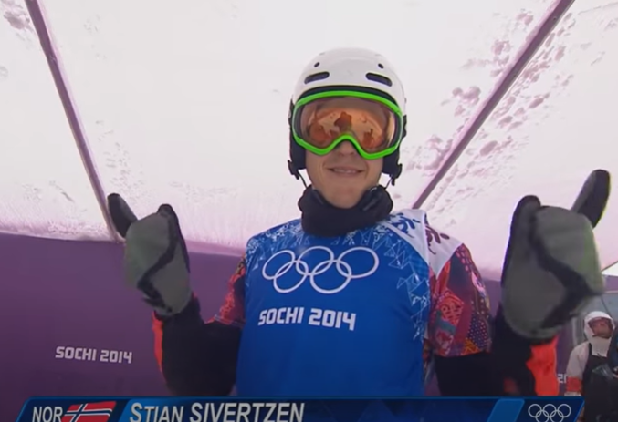
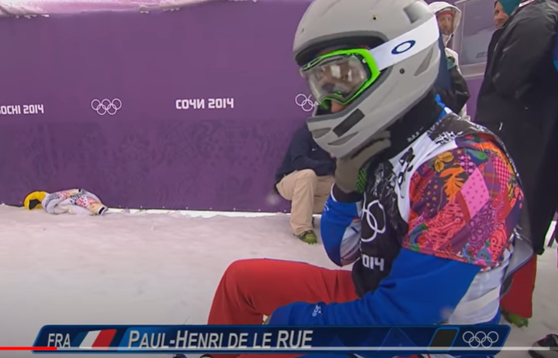

Newspaper Report Writing Monday 8th February
The Men’s Final of the Snowboard Cross Sochi Olympics 2014

Slide 2
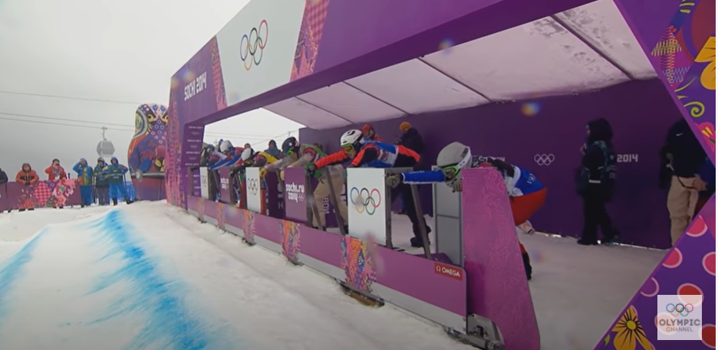
The start

Slide 3
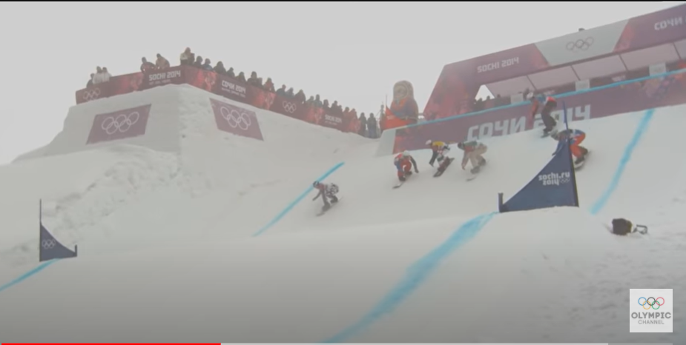
Just out of the starting gates….. Who is in the lead?

Slide 4
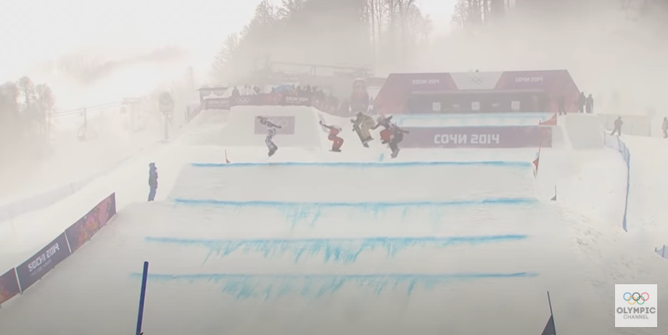
The first big jump

Slide 5
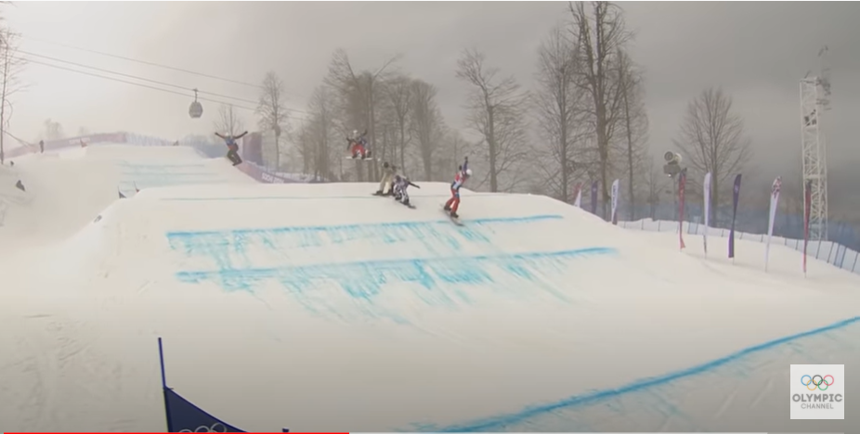
Who is in the lead now?

Slide 6
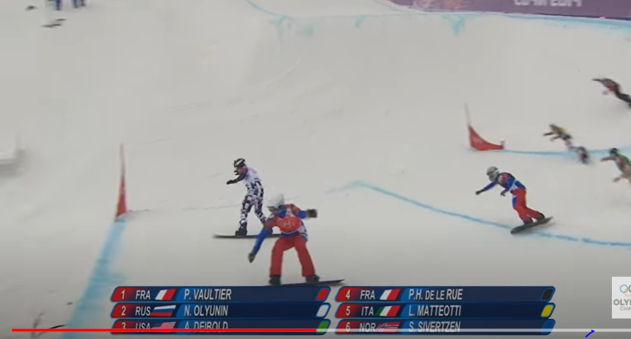
This looks like an exciting corner …

Slide 7
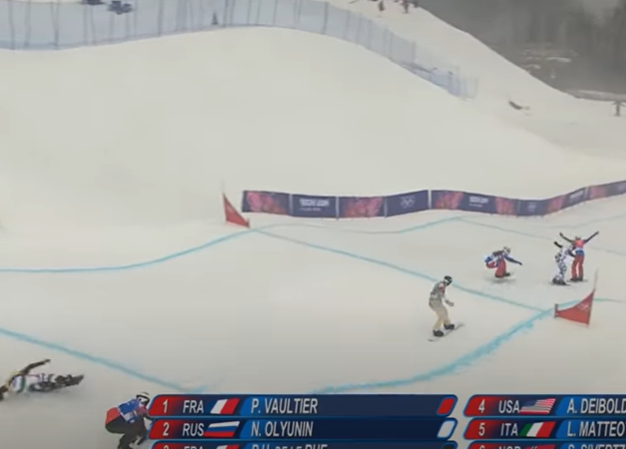
Uh oh … someone has fallen

Slide 8
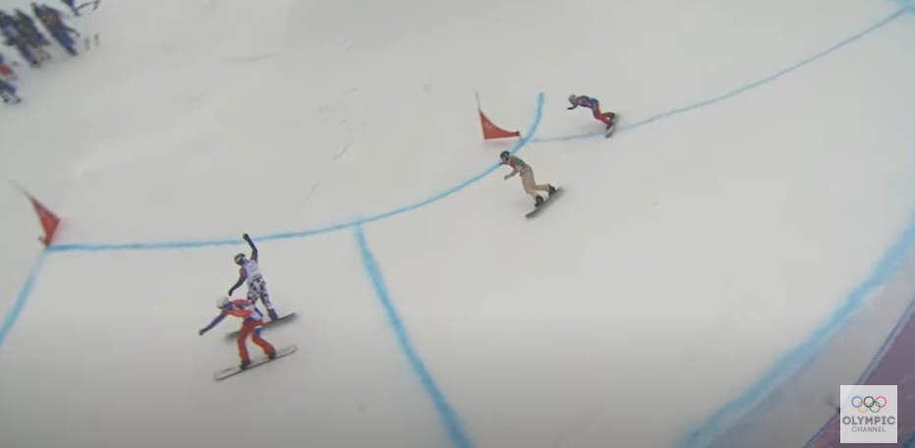
Who is battling for gold?

Slide 9
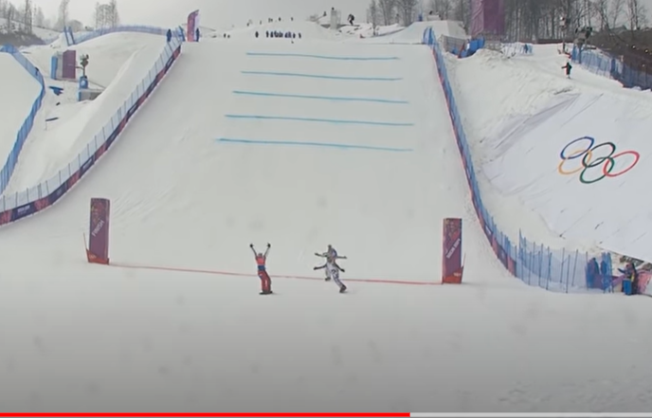
And the winner is…..

Slide 10
LO I can write a good newspaper report
LO I can write a great newspaper report
LO I can write an exceptional newspaper report
Success Criteria
Use plan
Rewatch the video to help you write the report.
Pause the video to help you write about certain points in the race.
Use the Newspaper report writing checklist to guide your writing (it is in the work folder for today)

