Slide 1

The Dreadful menace

Slide 2
Watch the film up to 14 seconds
https://www.youtube.com/watch?v=4b9Ji7DvsjU
or if you are in school use
https://www.literacyshed.com/the-sports-shed.html
or the link your teacher has.
Who or what is being spoken about? Why do you think this?
What do you think the conundrum is?
Hint: a conundrum is a riddle or a hard and puzzling question

Slide 3
Carry on watching the film to 53 seconds.
Questions to think about:
Who is standing on the ridge?
Why are they there?
Then watch the film to the end
What sports did you see?
This was the BBC Winter Olympics trailer in 2014

Slide 4
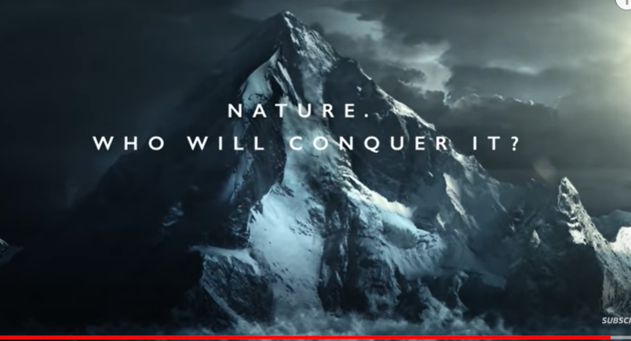
Why do you think this is a good ending to the trailer for the Winter Olympics?

Slide 5
Word of the day: conundrum
Your turn
I want you to look at the poem (there is a copy in the folder of work for today)
I want you to identify :
Personification (where something that is not human is given human qualities)
Simile (where something is compared to something else using like or as)
Metaphor (calling something something else: it was raining cats and dogs)
Hyperbole (over exaggeration)
Then answer the questions in the folder

