Slide 1


French
All About Ourselves
Year One
French | Year 5 | All About Ourselves | How Are you Feeling Today? | Lesson 5

Slide 2
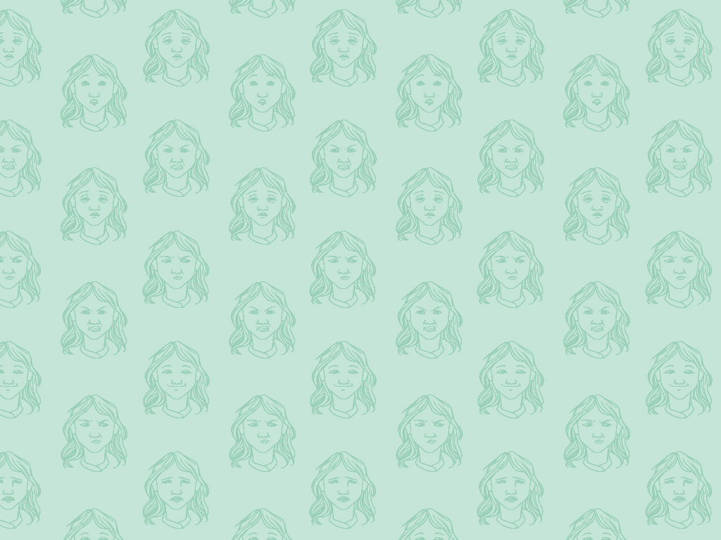

Comment te sens-tu aujourd'hui ?
(How Are You Feeling?)

Slide 3
Aim
I can alter an adjective to match gender.
I can pronounce the difference between two versions of the same adjective.
Success Criteria
I can ask how someone is feeling.
I can recognise written masculine/feminine adjectives.
I can listen to and repeat a word carefully.
I can say how I am feeling using an emotion word.

Slide 4

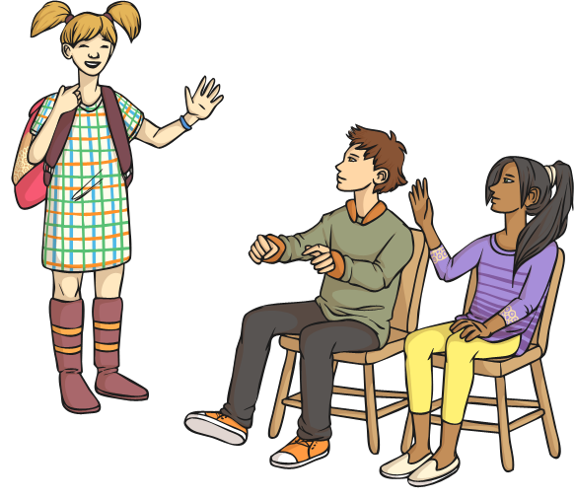
Show Me How You Feel
happy?
bored?
tired?

Slide 5



Spot the Cognates
Click play buttons throughout to hear phrases and words.
Look at these words:
surpris
fatigué
fier
fâché
désolé
énervé
heureux
triste
content
Do any of them seem familiar to you?
What do you think they mean?

Slide 6

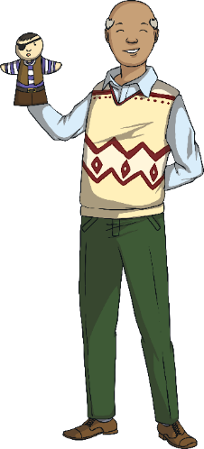
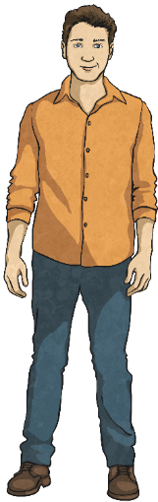
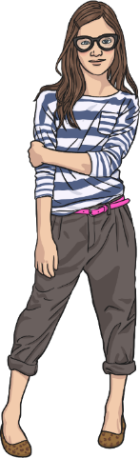
Comment te sens-tu aujourd'hui ?
(How Are You Feeling Today?)
Comment te sens-tu aujourd'hui ?
Je suis heureux.
Je suis heureuse.
Listen and read carefully: what is the difference between the two answers?

Slide 7
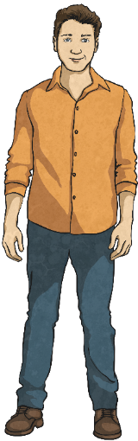
Comment te sens-tu aujourd'hui ?
(How Are You Feeling Today?)
Je suis désolée.
Comment te sens-tu aujourd'hui ?
Je suis désolé.
Listen and read carefully: what is the difference between the two answers?

Slide 8
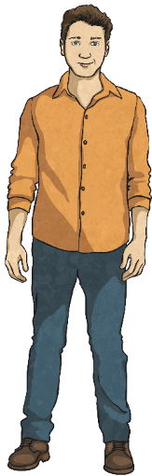
Comment te sens-tu aujourd'hui ?
(How Are You Feeling Today?)
Comment te sens-tu aujourd'hui ?
Je suis énervé.
Je suis énervée.
Listen and read carefully: what is the difference between the two answers?

Slide 9
Comment te sens-tu aujourd'hui ?
(How Are You Feeling Today?)
Comment te sens-tu aujourd'hui ?
Je suis fatiguée.
Je suis fatigué.
Listen and read carefully: what is the difference between the two answers?

Slide 10
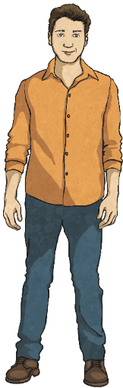
Comment te sens-tu aujourd'hui ?
(How Are You Feeling Today?)
Comment te sens-tu aujourd'hui ?
Je suis fier.
Je suis fière.
Listen and read carefully: what is the difference between the two answers?

Slide 11
Comment te sens-tu aujourd'hui ?
(How Are You Feeling Today?)
Comment te sens-tu aujourd'hui ?
Je suis surpris.
Je suis surprise.
Listen and read carefully: what is the difference between the two answers?

Slide 12
Comment te sens-tu aujourd'hui ?
(How Are You Feeling Today?)
Comment te sens-tu aujourd'hui ?
Je suis fâché.
Je suis fâchée.
Listen and read carefully: what is the difference between the two answers?

Slide 13
Comment te sens-tu aujourd'hui ?
(How Are You Feeling Today?)
Comment te sens-tu aujourd'hui ?
Je suis content.
Je suis contente.
c
Listen and read carefully: what is the difference between the two answers?

Slide 14
Comment te sens-tu aujourd'hui ?
(How Are You Feeling Today?)
Comment te sens-tu aujourd'hui ?
Je suis triste.
Je suis triste.
c
Listen and read carefully: what is the difference between the two answers?

Slide 15
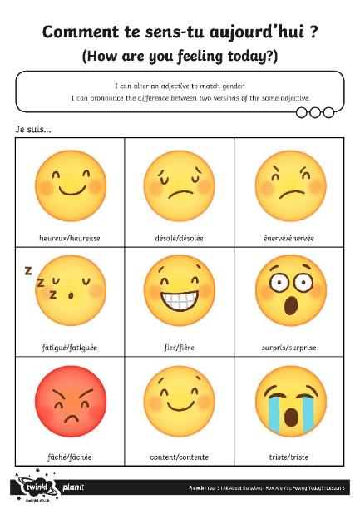
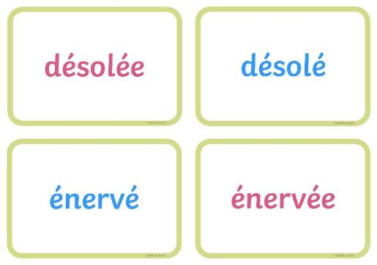
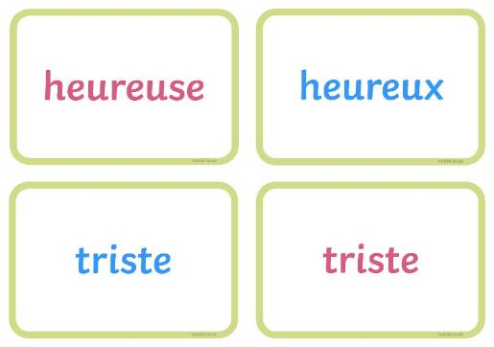
Jouons !
(Let’s Play!)
c
Match the emotions to the words.
c
c

