Slide 1
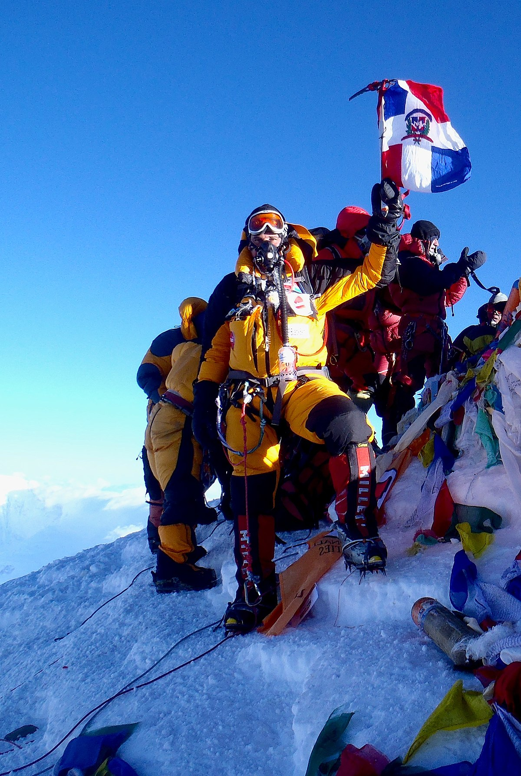

Discursive Writing Day 4
Imagine us on the summit, hoisting a Datchet St Mary’s flag!
This Photo by Unknown Author is licensed under CC BY-SA

Slide 2
LO I can edit to improve my work
1. Read over your own work.
2. Make sure it makes sense. (Check verbs agree - we were, we are, I was, they were).
3. Read for punctuation.
4. Read for spellings.
5. Improve with adjectives/adverbs/ complex sentences.
6. Use the checklist.
7. Improve what you have not already done.

