Slide 1

To recreate Hokusai’s Mount Fuji using painting

Slide 2
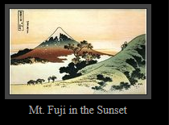
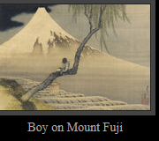
Day 2
LO
I can use watercolours to paint a Hokusai inspired mountain picture
SC
Sketch very lightly your outline of the mountain and trees
Use watercolours, mixing in the lid
Rinse brush before new colours.
Take care
Use the tip of the brush for outlines
Use the side of the brush to do washes or blending.

