Slide 1

Growth and Survival
Learning Objective: To find out about the offspring of a variety of different animals.
Success Criteria:
I know that all animals, including
humans, have offspring that grow into adults?
I can match a variety of adult animals to their offspring?
• I know that growth from offspring to
adult is a gradual process?

Slide 2





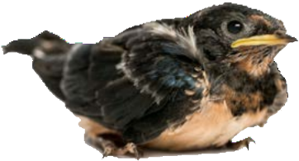
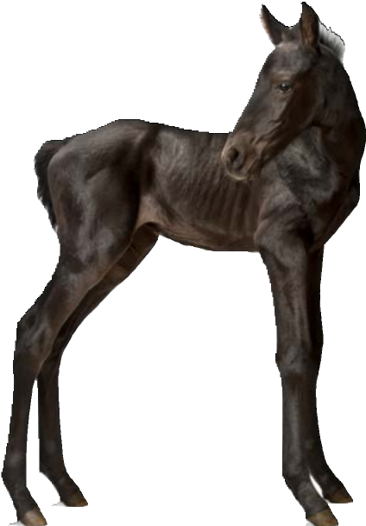
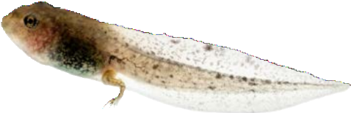
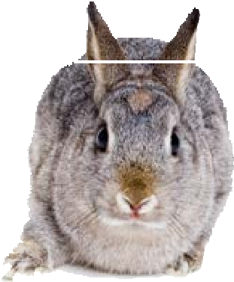
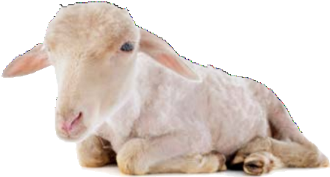
What do all these animals have in common?

Slide 3
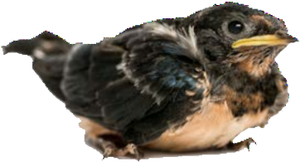

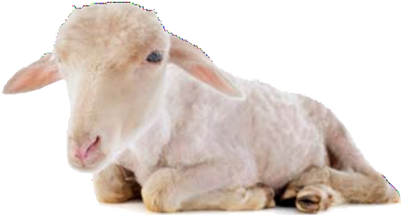
These animals are all babies. This means that they are young and that they are not fully grown yet.
One day, all these baby animals will become adults.

Slide 4








All species of animals have babies, just like humans.
Why do you think it is important for animals (including humans) to have babies?

Slide 5

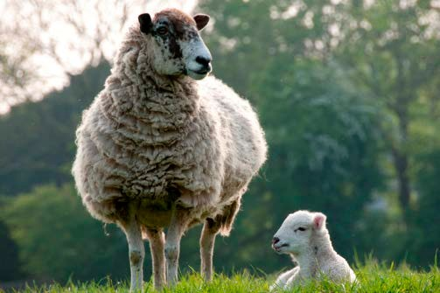
If animals didn’t have babies, the species would become extinct. This means that the type of animal wouldn’t exist anymore because they would have all died out. Animals have babies so that their species can survive.

Slide 6














Sometimes when a baby animal is born, it looks like a smaller version of its parents. Sometimes it looks completely different to how it will look when it is older.
Have a look at the photos of some
baby animals and their parents. Can you match which baby goes with which adult?

Slide 7

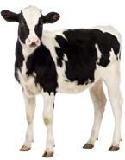


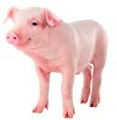
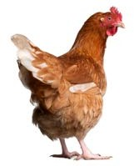
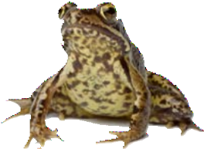
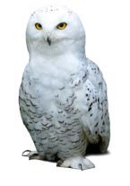
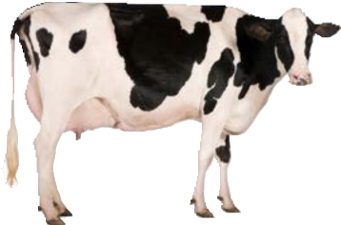
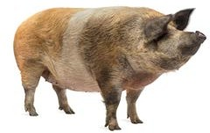
MATCH

Slide 8




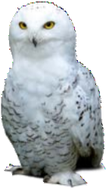
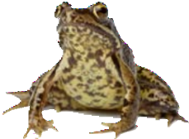


Did you match them all correctly?
owlet / owl
chick / chicken
tadpole / frog
piglet / pig
calf / cow

Slide 9










Have another go!
Have a look at these animals and see if you can match the baby to the adult.

Slide 10
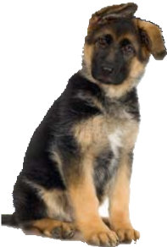
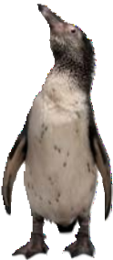
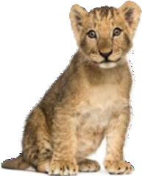
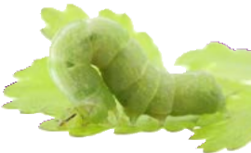

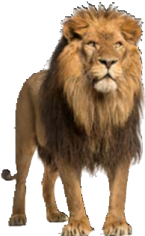
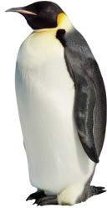
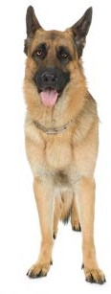
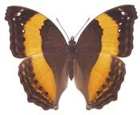
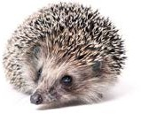
MATCH

Slide 11




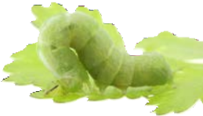
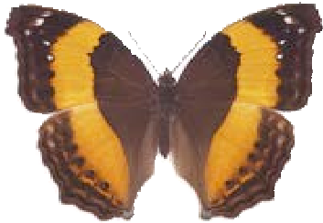
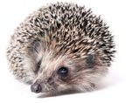
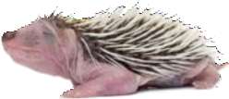
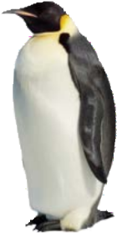
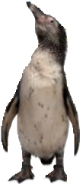
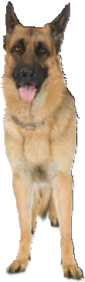
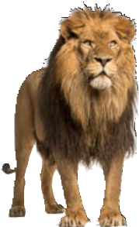
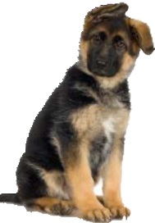
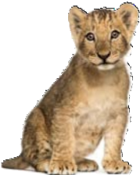
Did you match them all correctly?
hedgehog urchin / hedgehog
caterpillar / butterfly
penguin chick / penguin
lion cub / lion
puppy / dog

Slide 12





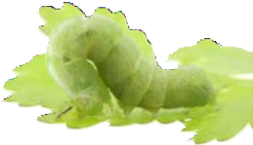
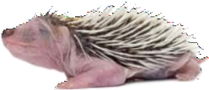
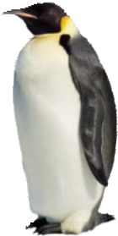
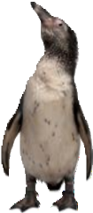

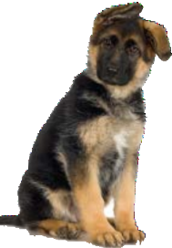

Which of these animals do you think is most different as a baby to how it looks when it is an adult? Why?
hedgehog urchin / hedgehog
caterpillar / butterfly
penguin chick / penguin
lion cub / lion
puppy / dog

Slide 13
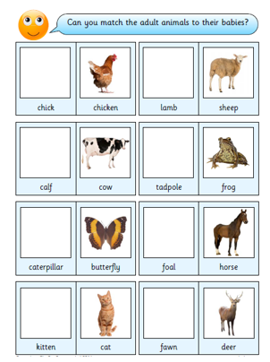
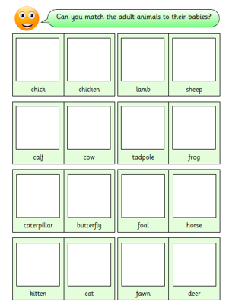
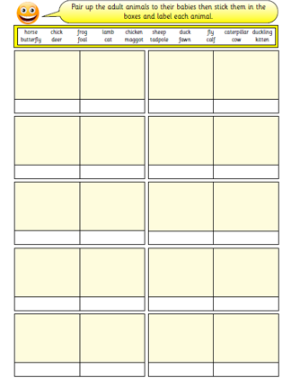
Challenge 1
Choose your activity
Challenge 2
Challenge 3

