Slide 1
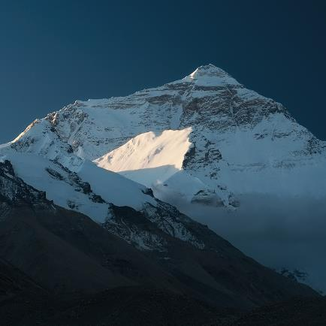


Discursive Writing Day 3
This Photo by Unknown Author is licensed under CC BY-SA
This Photo by Unknown Author is licensed under CC BY-SA-NC

Slide 2
LO I can write a good discursive text
LO I can write a great discursive text
LO I can write an exceptional discursive text
Success Criteria
Use plan
Make arguments powerful
Use reasons
Balanced conclusion
Use the Discursive writing checklist to guide your writing (it is in the work folder for today)

