Slide 1

To recreate Hokusai’s Mount Fuji using sketching

Slide 2
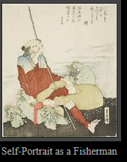
Born in 1760 in Japan
Hokusai had a long career, but he produced most of his important work after age 60. His most popular work is the ukiyo-e series Thirty-six Views of Mount Fuji, which was created between 1826 and 1833. It actually consists of 46 prints (10 of them added after publication). In addition, he is responsible for the 1834 One Hundred Views of Mount Fuji (富嶽百景 Fugaku Hyakkei), a work which "is generally considered the masterpiece among his landscape picture books." His ukiyo-e transformed the art form from a style of portraiture focused on the courtesans and actors popular during the Edo Period in Japan's cities into a much broader style of art that focused on landscapes, plants, and animals.
https://www.katsushikahokusai.org/the-complete-works.html

Slide 3
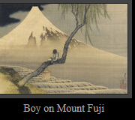
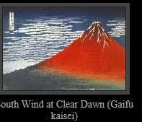
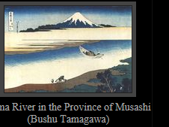
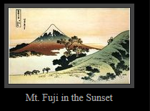
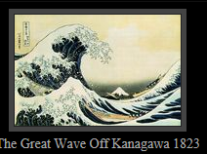
A selection of mountain pictures

Slide 4
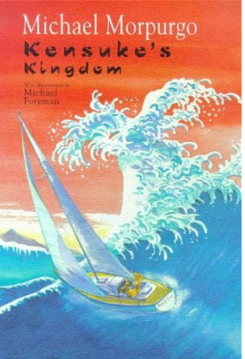
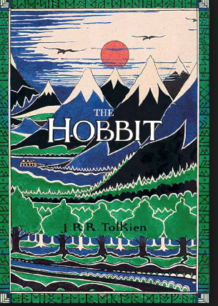
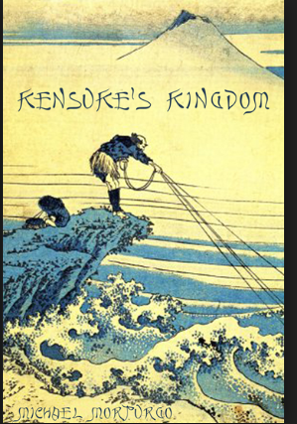
Book covers

Slide 5
I can sketch a Hokusai picture of Mount Fuji
SC
Landscape
Line for date & LO
Take time
Work quietly
Do the mountain first
Lighter shades for background
Extra challenge
Sketch the boy

Slide 6
Day 2
LO
I can use watercolours to paint a Hokusai inspired mountain picture
SC
Sketch very lightly your outline of the mountain and trees
Use watercolours, mixing in the lid
Rinse brush before new colours.
Take care
Use the tip of the brush for outlines
Use the side of the brush to do washes or blending.

