Slide 1
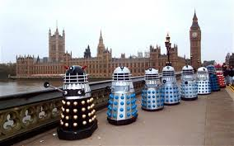

Find someone to talk to, it could be a person, an animal or a toy. Use discursive techniques to present your ideas about Daleks should be allowed on earth, using connectives
Alternatively However
On the other hand
It could be argued that
Many people disagree,arguing that
Furthermore Additionally
Moreover In addition

Slide 2
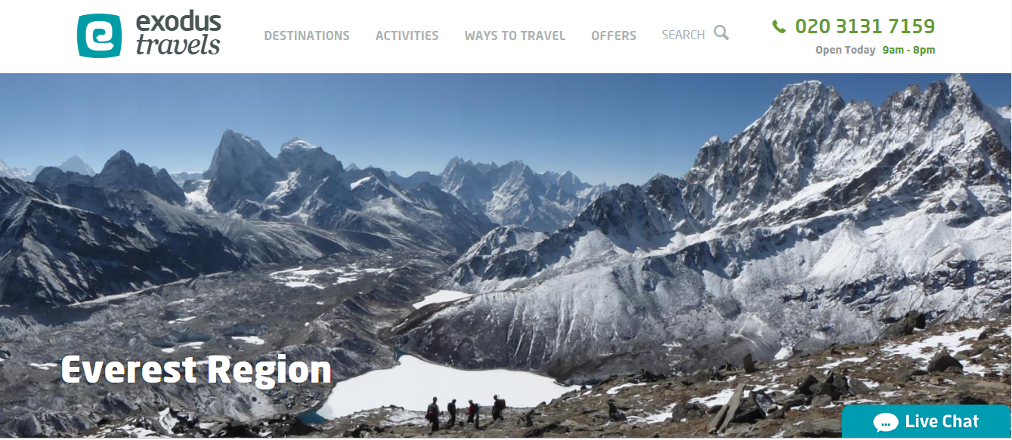
LO: I can plan a discursive text
What could we discuss about a holiday to the Everest region?
All of Year 6 children at Datchet St Mary's should have an expedition to Mount Everest

Slide 3

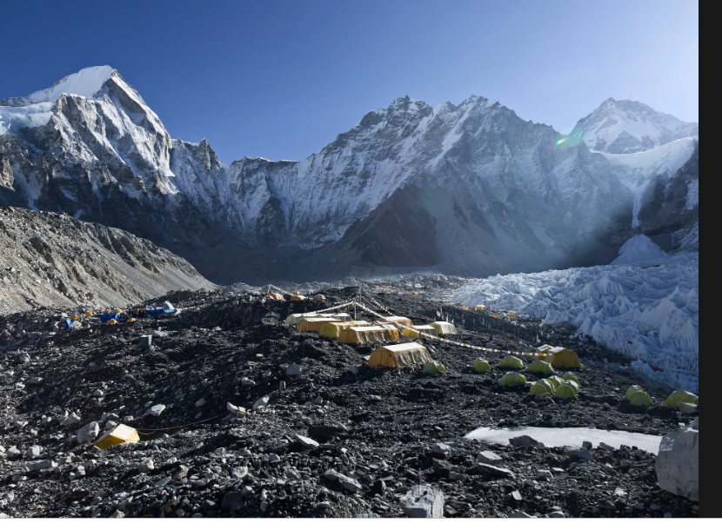

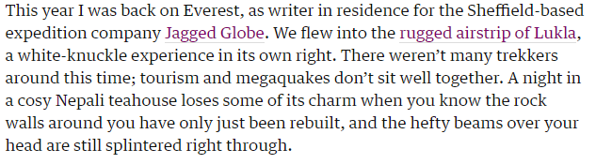
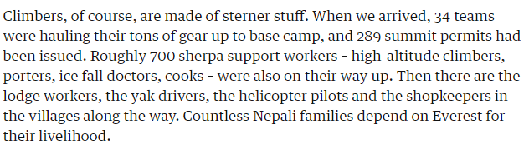
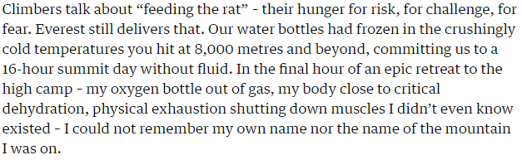
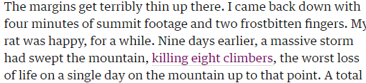

Slide 4
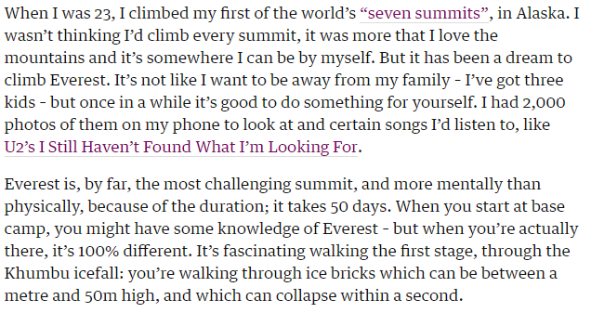

Slide 5
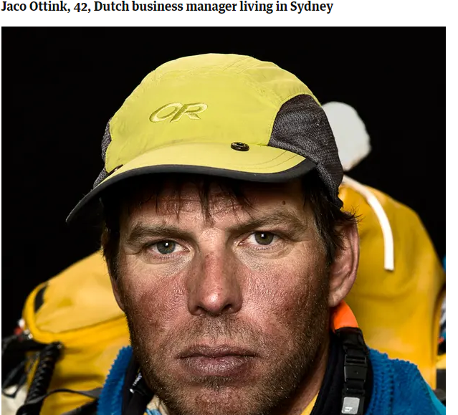
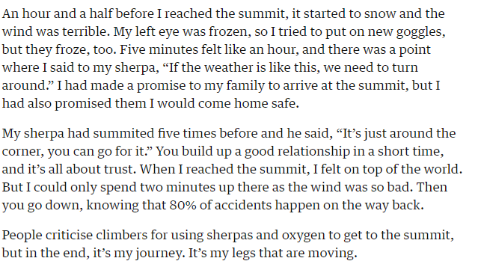
LO: I can plan a discursive text
Jaco Ottink

Slide 6
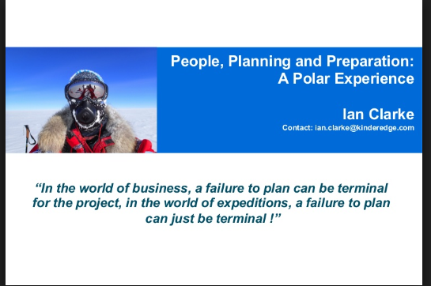
LO: I can plan a discursive text
https://everestexpedition.co.uk/everest/seven-attributes-to-climb-everest/

Slide 7
LO: I can plan a discursive text
Connectives which further the same view
Connectives introducing opposing views
Alternatively However
On the other hand
It could be argued that
Many people disagree,arguing that
Furthermore Additionally
Moreover In addition
There are more of these words on the Giving Your Opinion wordlist .

Slide 8
LO: I can begin to plan a good discursive text
LO I can begin to plan a great discursive text
LO I can begin to plan an exceptional discursive text
Success criteria
Use planning frame (chose the right one for you)
Use Giving Your Opinion wordlist to help build your arguments
Make reasons powerful
Use detailed arguments
Use Goldilocks discursive text from yesterday to help structure your argument (magpie)

