Slide 1


L.O:To comprehend the Christian belief in unconditional and eternal love.

Slide 2
Q-Does anything last forever?
https://www.truetube.co.uk/film/christian-marriage

Slide 3
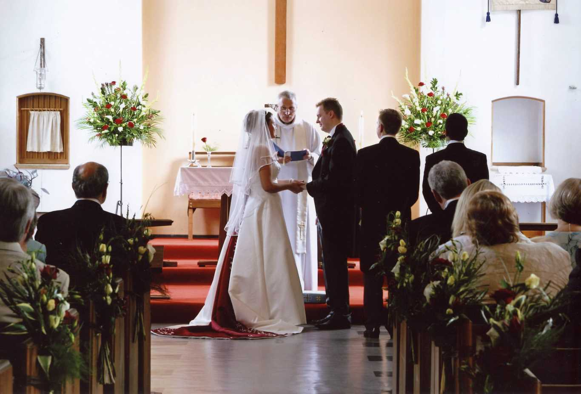
Q-Does anything last forever?
What do they promise one another?
To love each other for their whole lifetime.

Slide 4
The vows: "I take you, _____, to be my wife (or husband) to have and to hold from this day forward, for better for worse, for richer for poorer, in sickness and in health, to love and to cherish, till death us do part", have been recited at UK church weddings since 1552.
all that I am I give to you,
and all that I have I share with you,
within the love of God,
Father, Son and Holy Spirit.
Traditional words for the exchange of rings

Slide 5
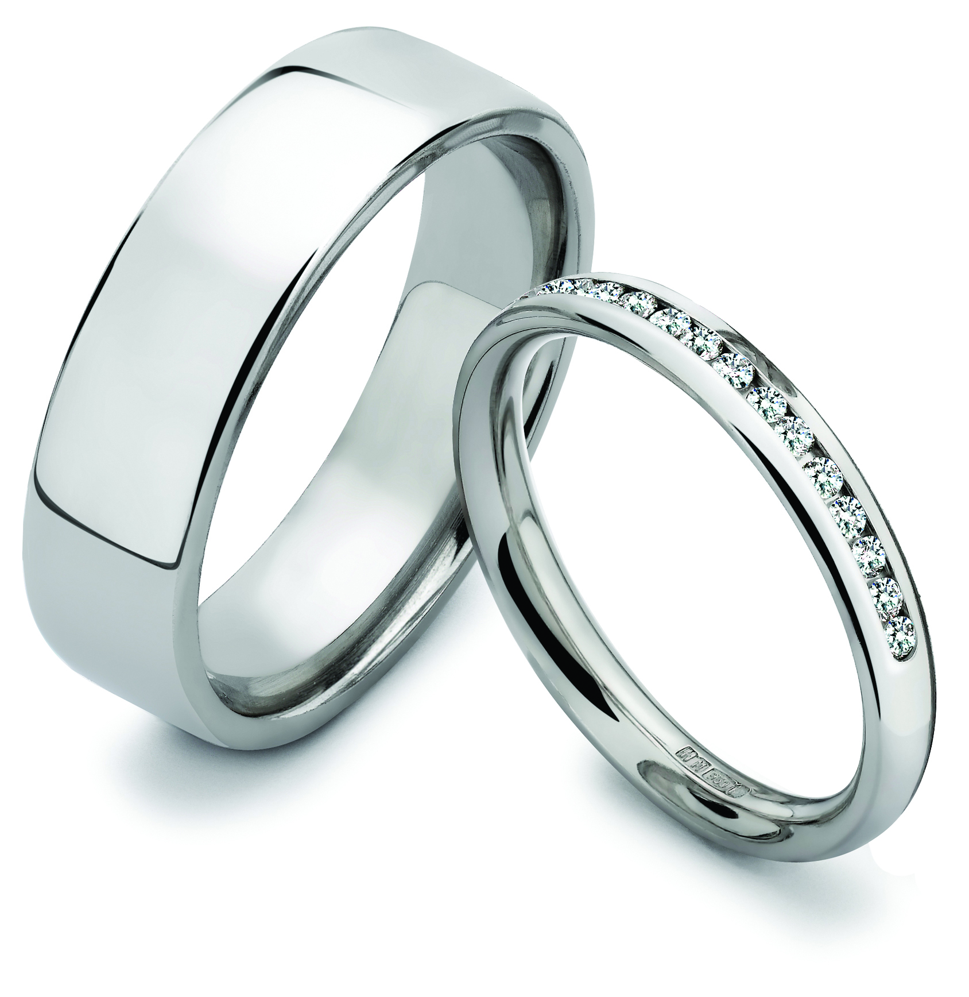
Q-Does anything last forever?
What do these represent?
ring symbolises eternity

Slide 6
Q-Does anything last forever?
What does eternity mean?
Is anything ever eternal?
Can love last forever?

Slide 7

Q-Does anything last forever?
What other types of love exist?
What is unconditional love?

Slide 8
What is unconditional mean?
No restrictions / limitless
What does unconditional love mean?
Known as affection without any limitations, it can also be love without conditions.
Q-Does anything last forever?

Slide 9
What did Jesus teach about love?
Love your enemies (Matthew 5 43-47);
The two great commandments (Mark 12 29-31; The Lost Son (Luke 15 11-32);
Jesus heals ten men (Luke 17, 11-19);
Jesus forgives those who crucified him (Luke 23:34); God loves the world (John 3; 16);
What is Love 1 Corinthians 13: 4-13.

Slide 10
Jesus taught that love should be eternal and unconditional.
Agape = unconditional love

Slide 11
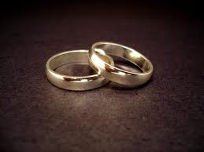
Write your own vows.
Think about: eternal love, care, respect

