Slide 1

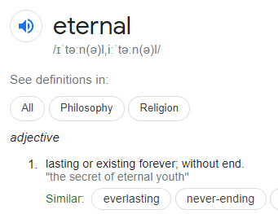
L.O:To understand different beliefs on eternity
Q-Is anything ever eternal?

Slide 2
L.O:To understand different beliefs on eternity
Has lasted my lifetime I think will last forever I wish would last
Oceans, celebrities, love, friendship, the world, water, the truth, memories, mountains, the sun, planets, a skeleton, food, trees, sky, stone henge, Jesus, a photograph.

Slide 3
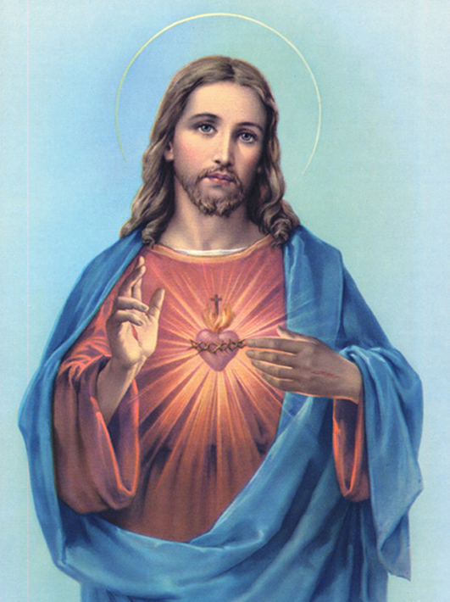
Do Christians think Jesus is eternal?

Slide 4
________________________________________________________________________________________________________________________________________________________________________________________________________________________________________________________________________________________________

