Slide 1
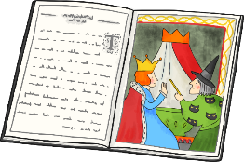

LO To investigate fables
Success criteria: I know that most traditional folktales are very old and are told all over the world. I know that a fable is a type of folktale. I can think about the theme/lesson a fable is trying to teach.

Slide 2
What Are Folktales?
Most traditional folktales are very old. They are stories which were passed down to new generations by storytellers. Later they were written down. Each tale may have many versions.
Folktales are told all over the world.
Often, folktales teach lessons.
Fables and fairy tales are types of folktales.
They have no specific author because they are stories that are handed down from storytellers around the world.
Something extraordinary happens to an ordinary character.

Slide 3
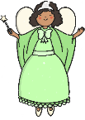
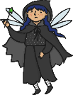
What Are The Key Features of Folktales?
May use the phrase “Once upon a time.“
May use the number three in the story ... number of characters, events, wishes, etc.
Has good and bad characters.
Uses repetition of phrases or responses, ex: “Little pig, little pig, let me in,” from The Three Little Pigs.
Involves common people and/or animals.
Main characters have a problem to solve.
Has a happy ending. Problem is solved.
Have no time frame, but most are thought to have happened in the past.
Usually teach a lesson.

Slide 4
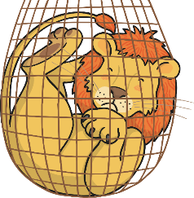
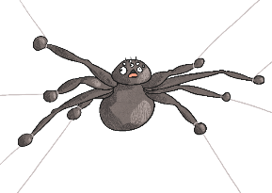
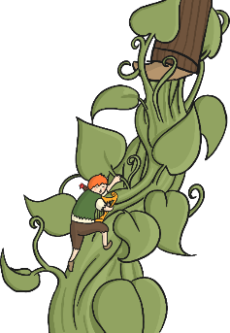
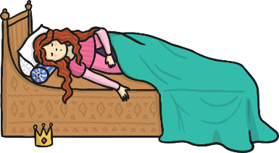

Types Of Folktales
Trickster tales
Fables
Explanation stories
Fairytales

Slide 5
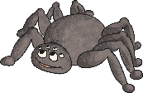
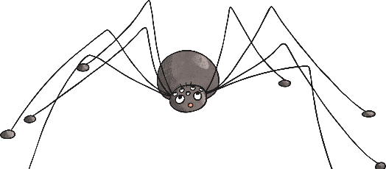
Trickster Tales
One character is clever and very tricky
Trickster causes problems for another character
He/she usually gets away with the trick
Different cultures have specific tricksters. Example: Anansi the Spider in Ashanti tales

Slide 6
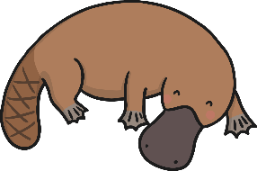
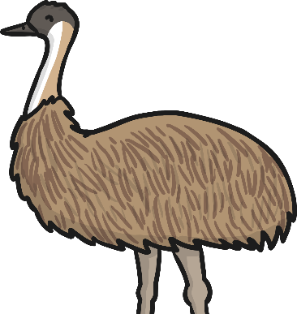

Explanation Folktales
Explain why something is as it is
Sometimes explains a phenomena
Explain how things came to be
Example: Australian Aboriginal dreamtime stories

Slide 7
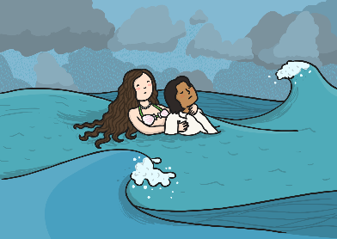

Fairy Stories
Include good and bad characters
A hero or heroine
Magic or fantasy
Includes predictable beginnings and endings “Once upon a time” “Happily ever after”
Problem which is usually overcome through kindness, courage, intelligence

Slide 8
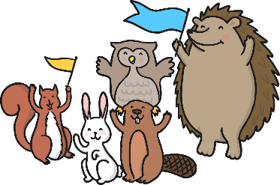
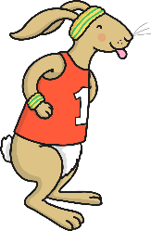
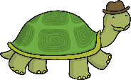
Fables
Short stories
Teach a lesson
Animal characters with human characteristics
Stress themes such as: the value of cooperation, looking at problems from different viewpoints, rewards if lesson is learned
Lessons may not be stated directly
Listener must find their own lesson in the tale

Slide 9
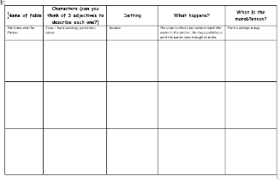
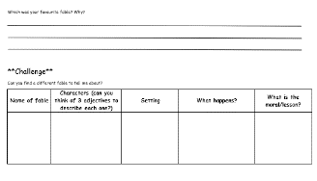


Independent Work
Complete the fable investigation grid.

