Slide 1

Friday Maths
Arithmetic

Slide 2
Just like Friday at school ….. You are going to do your arithmetic tests!
Allow yourself (at most half an hour to do the test
Your maths tests are in the work folder
Miss Gilbert’s and Mrs Phillips’s Maths Class do the test Labelled
Mrs Matharu’s Maths Group do the test labelled

Slide 3
When you have finished, use the mark sheet to mark your own work.
If you have got a question wrong, look at the answer and see if you can work out what you have done wrong.
If it is something I have not taught you yet, don’t panic!
On the next page is one thing I have not yet taught you.

Slide 4







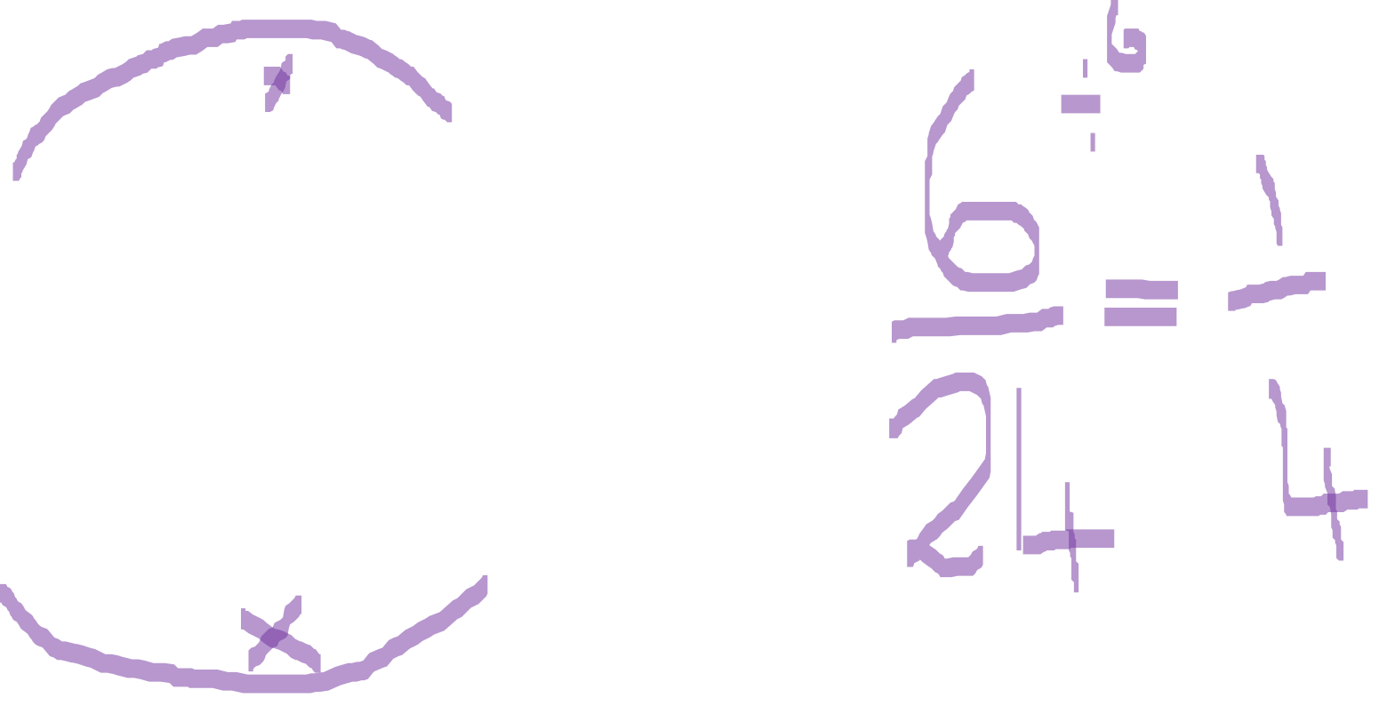
Multiplying fractions

