Slide 1


Persuasive letter writing

Slide 2
LO To write a persuasive letter
Persuasive writing techniques
Flattery – (You are so clever that I know you will ….)
Presumption (I know that you will realise what a brilliant opportunity this is…)
Threat (If you don’t let us go, there will be consequences…)

Slide 3
LO To write a persuasive letter
Structure and grammar
Objection
Did you use the subjunctive? (If I were you, I would …..

Slide 4
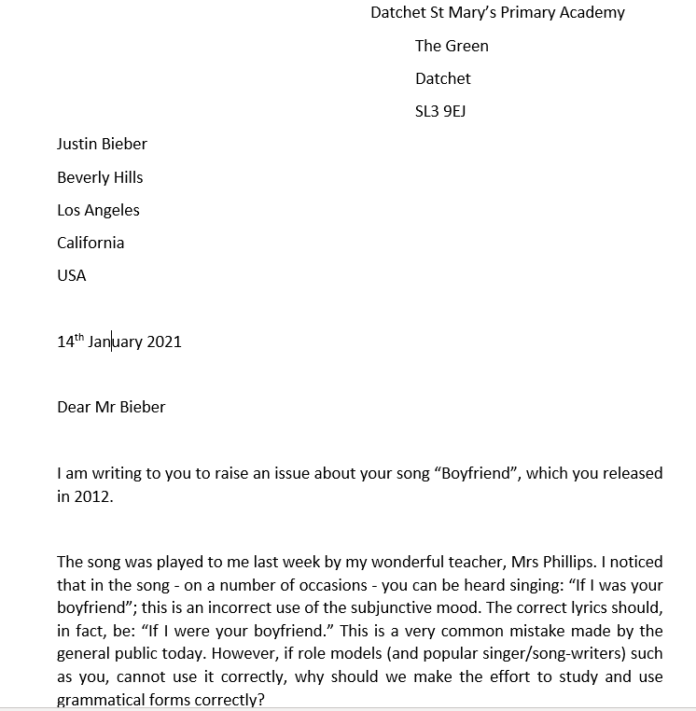

Slide 5
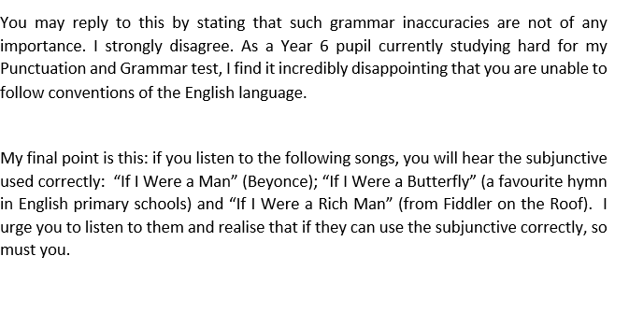



Slide 6
LO To write a persuasive letter
Your turn
Use your planning frame from yesterday to help you write your persuasive letter.
(You can check the Bieber letter on the pages on this PowerPoint to help you with the letter structure)
Make sure that you improve your letter and don’t just write out what is in your plan.
Purpose: To persuade Miss Green to allow Year 6 to go to Mount Everest
Audience: Miss Green
Once you have finished use editing checklist to ensure your writing is the best it can be
Fill in the self check targets sheet (Persuausive writing targets in the daily work folder)

