Slide 1


Persuasive letter writing

Slide 2
LO To plan a persuasive letter
What persuasive techniques can you remember from Mr Brown’s Oak National Academy lessons?
Flattery – (You are so clever that I know you will ….)
Presumption (I know that you will understand what a brilliant idea this is…)
Threat (If you don’t do this, there will be consequences)

Slide 3
LO To plan a persuasive letter
Today we are going to look at a letter to see if we can remember the features of a persuasive letter and spot a new grammar feature
Prepare yourself for some Beyonce and Bieber! (Apologies to Mrs. Anstee at this point who has to run out of the room when Bieber is played!)
If possible listen to Beyonce, IF I WERE A BOY
If possible listen to Justin Bieber (sorry Mrs Anstee), BOYFRIEND

Slide 4
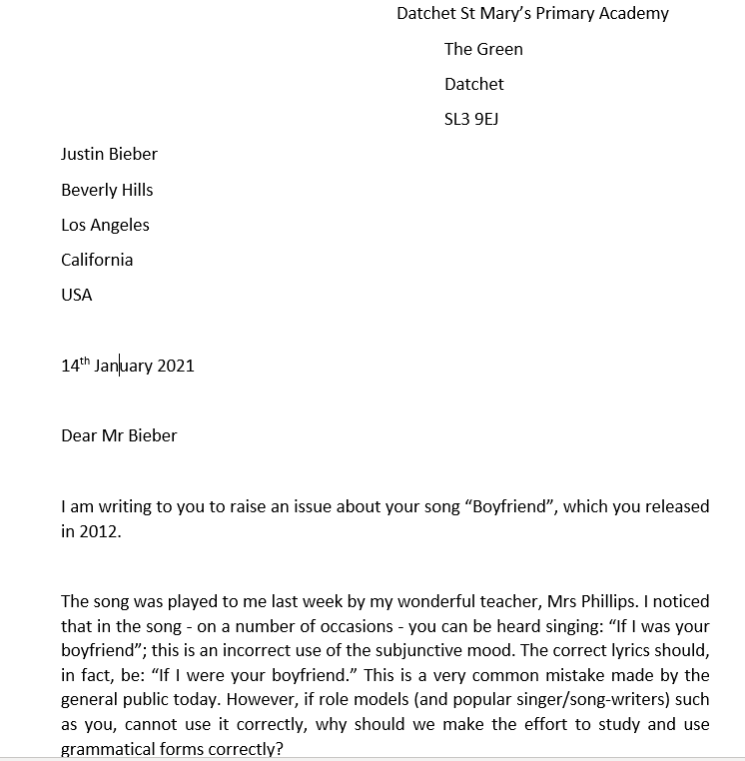

Slide 5
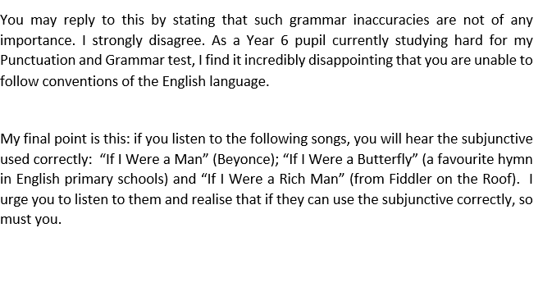


Slide 6
LO To plan a persuasive letter
Let’s look back at the letter and see what structural techniques are in it

Slide 7


Slide 9
LO To plan a persuasive letter
Your turn THIS IS ONLY PLANNING TODAY
You are going to use the planning frame to plan a letter persuading Miss Green to allow us to go on a trip to Mount Everest
So Purpose: To persuade Miss Green to allow Year 6 to go on a trip to Mount Everest
Audience: Miss Green
Think about why it would be a great idea to go – no children have climbed Mount Everest.
Think about what her objection would be – cost, dangers
Use the persuasive techniques – flattery, presumption, threat (go easy on the threats)

