Slide 1



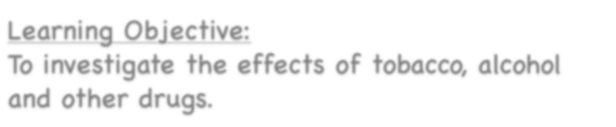





Healthy Bodies
Learning Objective:
To investigate the effects of tobacco, alcohol and other drugs.
NEXT
www.planbee.com

Slide 2












What is a drug?
Are drugs always
harmful?
BACK
NEXT
www.planbee.com

Slide 3
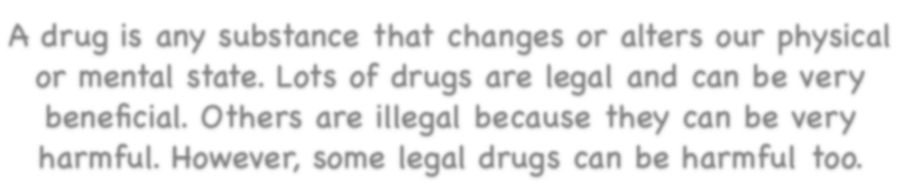




A drug is any substance that changes or alters our physical or mental state. Lots of drugs are legal and can be very beneficial. Others are illegal because they can be very harmful. However, some legal drugs can be harmful too.
Can you think of some examples of harmful and beneficial drugs?
Beneficial drugs | Harmful drugs
BACK
NEXT
www.planbee.com

Slide 4

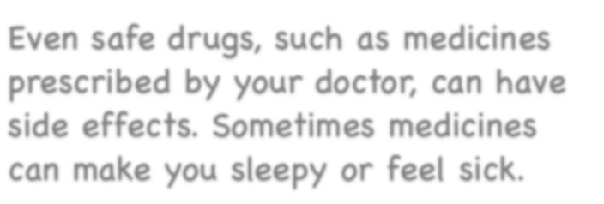

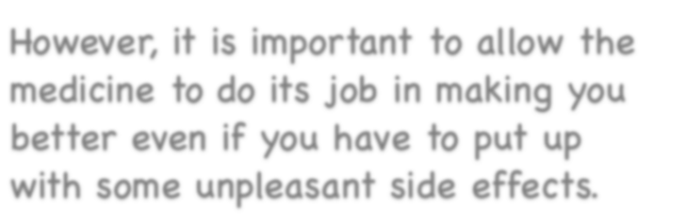



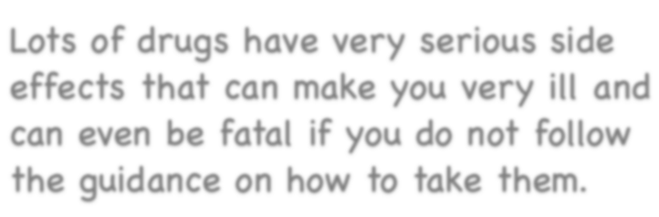

Even safe drugs, such as medicines prescribed by your doctor, can have side effects. Sometimes medicines can make you sleepy or feel sick.
However, it is important to allow the medicine to do its job in making you better even if you have to put up with some unpleasant side effects.
Lots of drugs have very serious side effects that can make you very ill and can even be fatal if you do not follow the guidance on how to take them.
BACK
NEXT
www.planbee.com

Slide 5





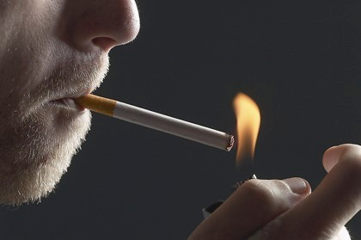


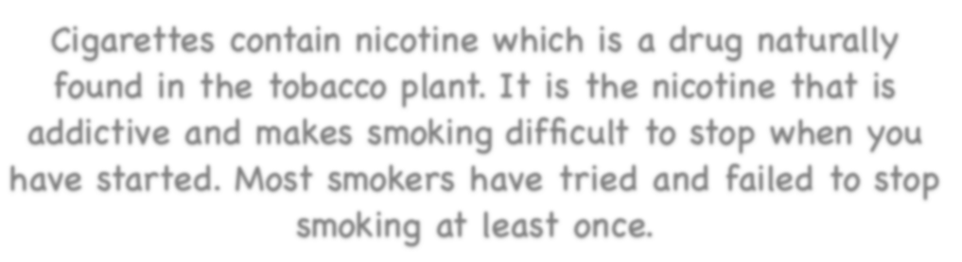

Tobacco
Cigarettes are made from dried leaves from the tobacco plant. These leaves are then mixed with lots of different chemicals before being made into cigarettes.
Cigarettes contain nicotine which is a drug naturally found in the tobacco plant. It is the nicotine that is addictive and makes smoking difficult to stop when you have started. Most smokers have tried and failed to stop smoking at least once.
BACK
NEXT
www.planbee.com

Slide 6
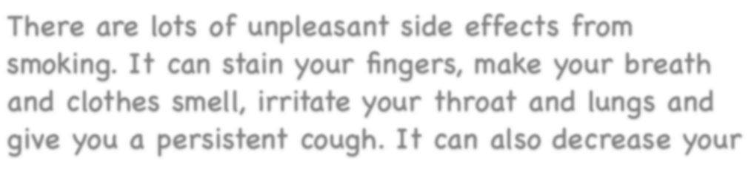
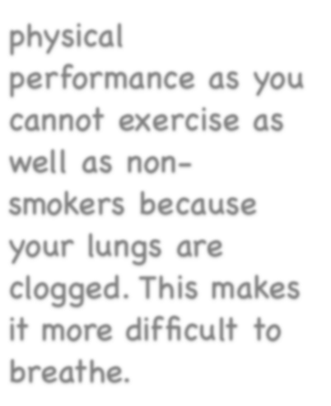











There are lots of unpleasant side effects from smoking. It can stain your fingers, make your breath and clothes smell, irritate your throat and lungs and give you a persistent cough. It can also decrease your physical
performance as you cannot exercise as well as non- smokers because your lungs are clogged. This makes it more difficult to breathe.
BACK
NEXT
www.planbee.com

Slide 7
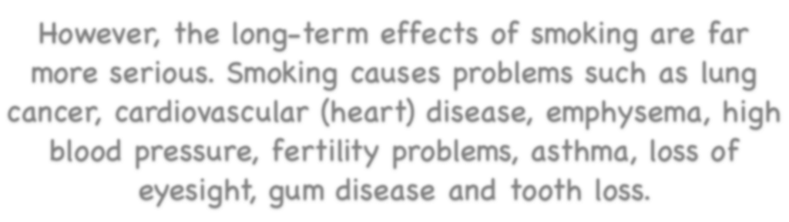























However, the long-term effects of smoking are far more serious. Smoking causes problems such as lung cancer, cardiovascular (heart) disease, emphysema, high blood pressure, fertility problems, asthma, loss of eyesight, gum disease and tooth loss.
Did you know. .?
Cigarettes contain more than 4000 chemical compounds and at least 400 toxic substances
Did you know. .?
A single cigarette reduces a person’s life expectancy by 11 minutes on average
Did you know. .?
Smoking kills around 114,000 people in the UK each year
BACK
NEXT
www.planbee.com

Slide 8



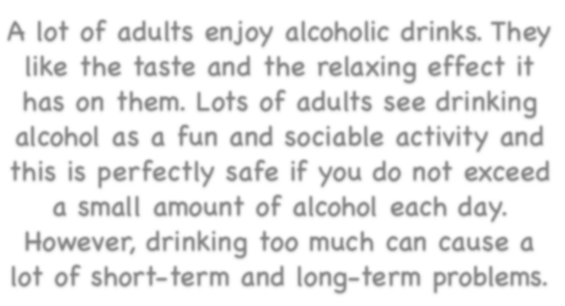

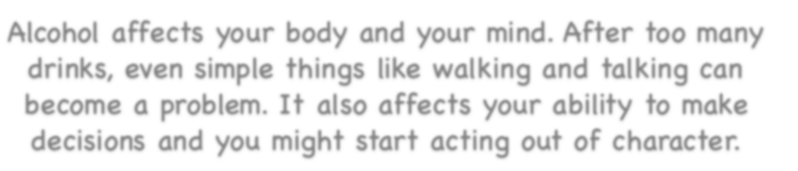
Alcohol
A lot of adults enjoy alcoholic drinks. They like the taste and the relaxing effect it has on them. Lots of adults see drinking alcohol as a fun and sociable activity and this is perfectly safe if you do not exceed a small amount of alcohol each day.
However, drinking too much can cause a lot of short-term and long-term problems.
Alcohol affects your body and your mind. After too many drinks, even simple things like walking and talking can become a problem. It also affects your ability to make decisions and you might start acting out of character.
BACK
NEXT
www.planbee.com

Slide 9
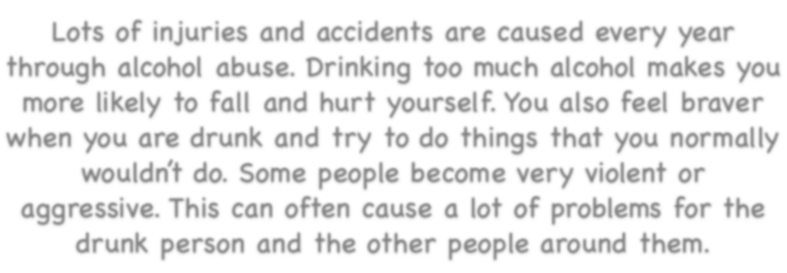


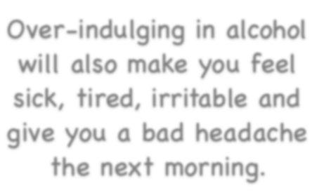




Lots of injuries and accidents are caused every year through alcohol abuse. Drinking too much alcohol makes you more likely to fall and hurt yourself. You also feel braver when you are drunk and try to do things that you normally wouldn’t do. Some people become very violent or aggressive. This can often cause a lot of problems for the drunk person and the other people around them.
Over-indulging in alcohol will also make you feel sick, tired, irritable and give you a bad headache the next morning.
BACK
NEXT
www.planbee.com

Slide 10
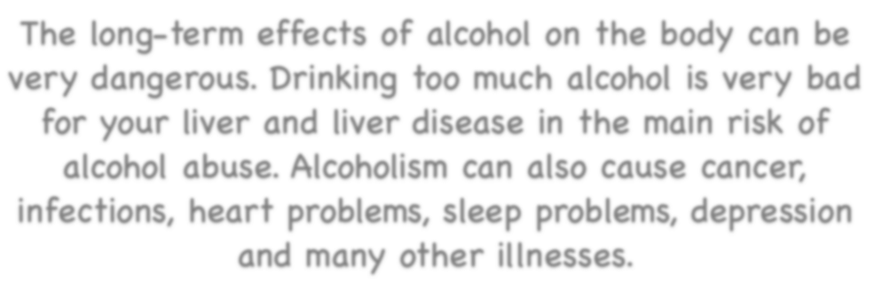

















The long-term effects of alcohol on the body can be very dangerous. Drinking too much alcohol is very bad for your liver and liver disease in the main risk of alcohol abuse. Alcoholism can also cause cancer, infections, heart problems, sleep problems, depression and many other illnesses.
Did you know. .?
One in five of all alcohol-related deaths are caused by cancer
Did you know. .?
Alcohol is responsible for around 33,000 deaths in the UK each year
Did you know. .?
Around 10 million adults in the UK drink more than the recommended amount of alcohol each week
BACK
PLENARY
www.planbee.com

Slide 11









Plenary:
Read the statements on the
next slides and vote for whether you think they are TRUE or FALSE. Ready?
BACK
NEXT
www.planbee.com

Slide 12




You can’t take too much paracetamol.
BACK
NEXT
www.planbee.com

Slide 13








It’s FALSE! If you take too much paracetamol, or any other drug, it can be fatal.
BACK
NEXT
www.planbee.com

Slide 14


Smoking can cause major damage to your liver.
BACK
NEXT
www.planbee.com

Slide 15









It’s FALSE!
Smoking causes major damage to your heart and
lungs. It is alcohol that can damage your liver.
BACK
NEXT
www.planbee.com

Slide 16

Smoking is very addictive.
BACK
NEXT
www.planbee.com

Slide 17











It’s TRUE!
Cigarettes contain nicotine which is
highly addictive. It is very difficult to stop smoking once you have started.
BACK
NEXT
www.planbee.com

Slide 18
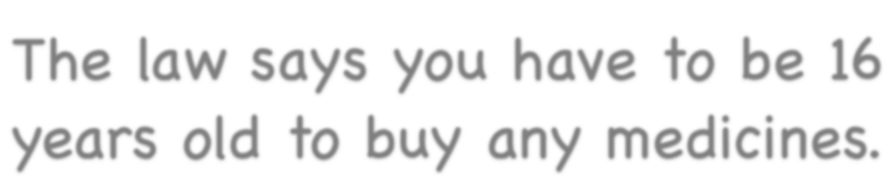
The law says you have to be 16 years old to buy any medicines.
BACK
NEXT
www.planbee.com

Slide 19













It’s FALSE! There are no laws about the age at which you can buy over-the-counter drugs, like cough
medicine, but most pharmacies have age restrictions to make sure children stay safe.
BACK
NEXT
www.planbee.com

