Slide 1



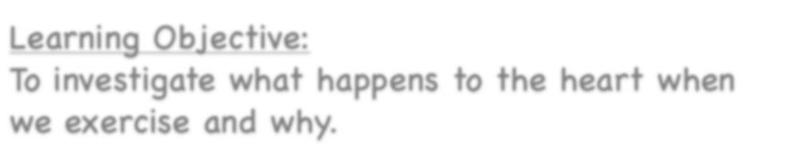





Healthy Bodies
Learning Objective:
To investigate what happens to the heart when we exercise and why.
NEXT
www.planbee.com

Slide 2







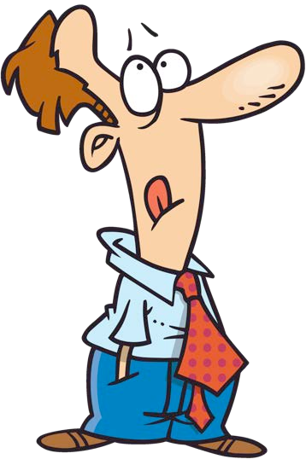











What
can you remember about the circulatory system?
How does it work?
What does it do?
BACK
NEXT
www.planbee.com

Slide 3
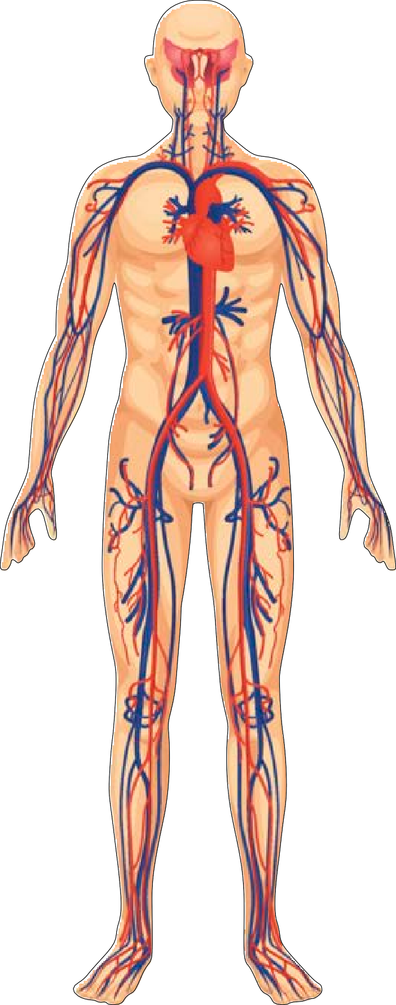
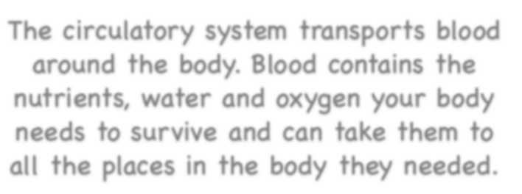
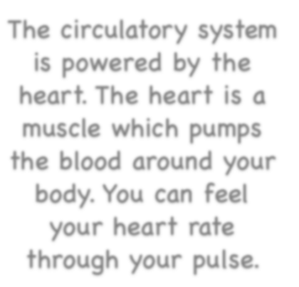
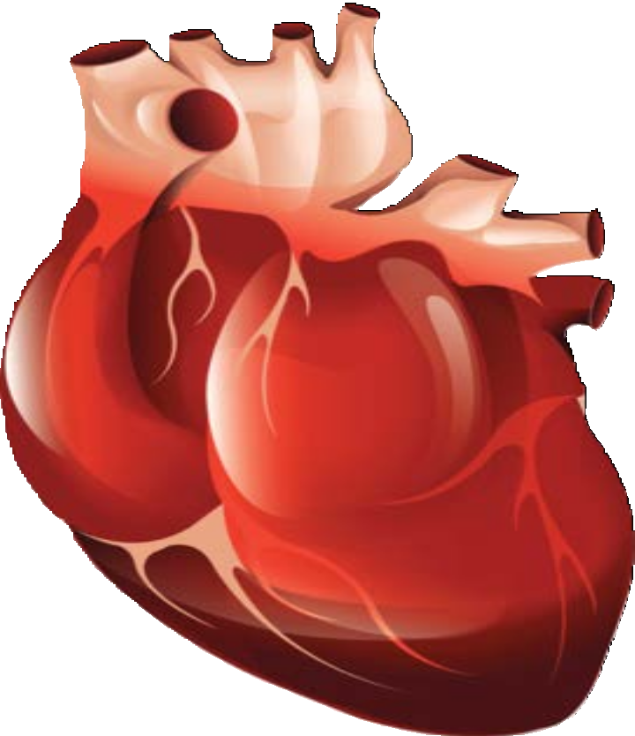







The circulatory system transports blood around the body. Blood contains the nutrients, water and oxygen your body needs to survive and can take them to all the places in the body they needed.
The circulatory system is powered by the heart. The heart is a muscle which pumps the blood around your body. You can feel your heart rate through your pulse.
BACK
NEXT
www.planbee.com

Slide 4
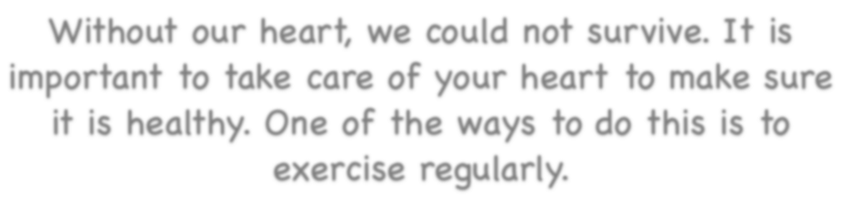

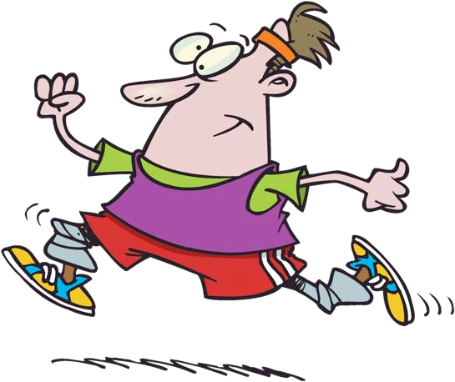






Without our heart, we could not survive. It is important to take care of your heart to make sure it is healthy. One of the ways to do this is to exercise regularly.
What happens to your heart when you exercise?
BACK
NEXT
www.planbee.com

Slide 5
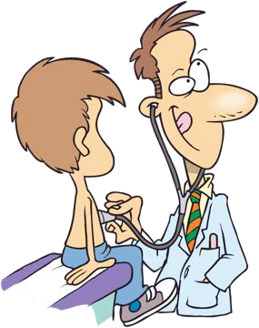




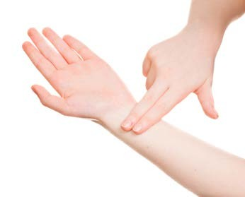
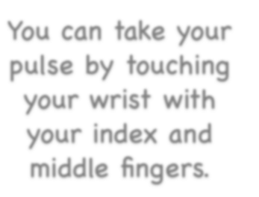





What is your resting pulse rate? In other words, how many times a minute does your heart beat when you are resting?
You can take your pulse by touching your wrist with your index and middle fingers.
BACK
NEXT
www.planbee.com

Slide 6




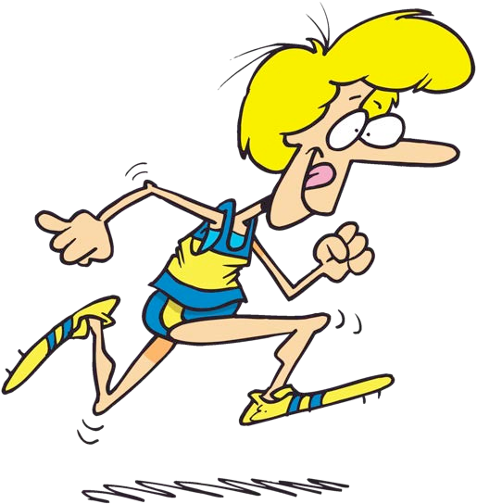










How
do you think your heart rate might change after you have done twenty star jumps?
What about if you ran around the
playground three times?
BACK
NEXT
www.planbee.com

Slide 7




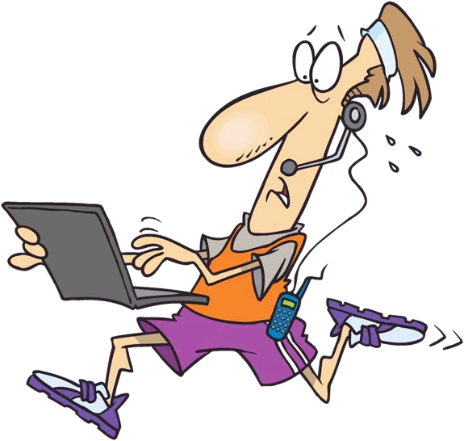

Today we will be investigating how our
heart rates are affected by exercise. How do you think we could do this so it is a fair test?
BACK
NEXT
www.planbee.com

Slide 8
Now we are going to do an experiment!
What you will need:
The worksheet
A timer (can be on a phone or ipad or computer)
Room to exercise

Slide 9
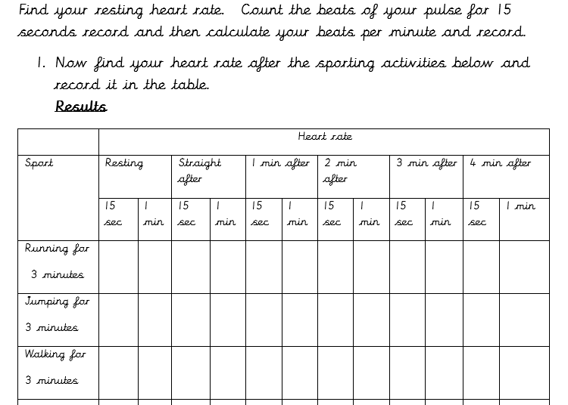

Slide 10
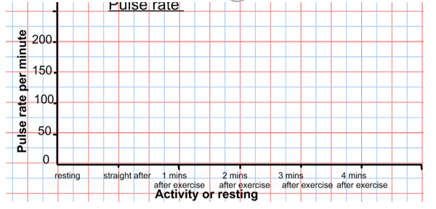

Slide 11
Review your results. What did you notice about the results? What does this tell you? Think about the impact on the heart and what it tells you about the amount of work needed to be done by the body and why. Record your thoughts under the heading Conclusion.

