Slide 1



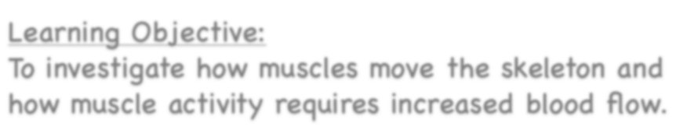


Healthy Bodies
Learning Objective:
To investigate how muscles move the skeleton and how muscle activity requires increased blood flow.
NEXT
www.planbee.com

Slide 2
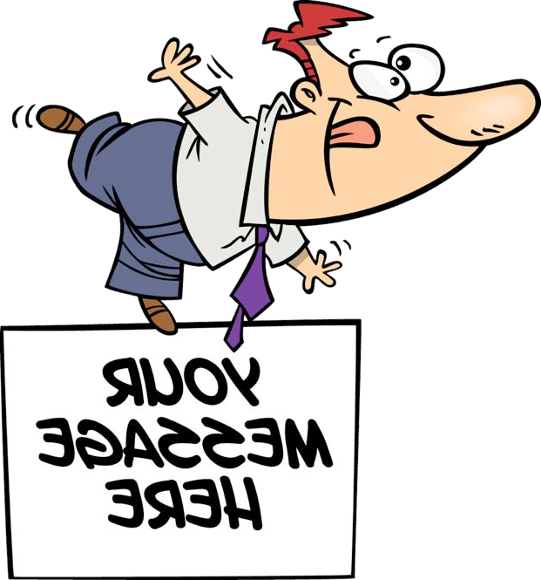










How do you do that? How do you make your body move?
Can you stand up and balance on one leg?
BACK
NEXT
www.planbee.com

Slide 3
Start by watching this video:
https://www.bbc.co.uk/teach/class-clips-video/science-ks2-how-do-muscles-and-bones-work/zfgtscw

Slide 4
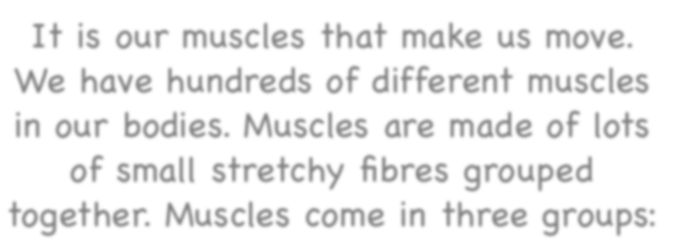
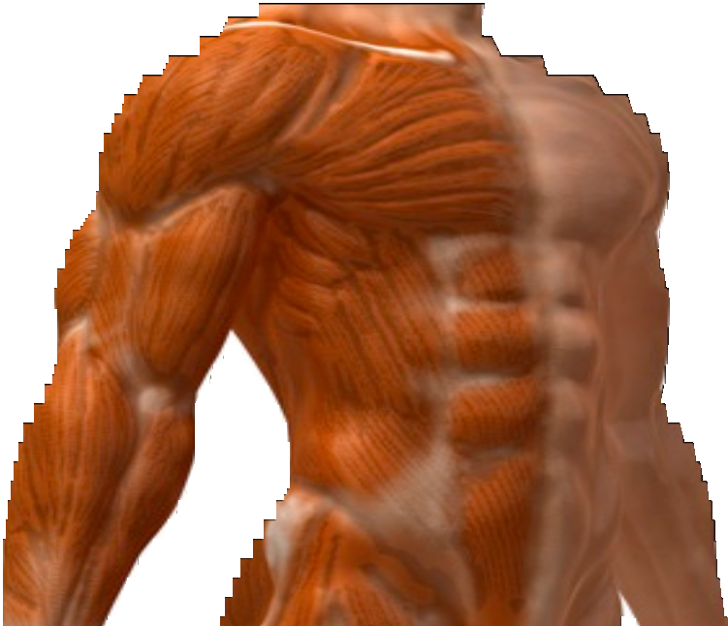



It is our muscles that make us move.
We have hundreds of different muscles in our bodies. Muscles are made of lots of small stretchy fibres grouped together. Muscles come in three groups:
Smooth muscles: these are the muscles that move without you controlling them, such as those in your digestive system.
Cardiac muscles: these are the muscles that control the heart and help to pump your blood around your body.
Skeletal muscles: these muscles are attached to bones and are the muscles that you can move when you want to. You can use your skeletal muscles to kick a ball, walk, hold a pen, and for lots of other things.
BACK
NEXT
www.planbee.com

Slide 5
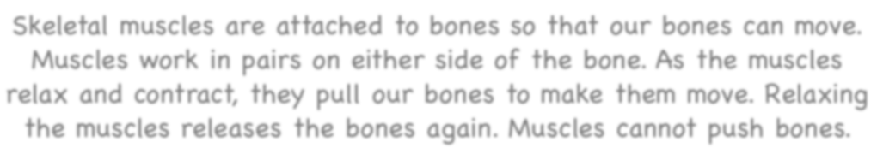
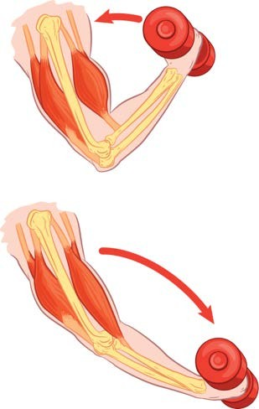
Skeletal muscles are attached to bones so that our bones can move.
Muscles work in pairs on either side of the bone. As the muscles relax and contract, they pull our bones to make them move. Relaxing the muscles releases the bones again. Muscles cannot push bones.
This muscle is called the extensor. As the flexor contracts, this muscle relaxes to allow the bone to move.
This muscle is called the flexor. It contracts to make it smaller. As it is attached to the forearm, it pulls the forearm upwards as it contracts.
As this muscle relaxes, it gets longer. This allows the arm to move back down again.
This muscle contracts again as the flexor relaxes.
BACK
NEXT
www.planbee.com

Slide 6
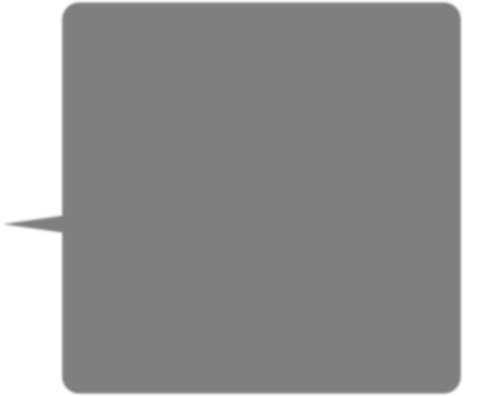

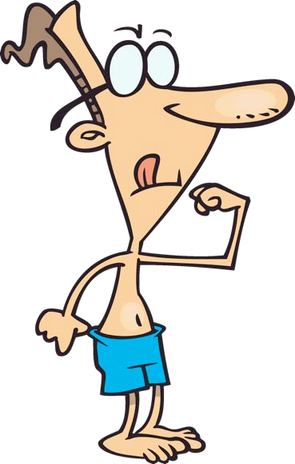







Did you know that your body has more than 600 muscles?
Can you name any of the major muscle groups? Let’s have a look. .
BACK
NEXT
www.planbee.com

Slide 7
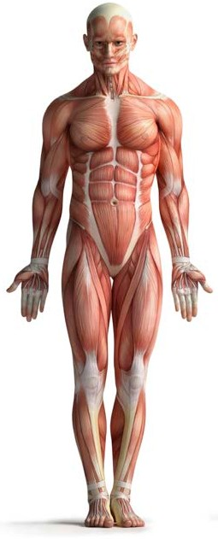
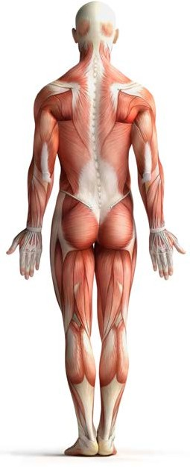
trapezius
deltoids (delts)
pectorals (pecs)
biceps
latissimus dorsi (lats)
triceps
rectus abdominis (abs)
obliques
gluteals (glutes)
biceps femoris (hamstrings)
quadriceps (quads)
gastrocnemius (calves)
BACK
NEXT
www.planbee.com

Slide 8
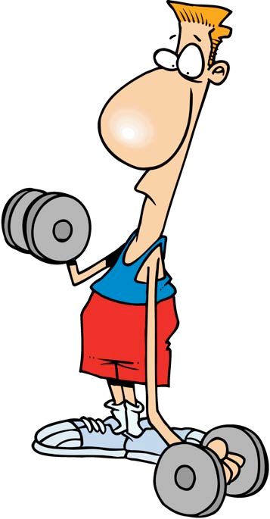
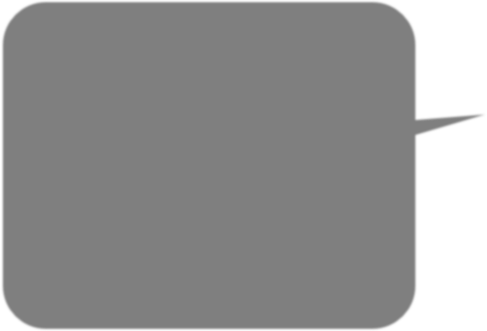






Let’s try some exercises to see what happens to our muscles. As you exercise your muscles,
think about how they feel and why this might be.
BACK
NEXT
www.planbee.com

Slide 9
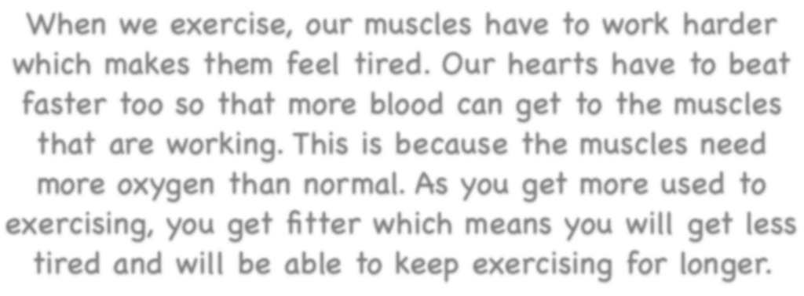
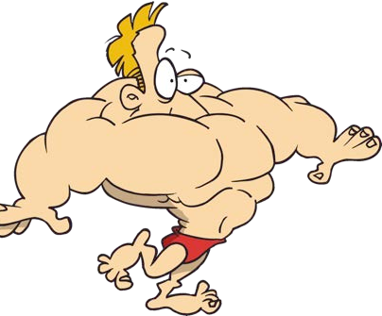


When we exercise, our muscles have to work harder which makes them feel tired. Our hearts have to beat faster too so that more blood can get to the muscles that are working. This is because the muscles need more oxygen than normal. As you get more used to exercising, you get fitter which means you will get less tired and will be able to keep exercising for longer.
Have a look at the pictures on the next slides. Which muscles do you think are working the hardest?
Which parts of the body would have most blood flowing to them?
BACK
NEXT
www.planbee.com

Slide 10
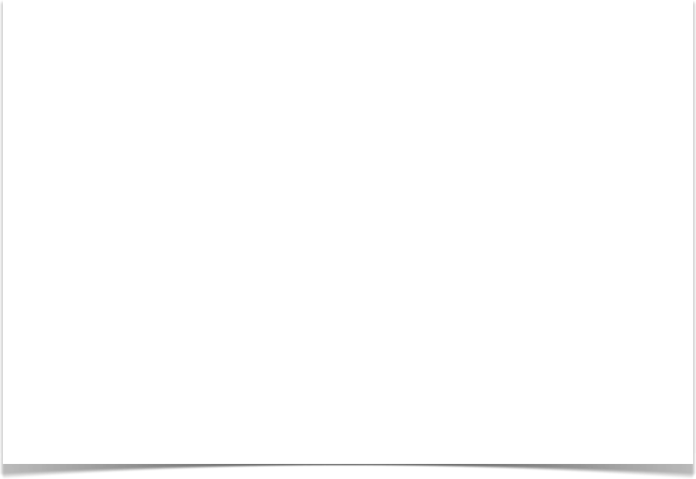
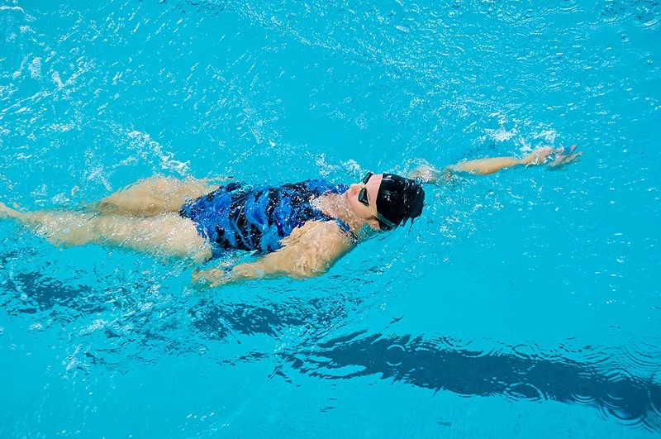
BACK
NEXT
www.planbee.com

Slide 11
trapezius
deltoids (delts)
pectorals (pecs)
biceps
latissimus dorsi (lats)
triceps
rectus abdominis (abs)
obliques
gluteals (glutes)
biceps femoris (hamstrings)
quadriceps (quads)
gastrocnemius (calves)
BACK
NEXT
www.planbee.com

Slide 12
This video shows you how backstroke uses your muscles:
https://www.youtube.com/watch?v=zpCByHvKmUM&feature=youtu.be

Slide 13

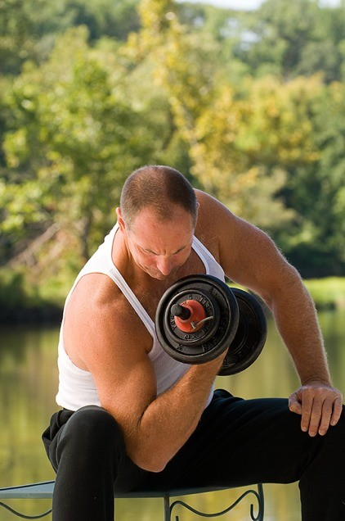
BACK
NEXT
www.planbee.com

Slide 14
trapezius
deltoids (delts)
pectorals (pecs)
biceps
latissimus dorsi (lats)
triceps
rectus abdominis (abs)
obliques
gluteals (glutes)
biceps femoris (hamstrings)
quadriceps (quads)
gastrocnemius (calves)
BACK
NEXT
www.planbee.com

