Slide 1

Lesson one:
Mount Everest

Slide 2
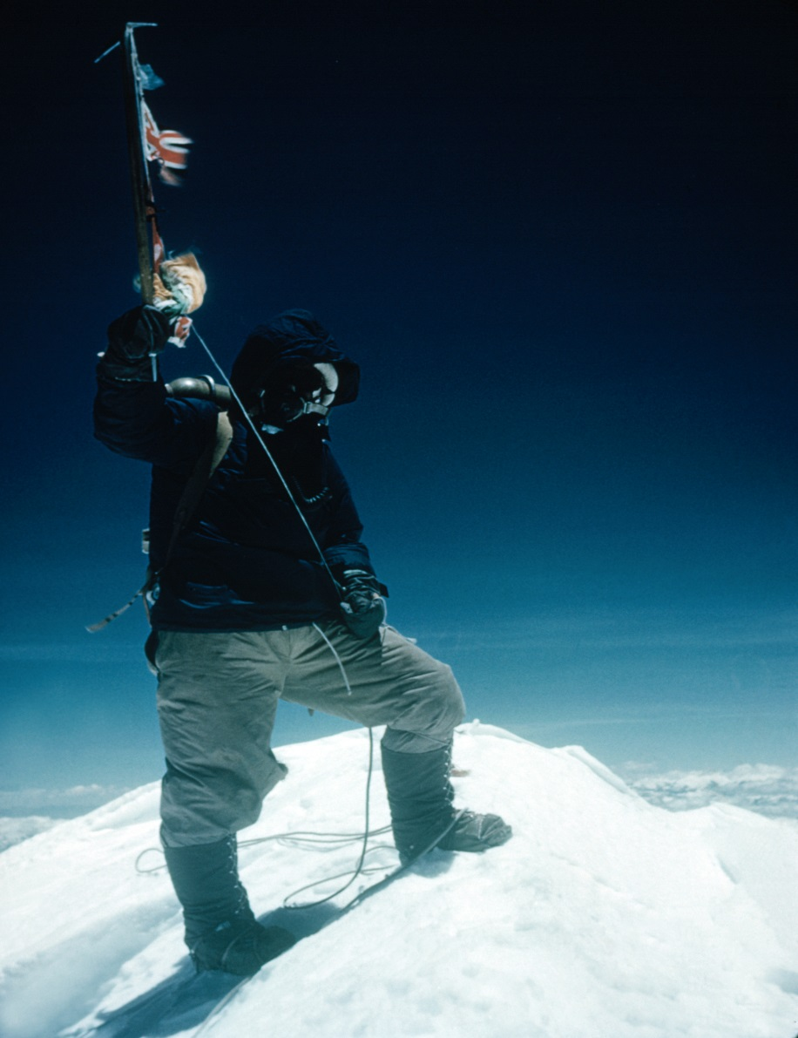
© RGS-IBG S0001056

Slide 3
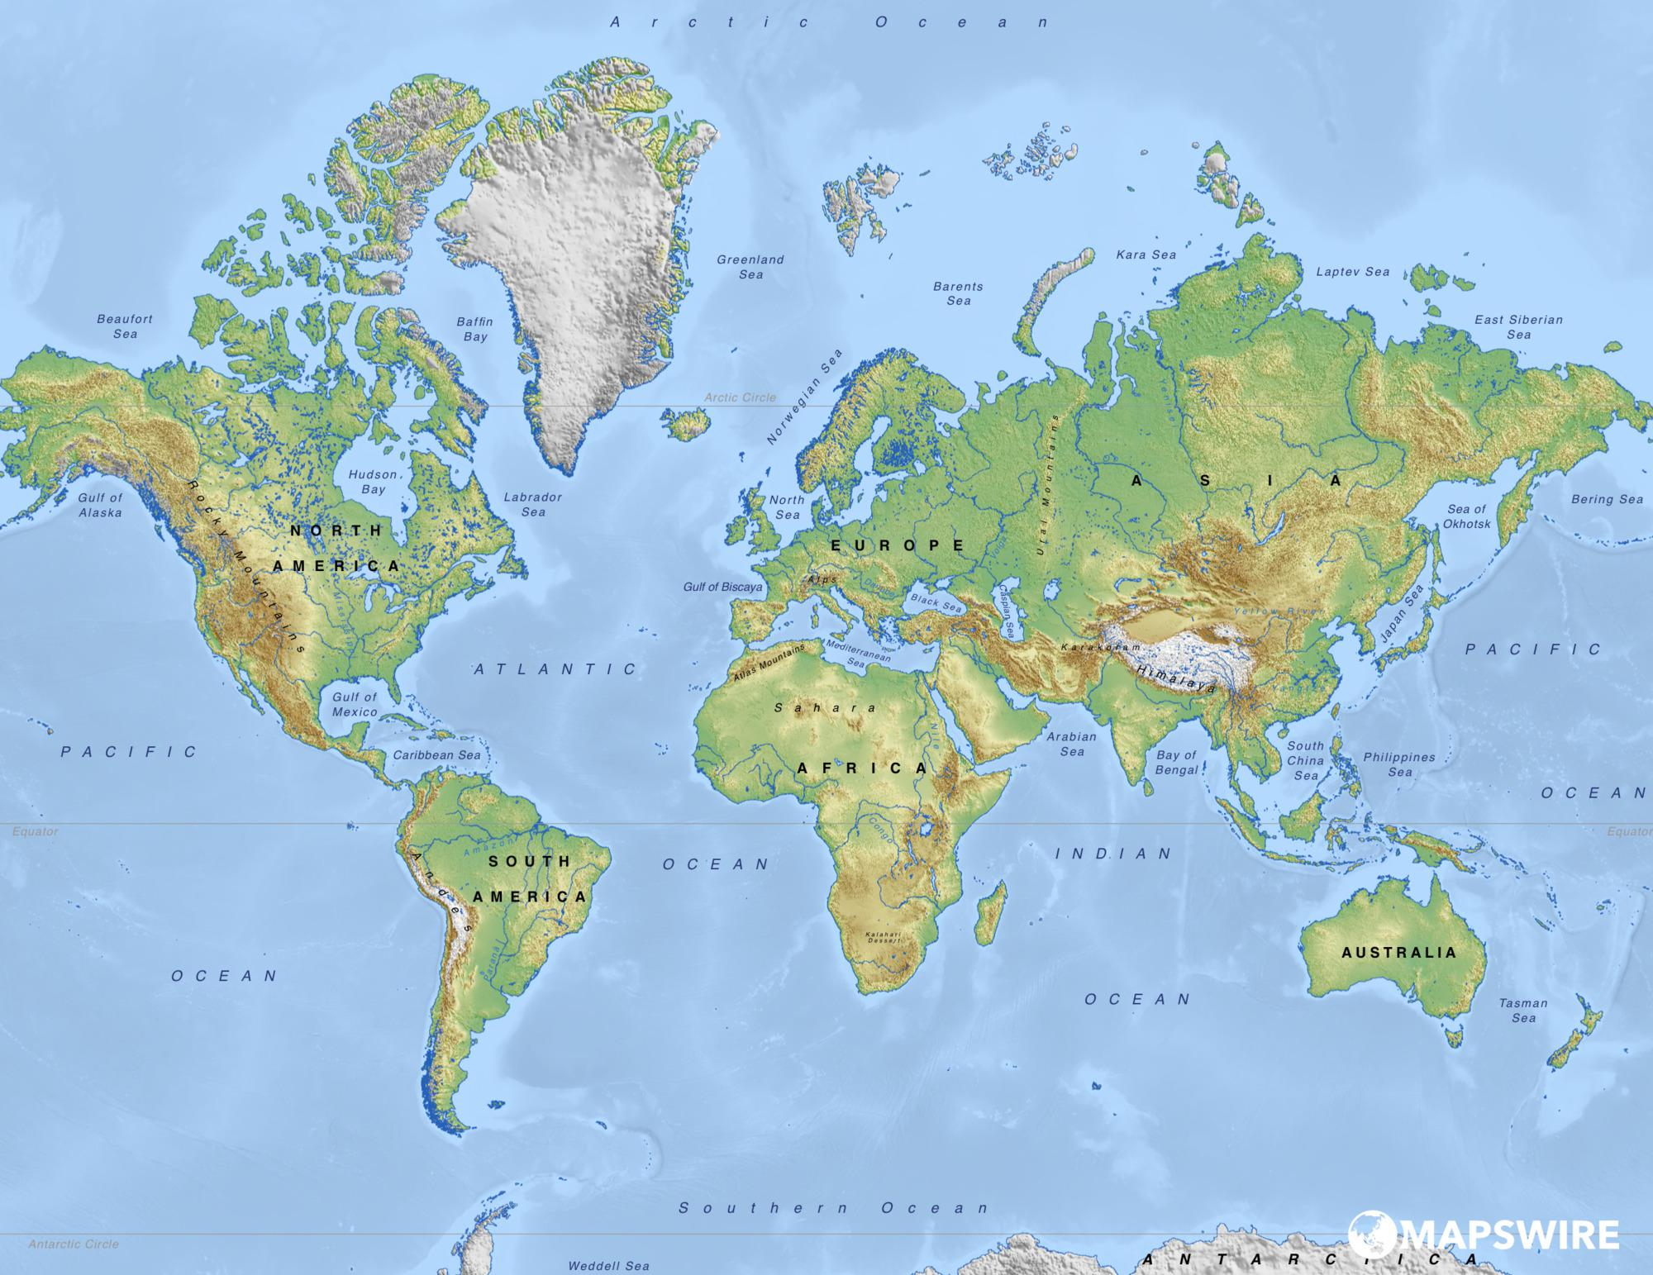
Where is Mount Everest?
This Photo by Unknown Author is licensed under CC BY

Slide 4
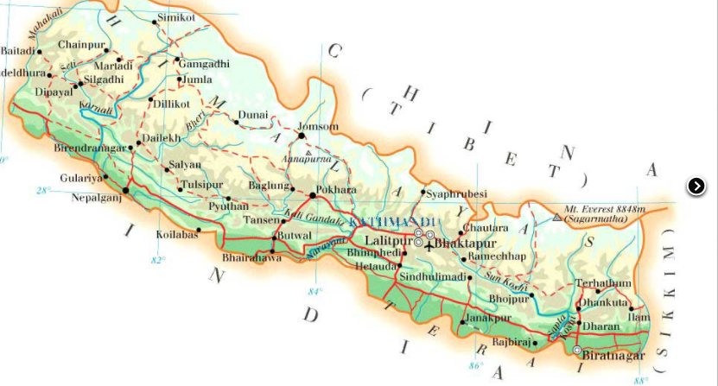

Slide 5
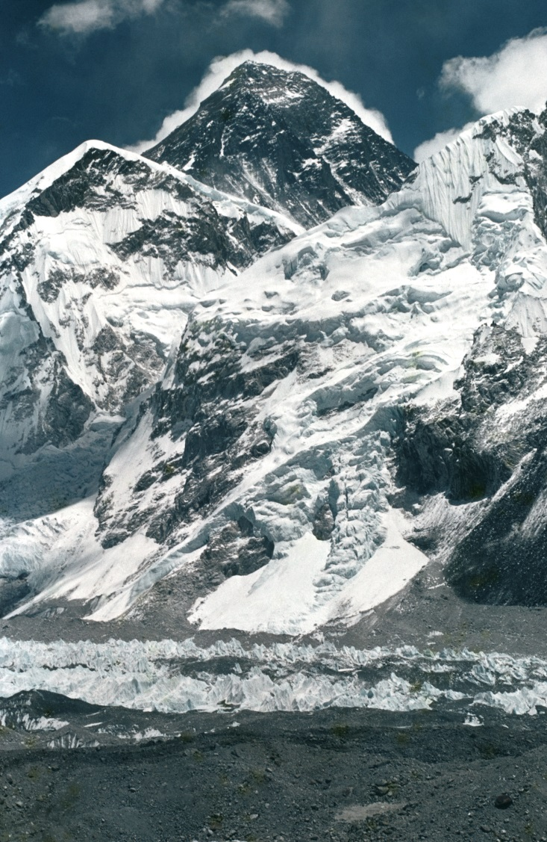
Mount Everest
Mount Everest © RGS-IBG, S0001353

Slide 6
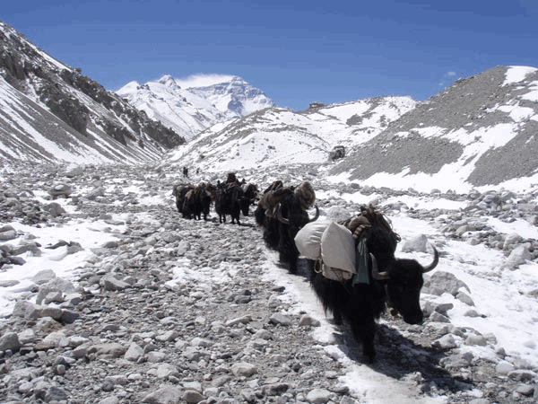
Yaks on the mountain

Slide 7
Mount Everest: naming the features
Peak or Summit
Ridge
Glacier
Moraine
Mount Everest © RGS-IBG, S0001353

Slide 8
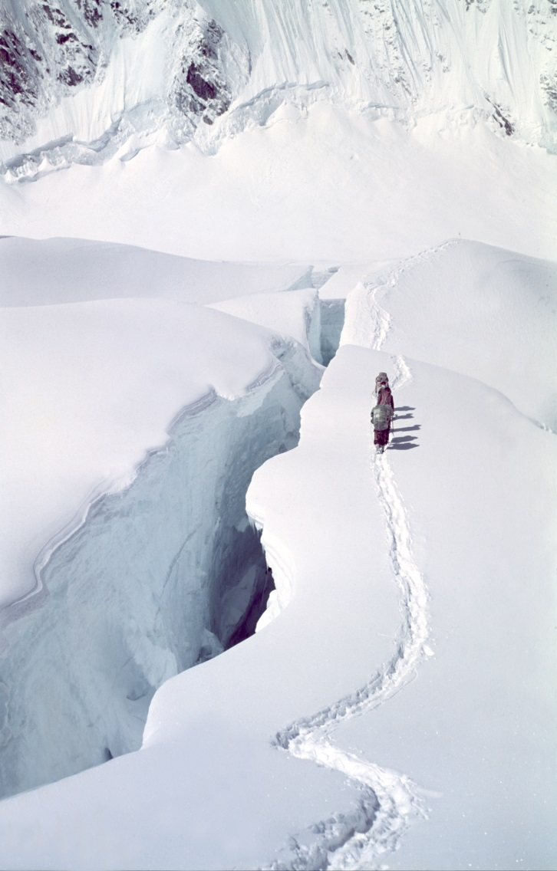
A crevasse
The Western Cwm Party S0001120 © RGS-IBG

Slide 9
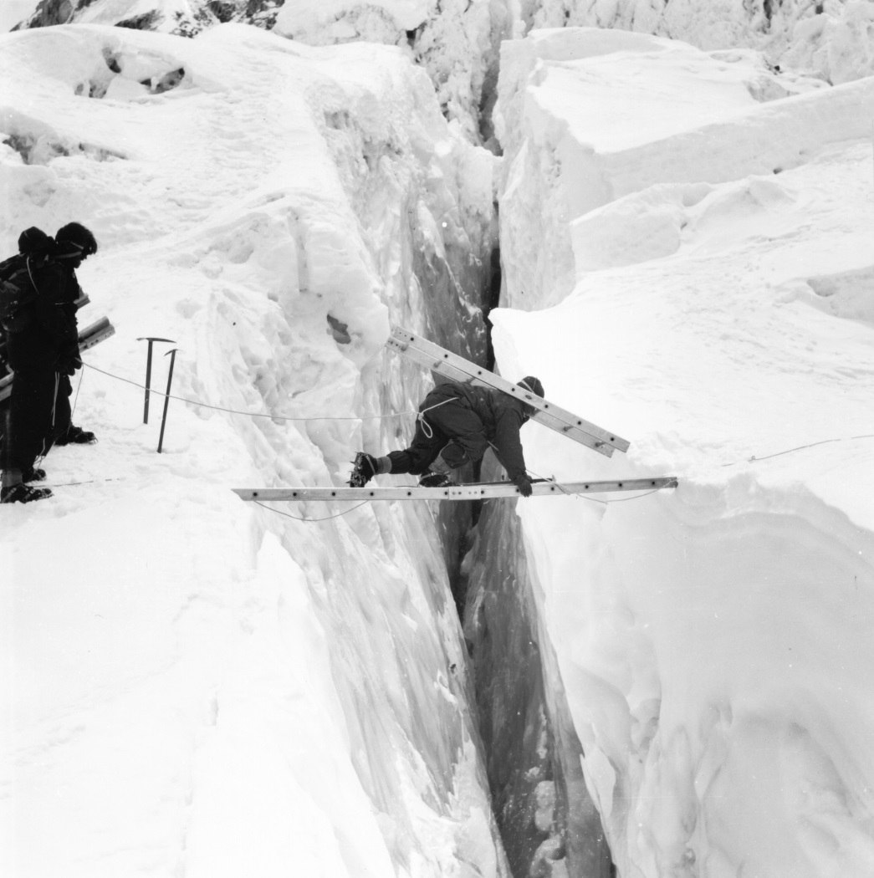
Crossing a crevasse
Image: Sherpa carrying a ladder section across ladder bridge on the Icefall between Camps I and II. Mike Westmacott, 1953.
© RGS-IBG, S0001292

Slide 10
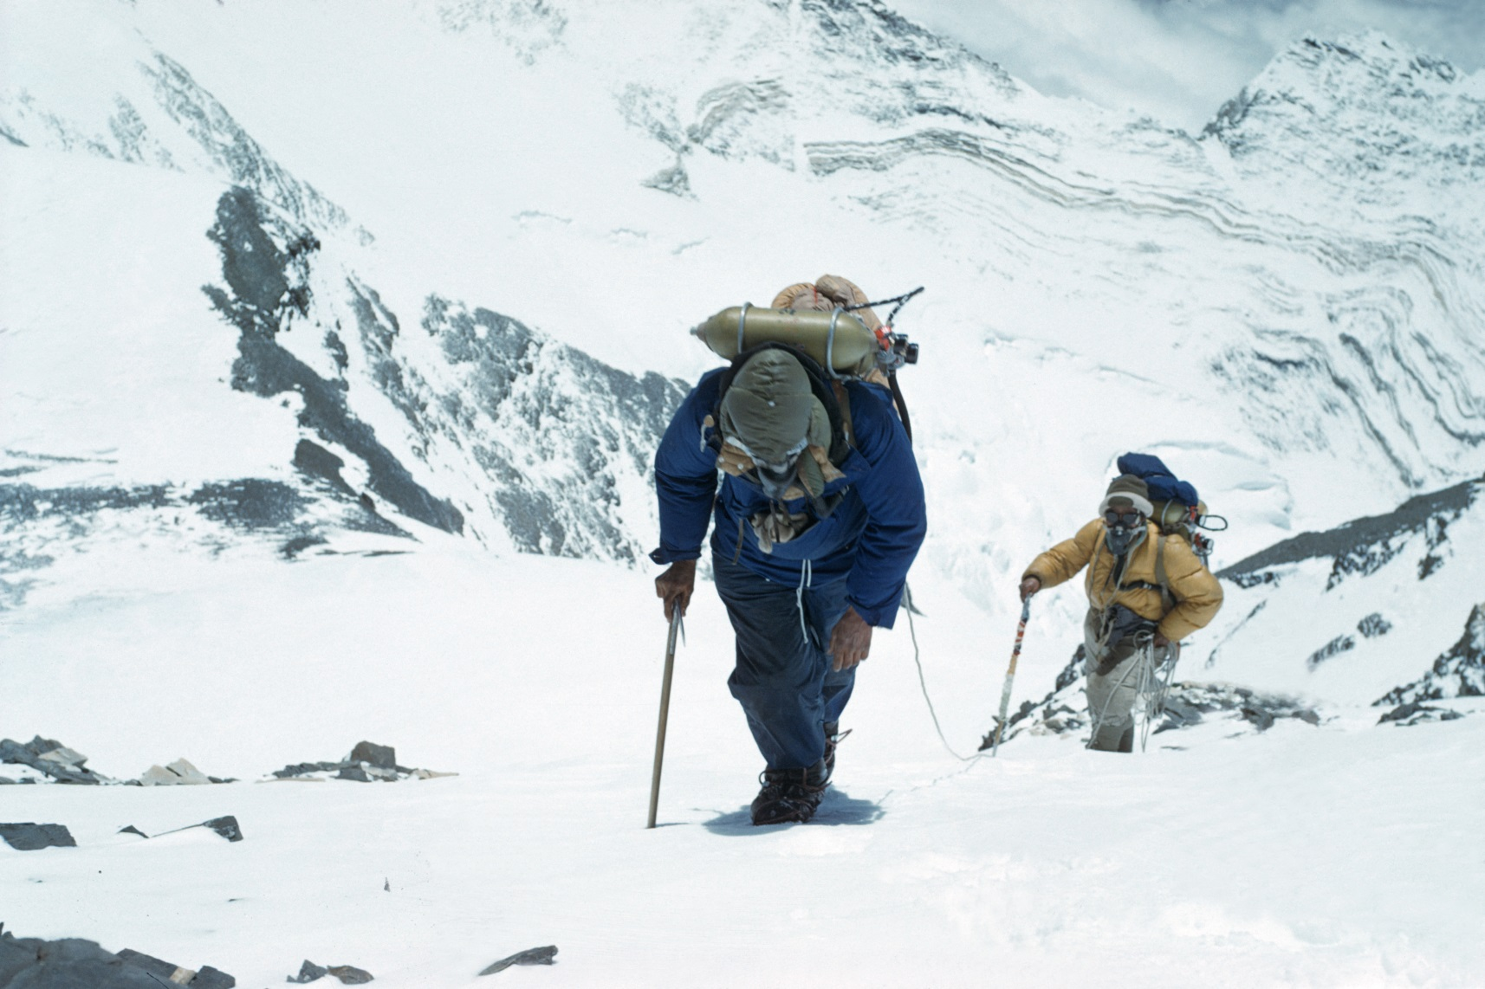
What other dangers does the Everest environment pose?
Edmund Hillary and Tenzing Norgay approach the South East ridge at 27-300 feet © RGS-IBG S0001054

Slide 11
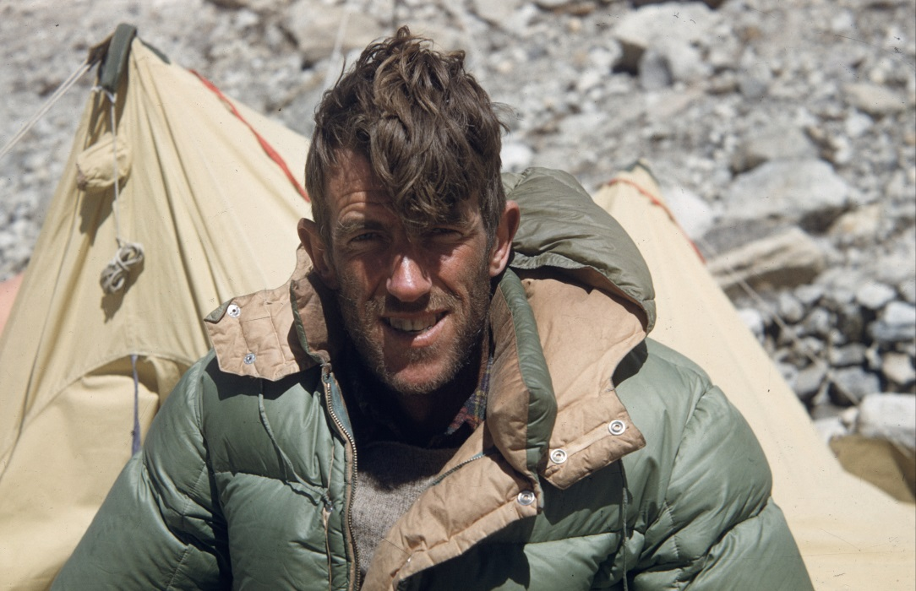
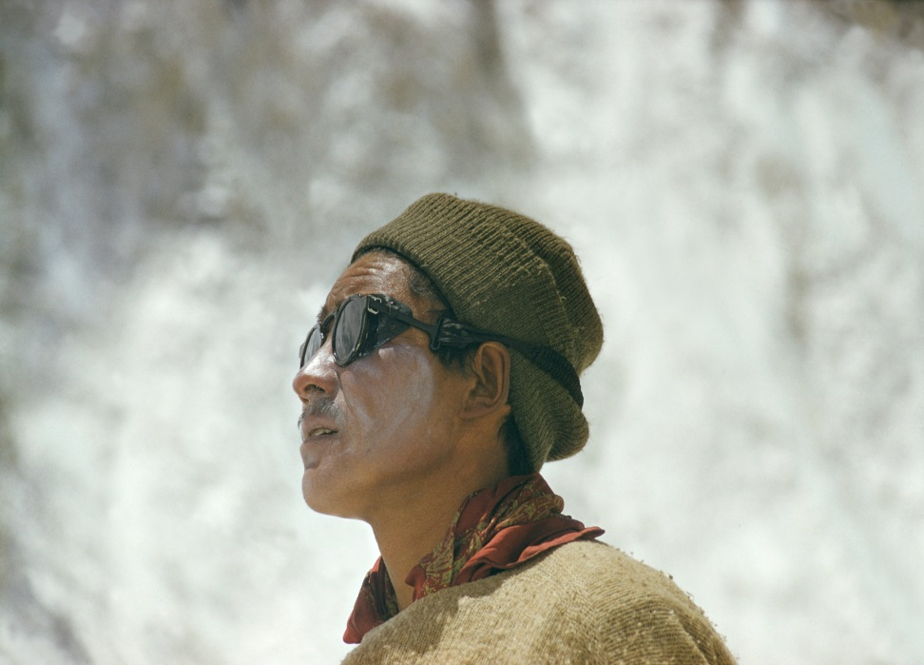
Climbing Mount Everest: the first successful ascent
Portrait of Edmund Hillary © RGS-IBG S0001324
Tenzing Norgay © RGS-IBG S0004902

Slide 12
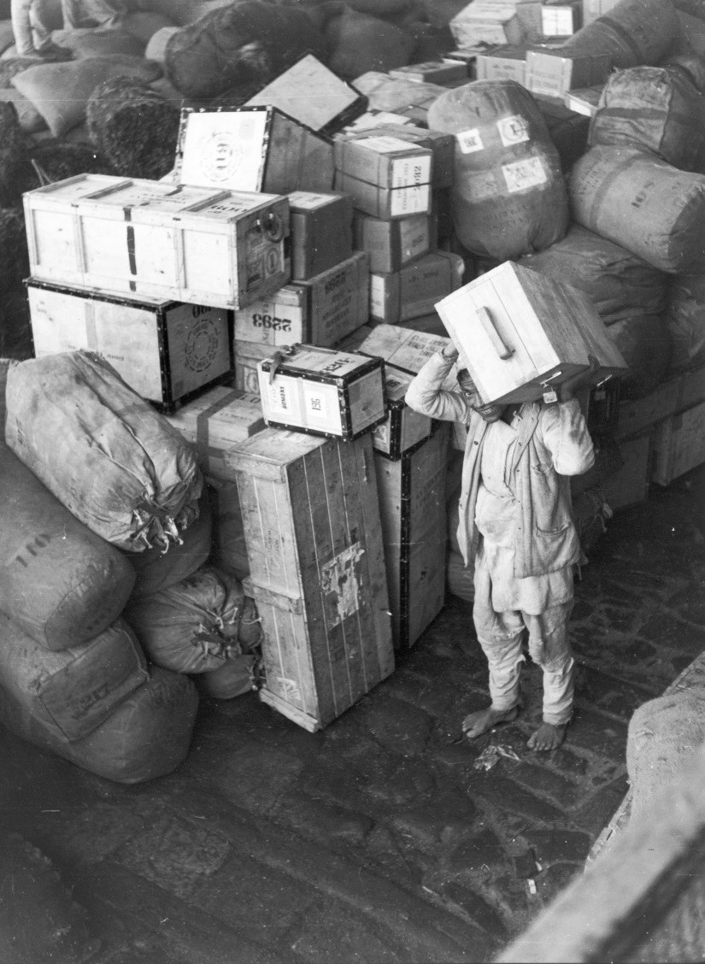
The equipment
Baggage arrives at Tankot © RGS-IBG S0001271

Slide 13
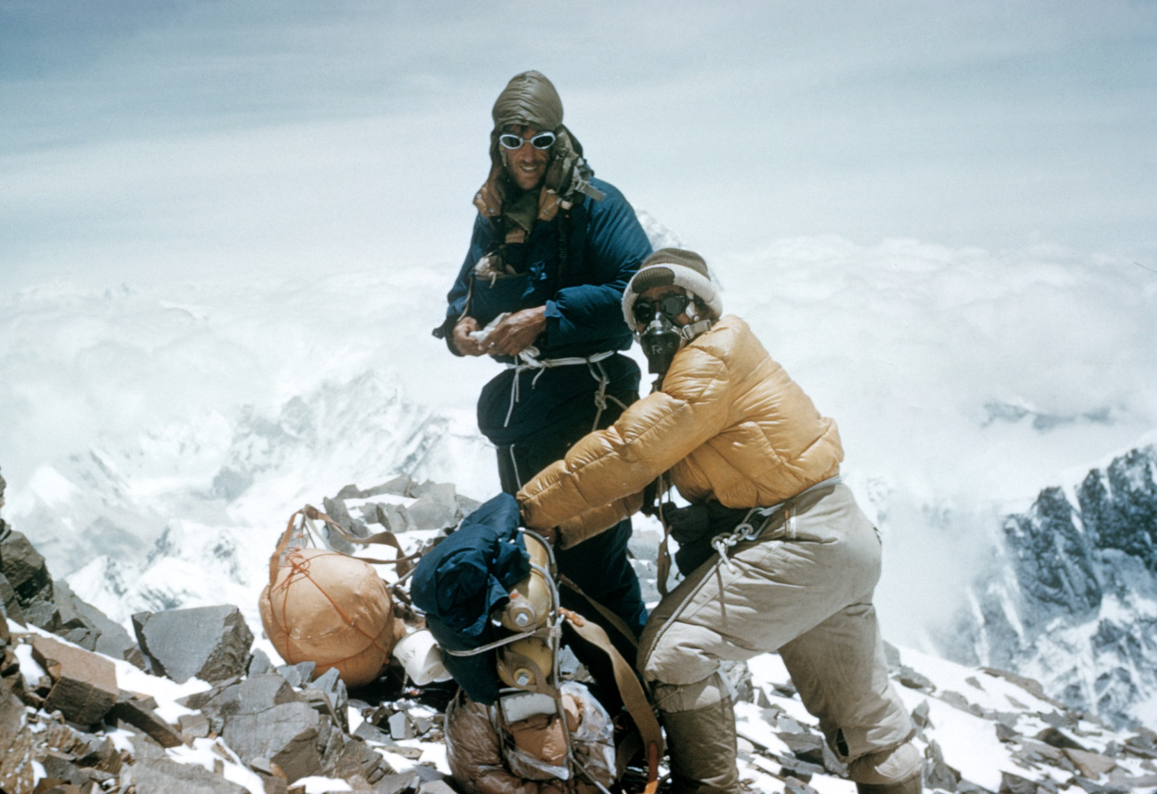
28th May 1953
On their way to establishing Camp 9
Edmund Hillary and Tenzing Norgay on the South-East ridge about to leave to the South Col to establish Camp IX below the South Summit on Everest. The day before they approached the summit of Everest. Alfred Gregory, 28 May 1953.
© RGS-IBG S0001055

Slide 14
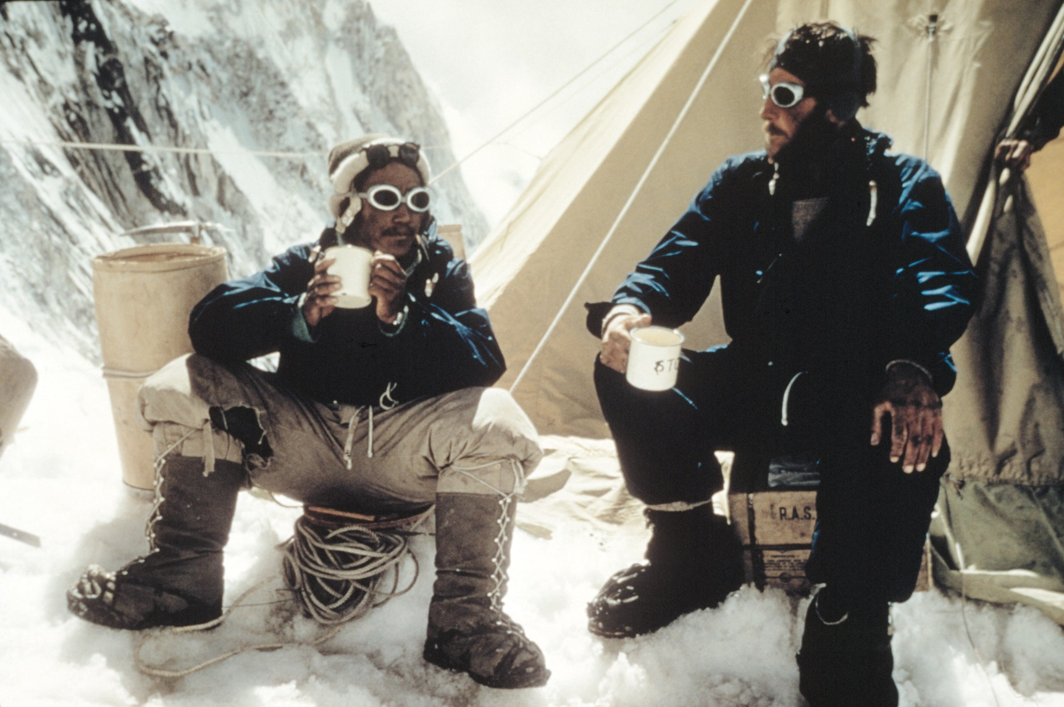
A well earned cup of tea
Tenzing Norgay and Edmund Hillary drink tea in the Western Cwm © RGS-IBG S0001063

Slide 15
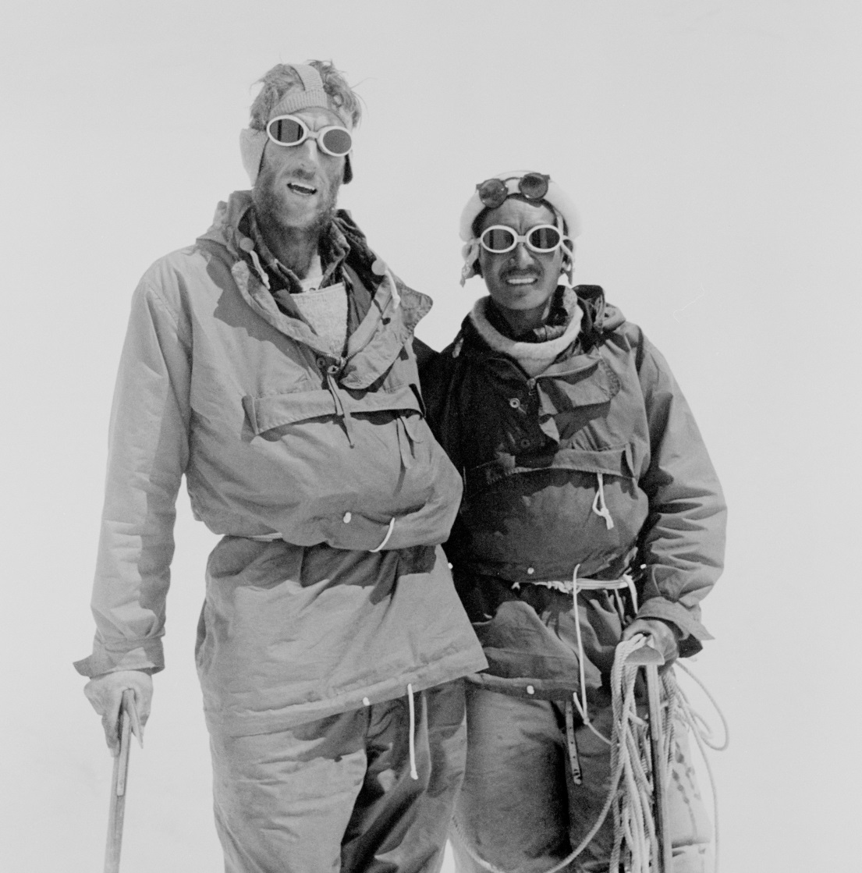
Returning with good news
Hillary and Tenzing Norgay at Camp IV after their ascent of Everest © RGS-IBG S0001173

