Slide 1

Lesson two:
Mapping mountains

Slide 2
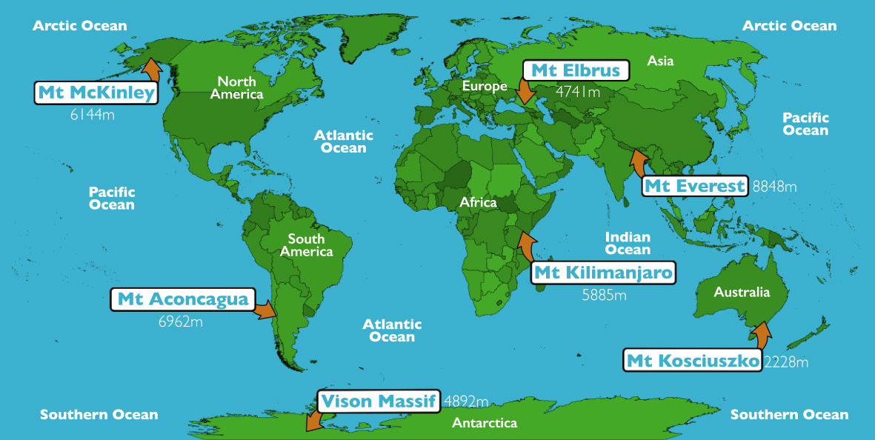
The seven highest peaks

Slide 3
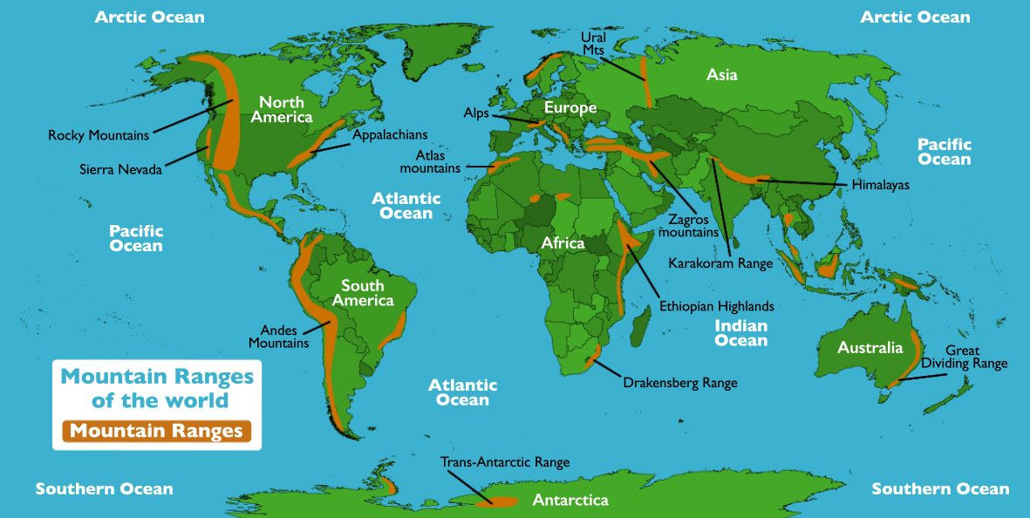
The main mountain ranges

Slide 4
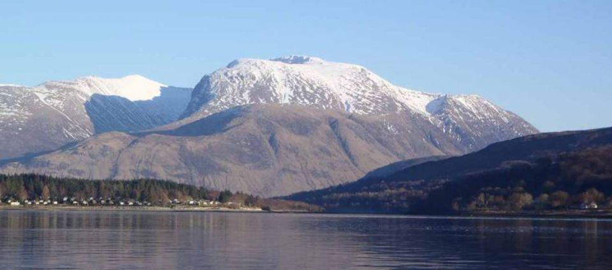
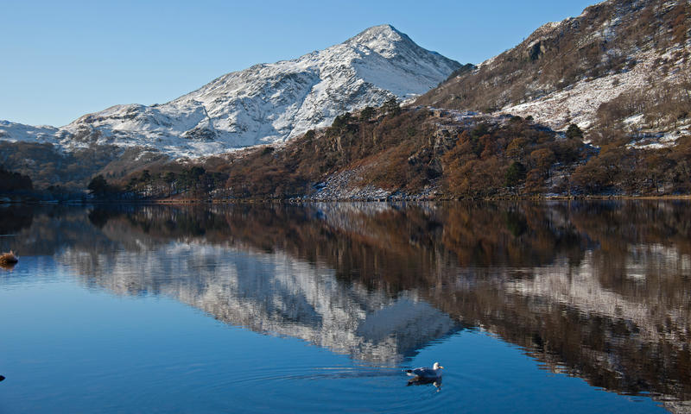
Highest Peaks in the UK
Ben Nevis 1344m
Snowden 1038m

Slide 5
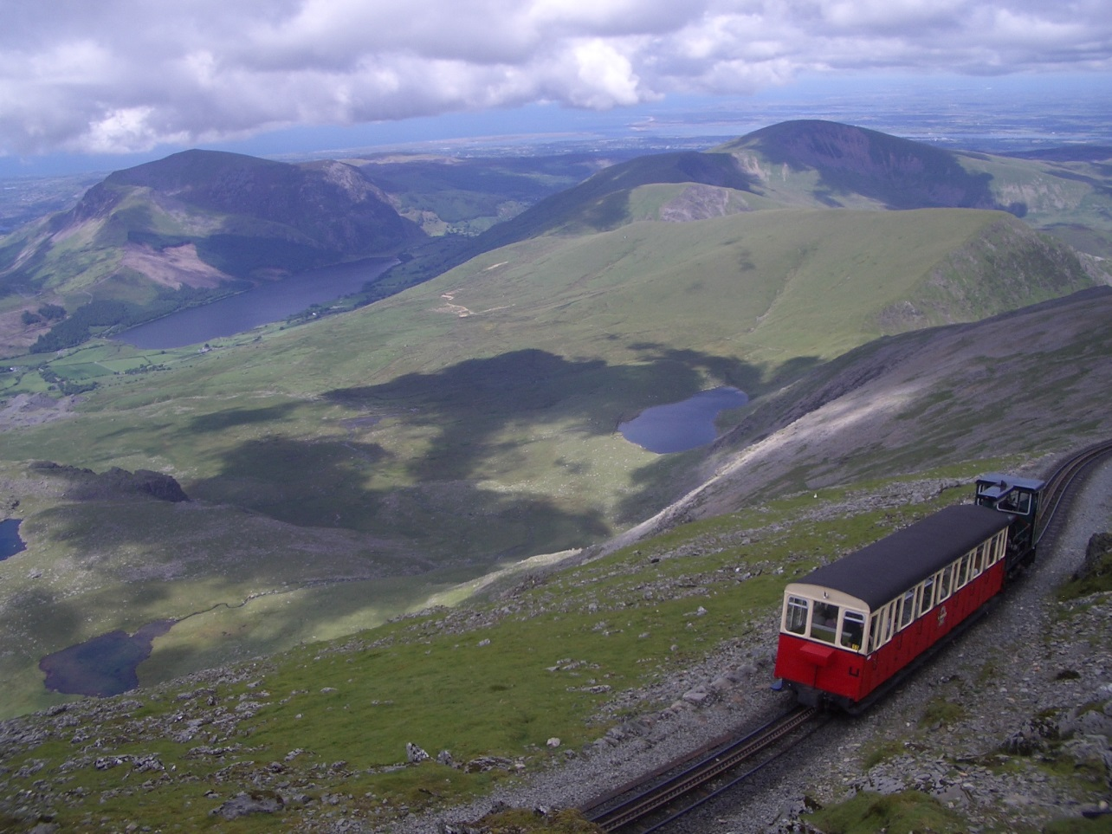
The steam train approaching the summit of Snowdon
Snowdon Mountain Railway near summit © Flickr, Duncan Hull

Slide 6
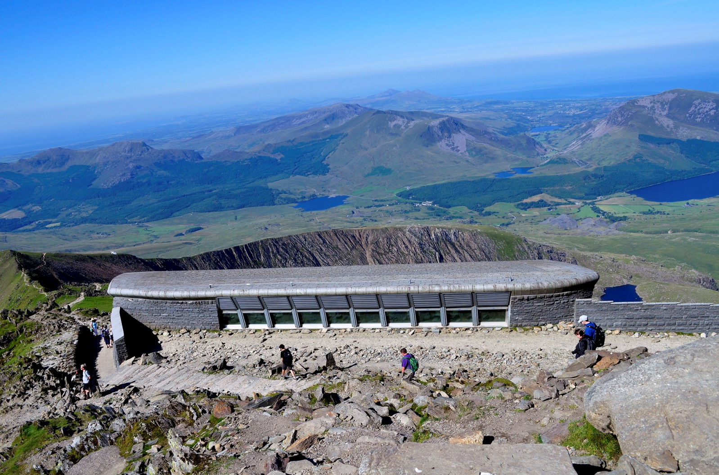
Snowdon summit: Visitor centre and cafe
Top of Mount Snowdon © Flickr, Hefin Owen

Slide 7
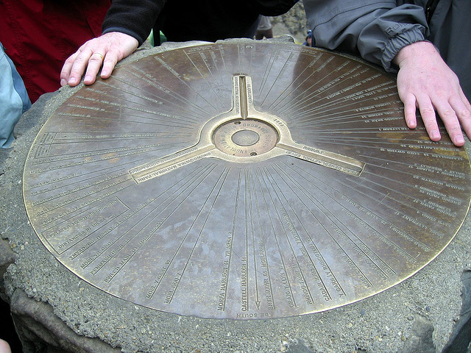
The trig point at the summit of Snowdon
Snowdon Trig Point © Flickr, John Brennan

Slide 8
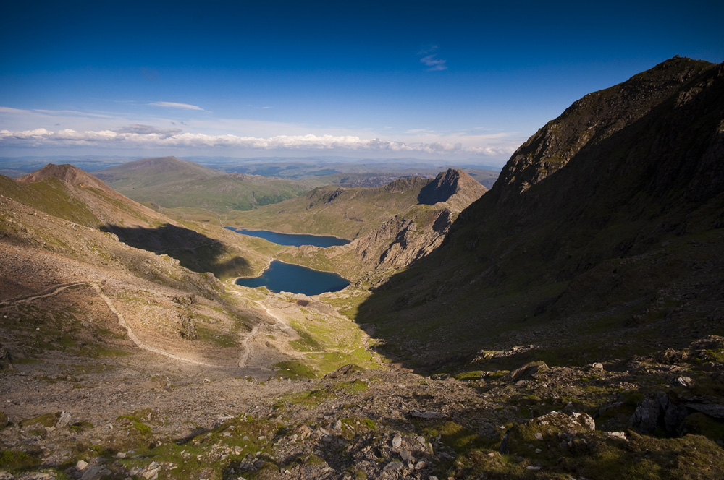
Glaslyn and Llyn Llydaw from Snowdon
Glaslyn © Flickr, Joe Dunckley

Slide 9
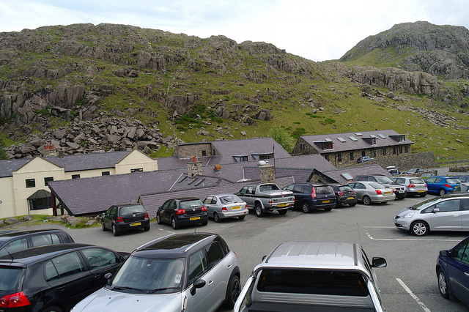
Facilities at Pen-y-Pas
© Flickr, Martin V Morris

Slide 10
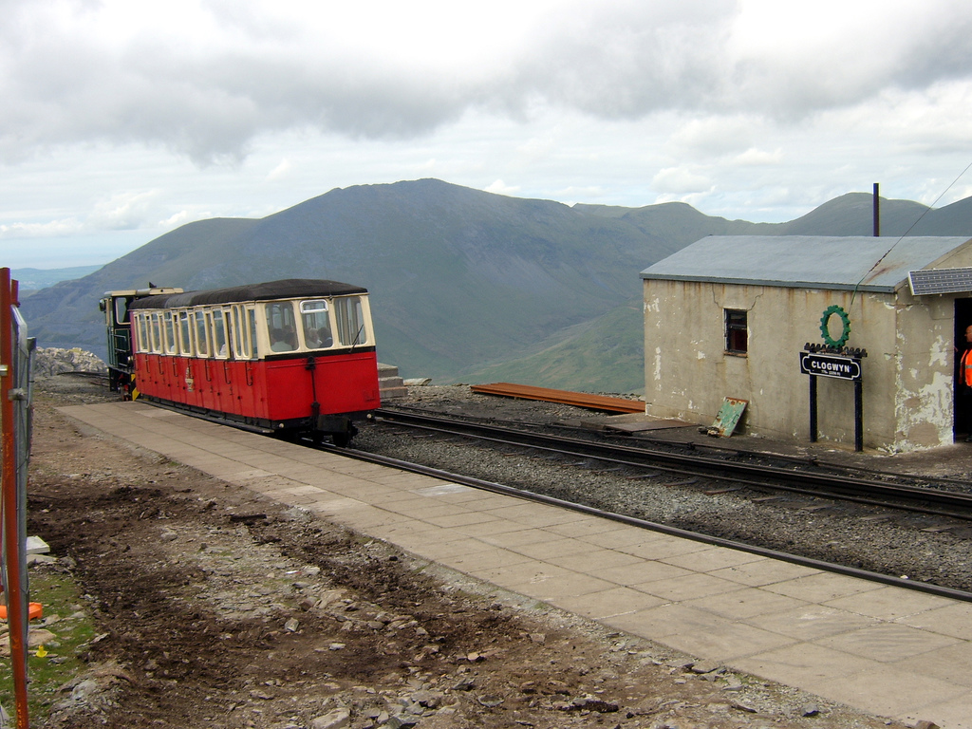
Clogwyn Station
Clogwyn station © Flickr, Neil Turner

