Slide 1

Lesson three: The formation of mountains

Slide 2
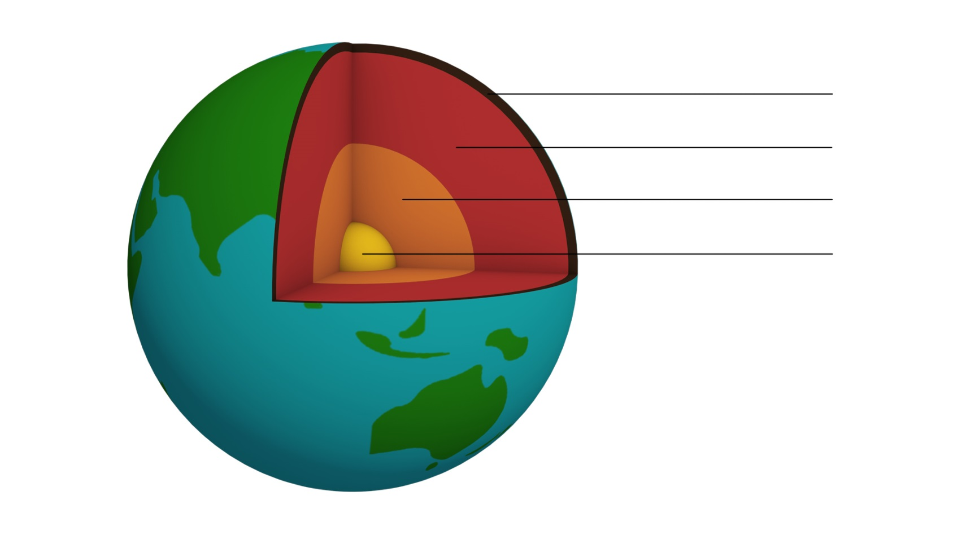

The structure of the Earth

Slide 3
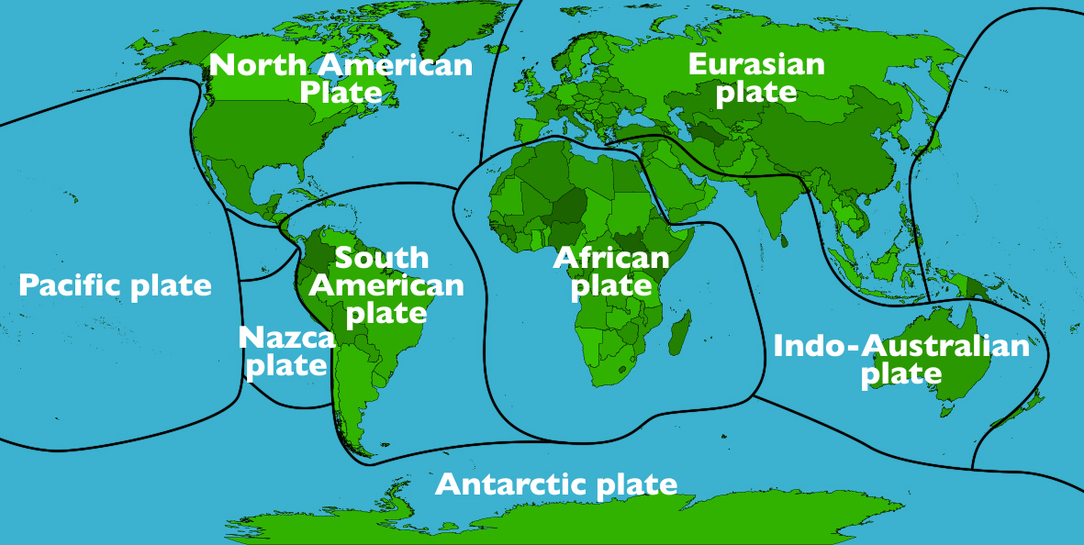
The Earth’s major plates

Slide 4
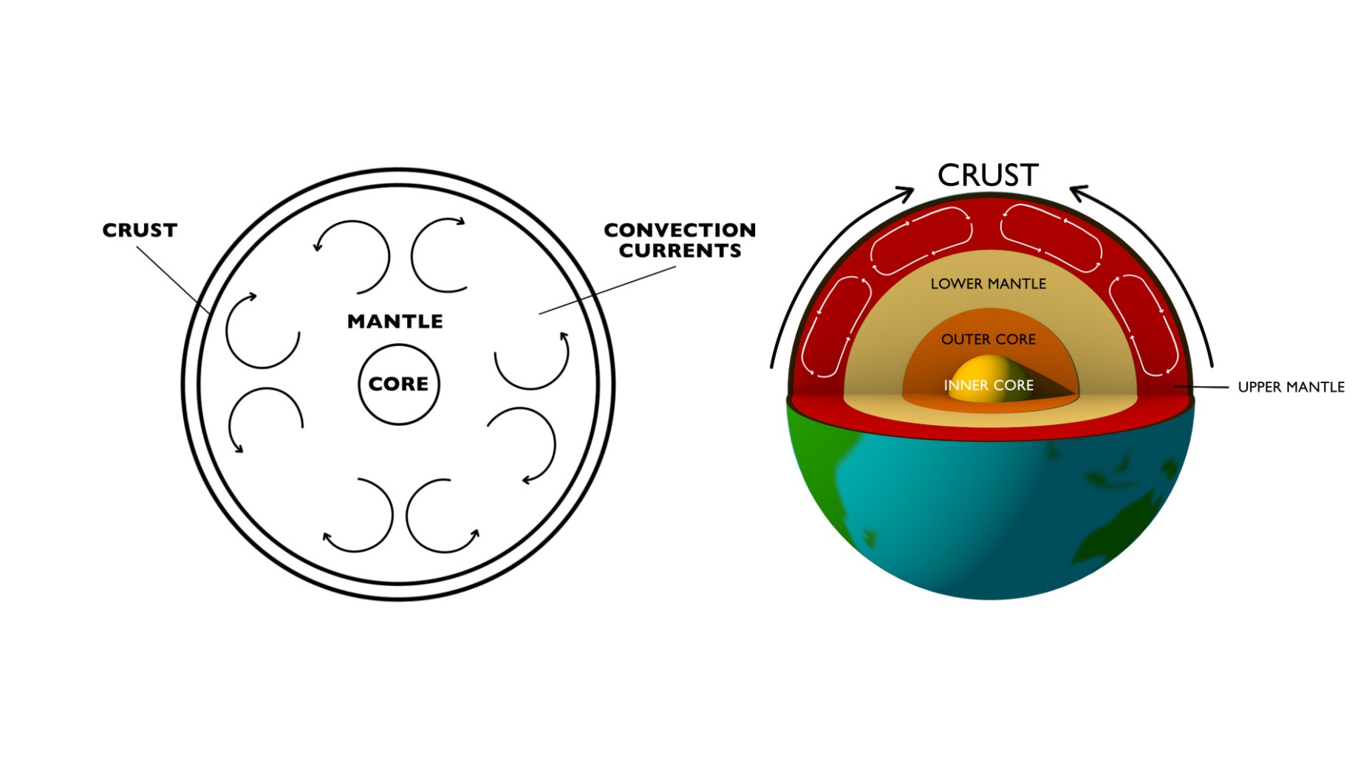
Convection currents

Slide 5
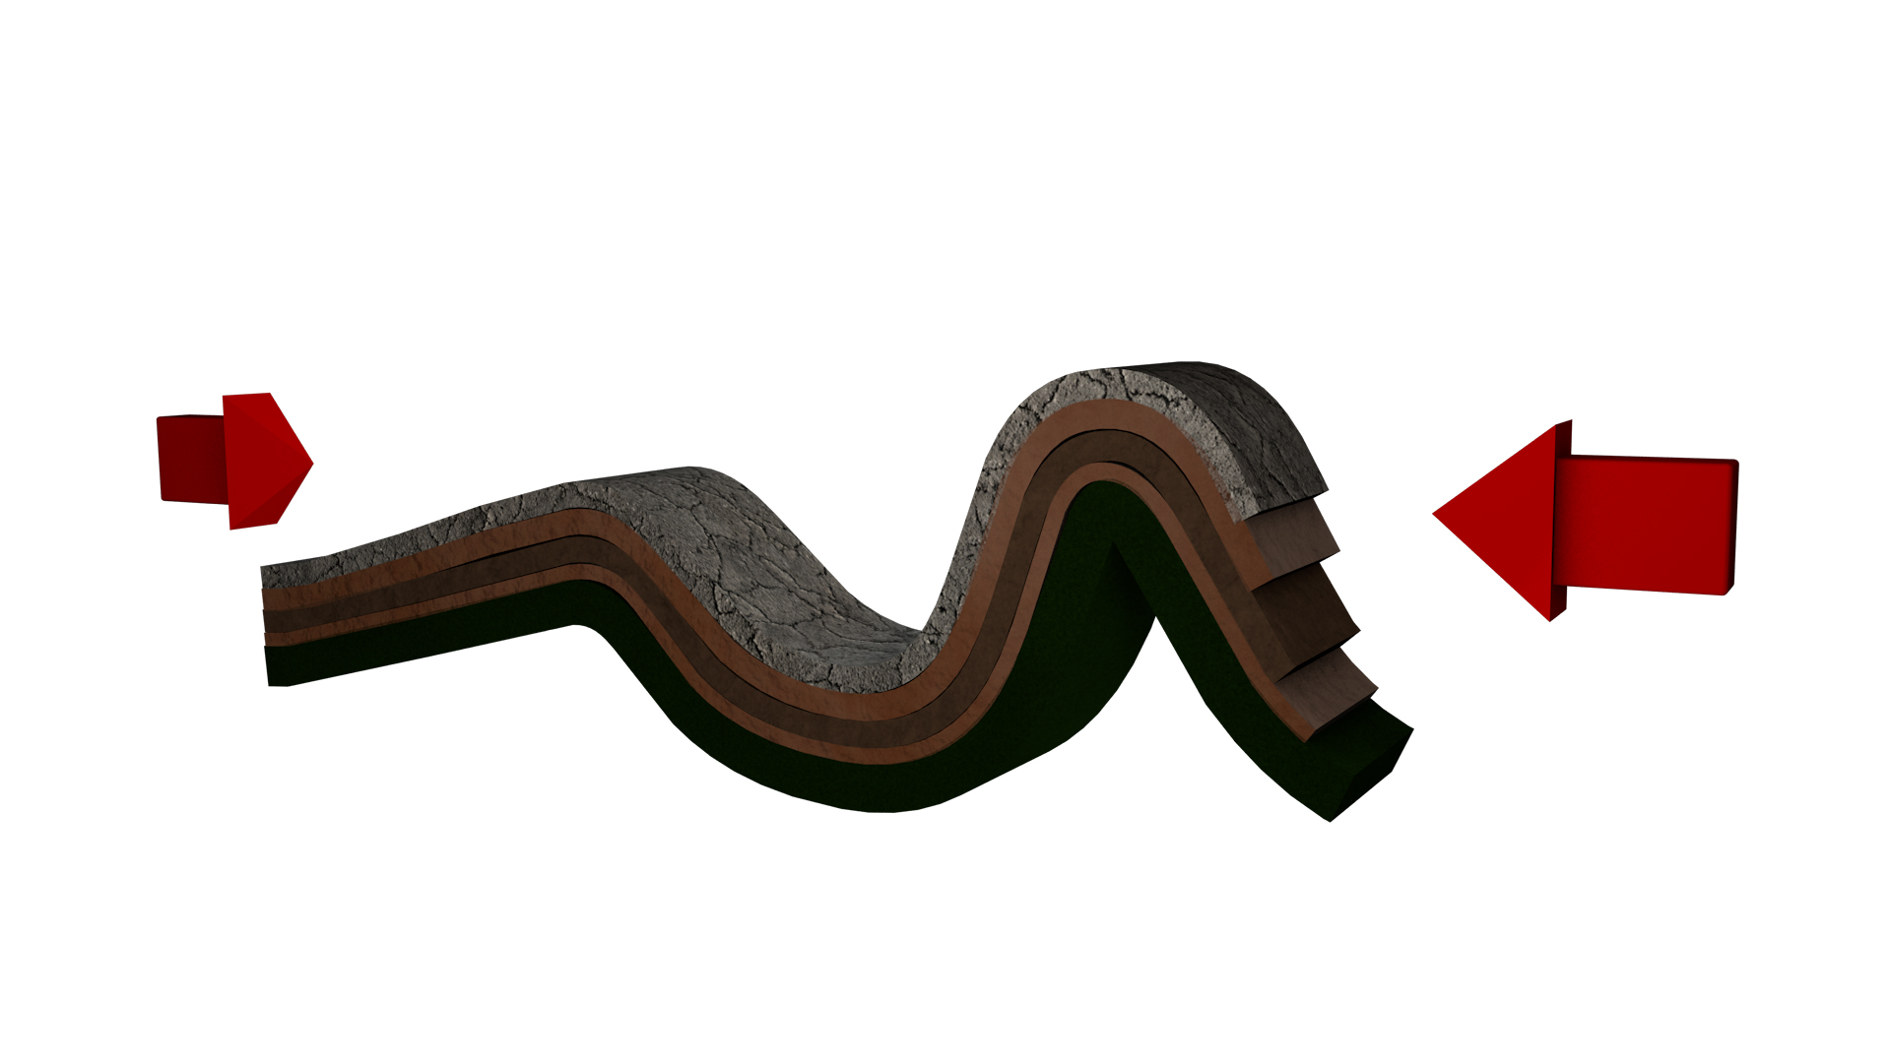
Fold mountains

Slide 6
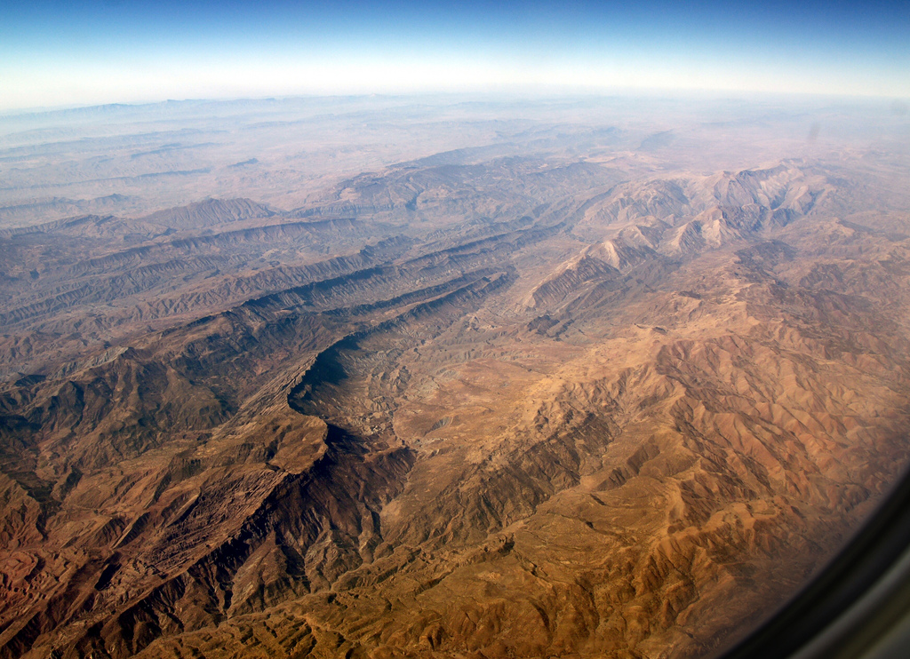
Fold mountain rock formation
Zagros Mountains © Stefan Jürgenson , Flickr

Slide 7
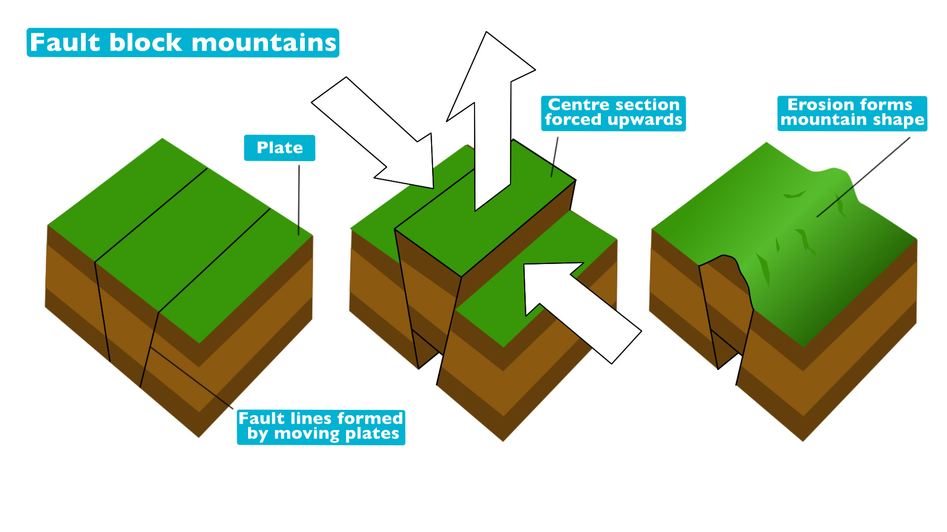
Fault block mountains

Slide 8
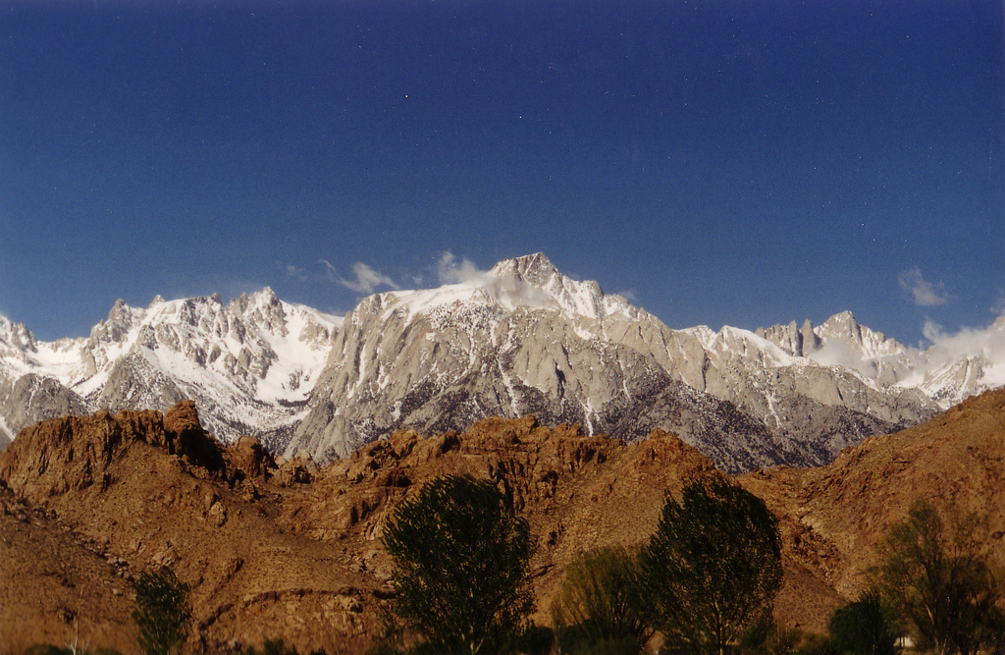
Fault block mountains
Sierra Nevada from the east © Mary, Flickr

Slide 9
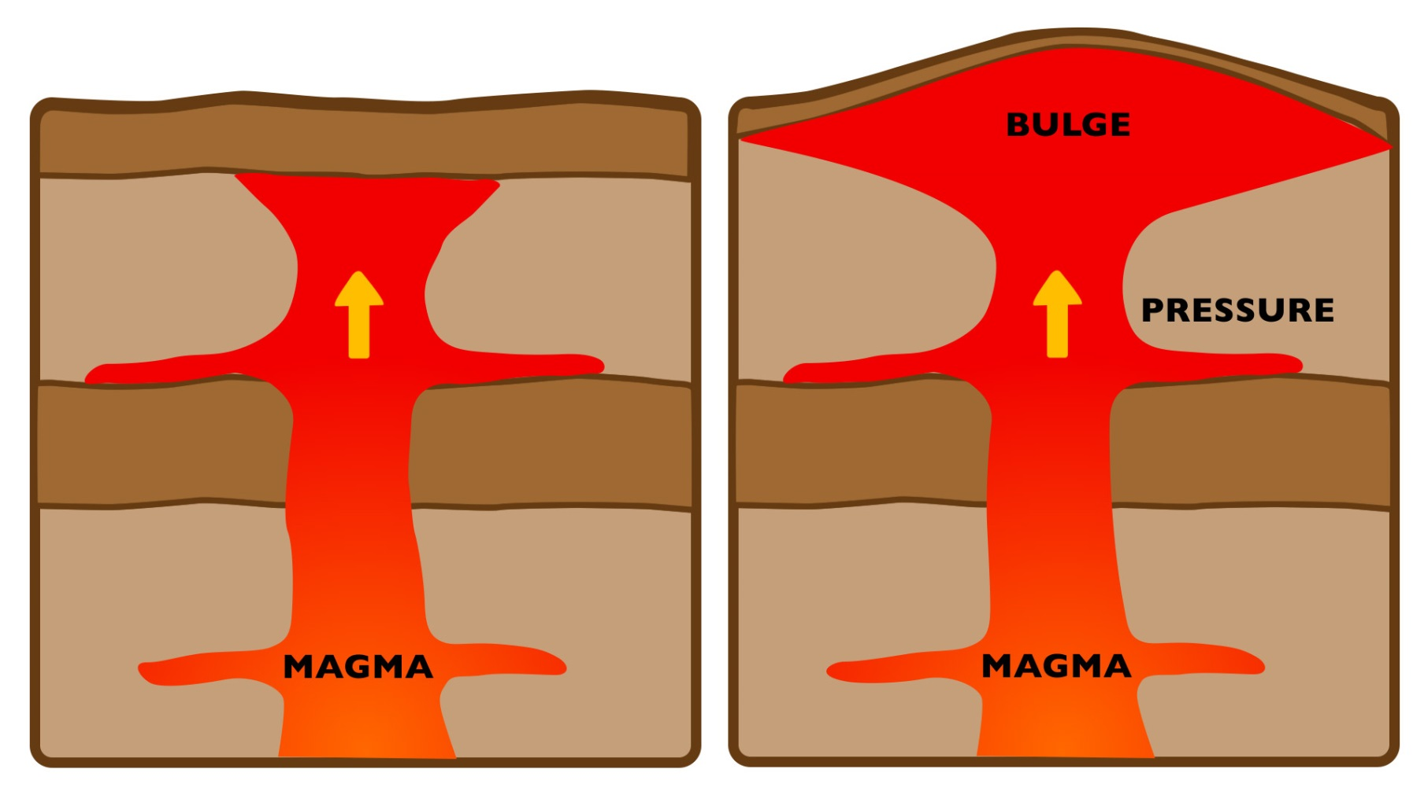
Dome mountains

Slide 10
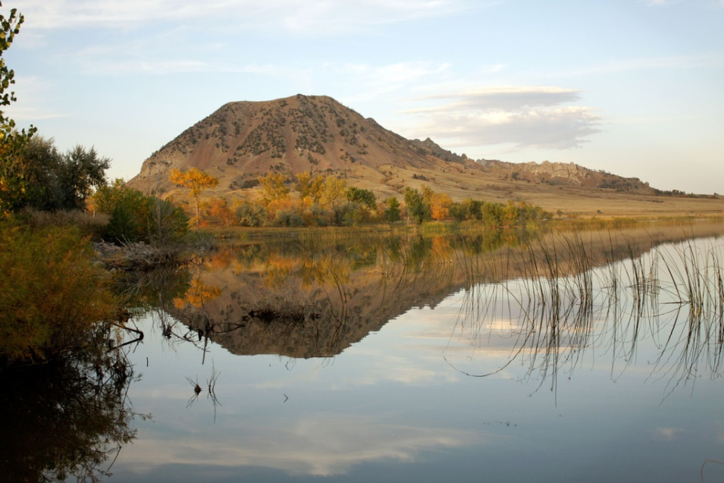
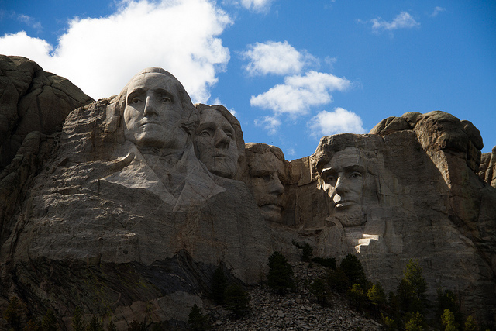
Dome mountains
Bear Butte © Flickr, bl0ndeeo2
Mount Rushmore © Flickr, Paul Weimer

