Slide 1

Poetry
Mountains

Slide 2
What do you know about poetry?
Does it always rhyme?
Is it written like normal sentences?
How long is a poem?

Slide 3
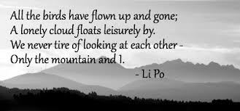
Mountain Poems
Li Po Chinese Poet AD701-762

Slide 4
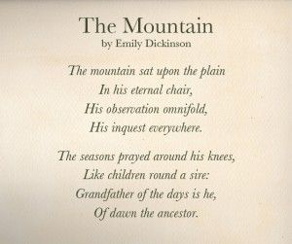
Mountain poems
Emily Dickinson was an American poet
1830-1886

Slide 5
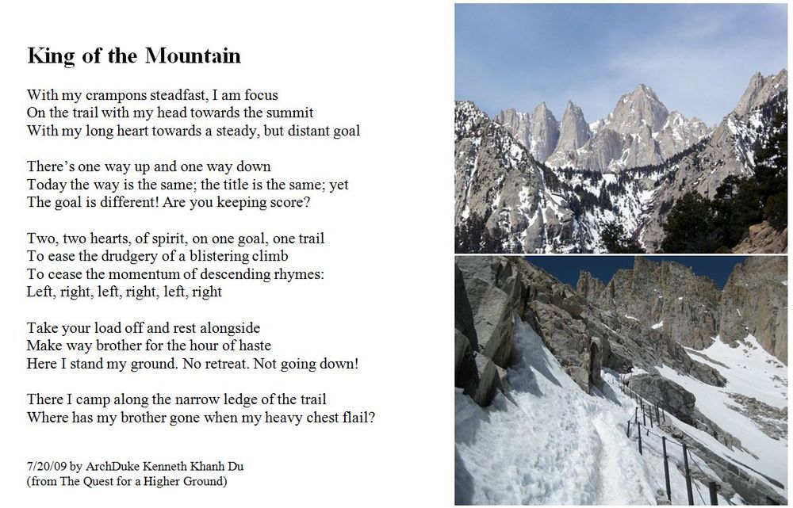
Mountain Poems
Archduke Kenneth Khan Du is a modern poet (he is still alive and writing poetry)

Slide 6
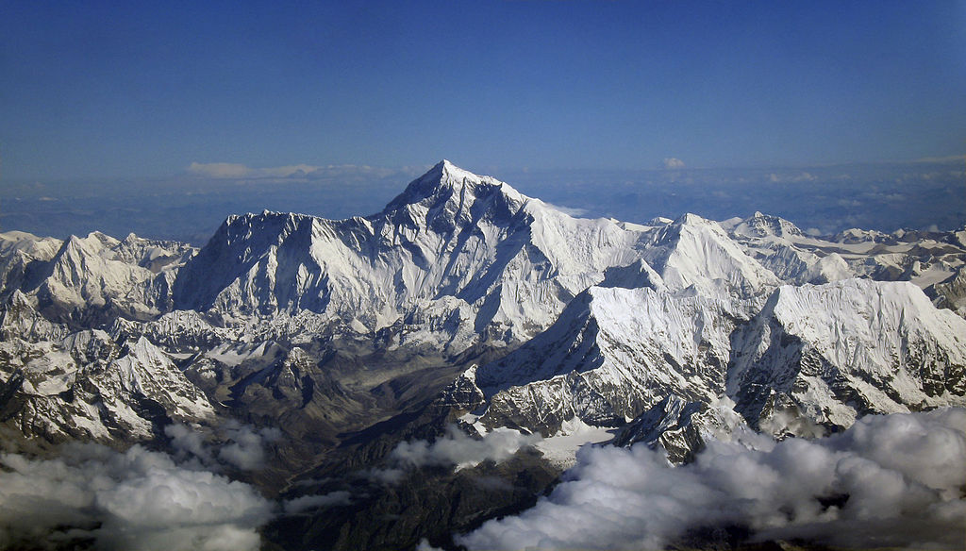
Mountain Poems

Slide 7
Mountain Poems
To give you a real sense of what Mount Everest is like, please watch this video
https://www.youtube.com/watch?v=aFkC7Cd
As you are watching think : what can I see, what can I hear, what can I smell, how do I feel.

Slide 8
Mountain Poems
Now it is your turn to write a poem about Mount Everest.

