Slide 1

LO To explain why Maundy Thursday is important to Christians
Success Criteria
I can tell you what Jesus told his disciples they must do.
I can tell you what the bread and wine represents.
I can tell you who betrayed Jesus.

Slide 2

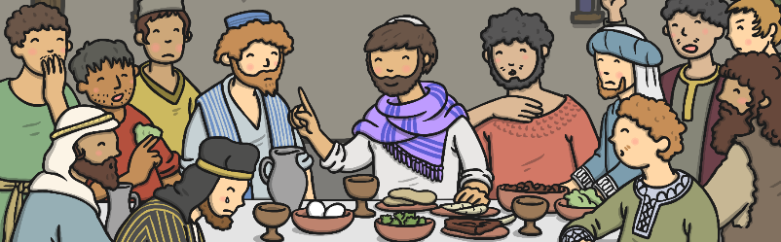
Maundy Thursday and
The Last Supper
Maundy Thursday is the day before Good Friday. It remembers the Last Supper – this was Jesus’s last meal before he died.
The word ‘Maundy’ comes from a word which means ‘command’. At the Last Supper, Jesus told his disciples they must love one another.

Slide 3
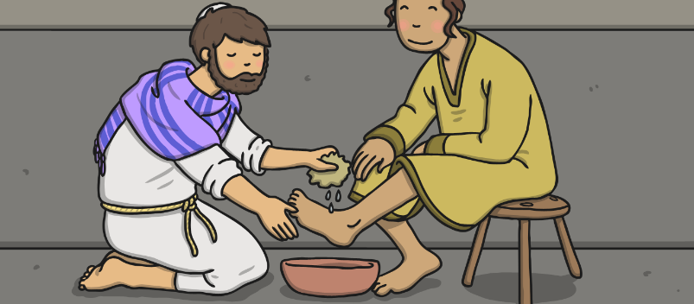
Maundy Thursday
On Thursday, Jesus gathered the disciples together and one a time, he washed their feet. Then Jesus told the disciples they must love one another, as he had loved them, by looking after each other.

Slide 4
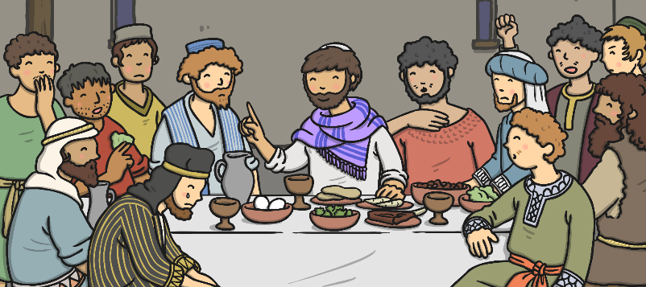
Maundy Thursday
Jesus celebrated Passover with his twelve disciples. Jesus knew he was soon to die and that this meal would be his last. He told his disciples this and they were very sad. He already knew that one of the disciples was going to betray him.

Slide 5
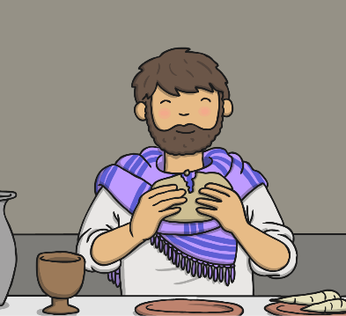
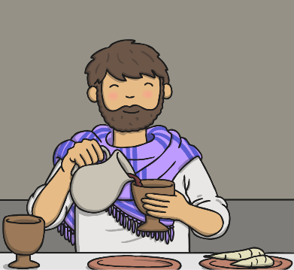
Maundy Thursday
Jesus broke the bread and blessed it. He told his disciples it was his body and that they should eat it and remember him. Jesus then took a cup of wine and blessed it. He told his disciples it was his blood and that they should drink some wine from the cup and remember him.

Slide 6
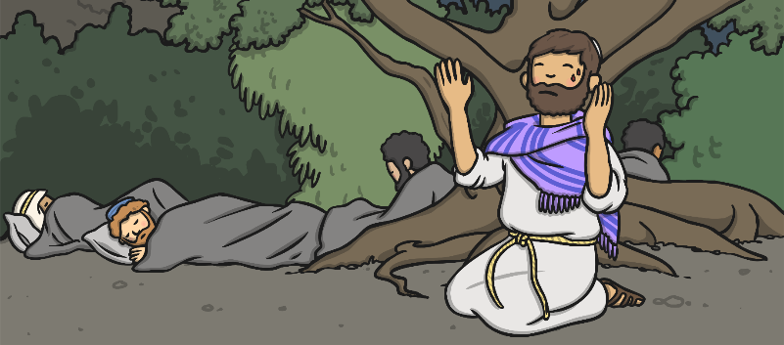
Maundy Thursday
Jesus and his disciples went to the Garden of Gethsemane. Jesus prayed to God and the disciples fell asleep.

Slide 7
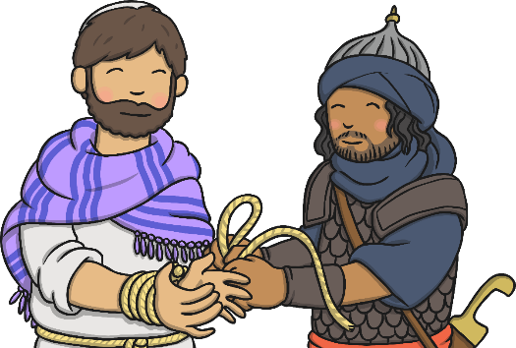
Maundy Thursday
Judas came into the Garden of Gethsemane with the priests and guards. He kissed Jesus on the cheek. This was the sign that showed the priests and the guards who Jesus was. The guards arrested Jesus and he was taken away.

Slide 8

How Do Christians Remember
Maundy Thursday?
Some churches have special feet washing services on Maundy Thursday.
Hundreds of years ago, our monarch used to wash poor people’s feet on Maundy Thursday. Can you imagine the Queen washing your feet?

Slide 9

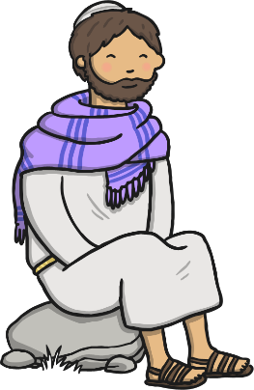
Story Discussion
What did Jesus tell the disciples after he washed their feet?
What did Jesus share with the disciples at the Last Supper?
Where did Jesus and the disciples go after the Last Supper?
Which disciple betrayed Jesus?

Slide 10


Bread and Wine
The bread Jesus broke at the Last Supper represents his body and the wine Jesus poured at the Last Supper represents his blood.
In Church services today, Christians still re-enact this special moment from the Last Supper – this is called Holy Communion.

Slide 11
Important Events
Which parts of the story do you think are the most important?
Why?
How might the rest of the Easter story be different if that part of the story hadn’t happened?

Slide 12


Independent Work
Choose 3 events from Maundy Thursday. Draw a picture and write a few sentences for each.

