Slide 1




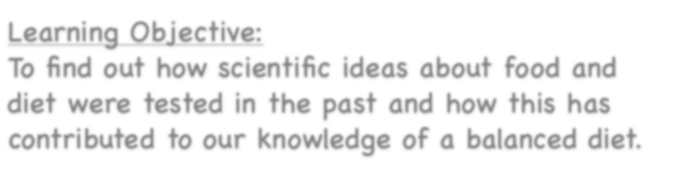



Healthy Bodies
Learning Objective:
To find out how scientific ideas about food and diet were tested in the past and how this has contributed to our knowledge of a balanced diet.
NEXT
www.planbee.com

Slide 2



Which of these statements are true and which are false?
A balanced diet means you eat equal amounts of each different food group.
Eating the correct foods will give you lots of energy.
The heart is a muscle that needs to be exercised in order to keep healthy.
The fitter you are, the faster your heart rate is.
You should exercise once a week.
Fruits and vegetables contain lots of important vitamins and minerals.
Without proteins, such as meat, eggs and cheese, you will not grow properly.
Drugs are always bad for you.
BACK
NEXT
www.planbee.com

Slide 3
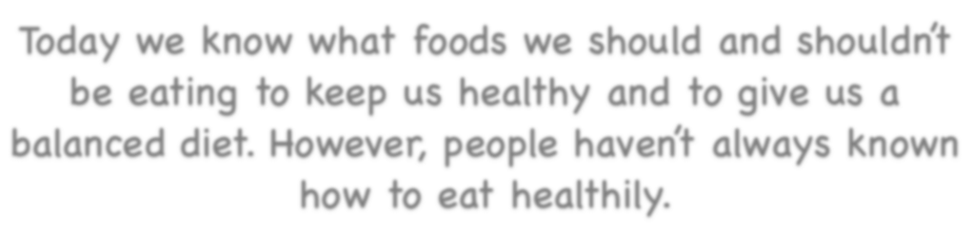

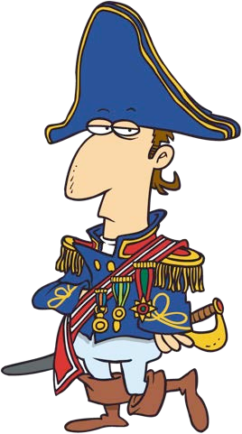







Today we know what foods we should and shouldn’t be eating to keep us healthy and to give us a balanced diet. However, people haven’t always known how to eat healthily.
Why do you think people in the past didn’t know about how to eat a healthy, balanced diet?
BACK
NEXT
www.planbee.com

Slide 4




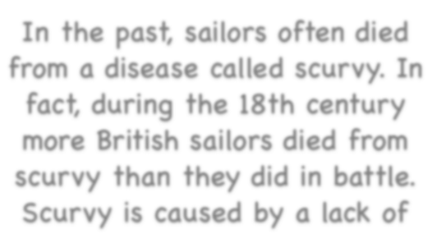
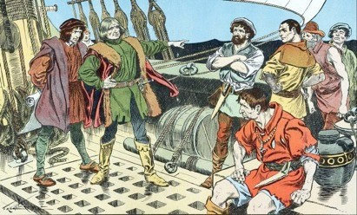
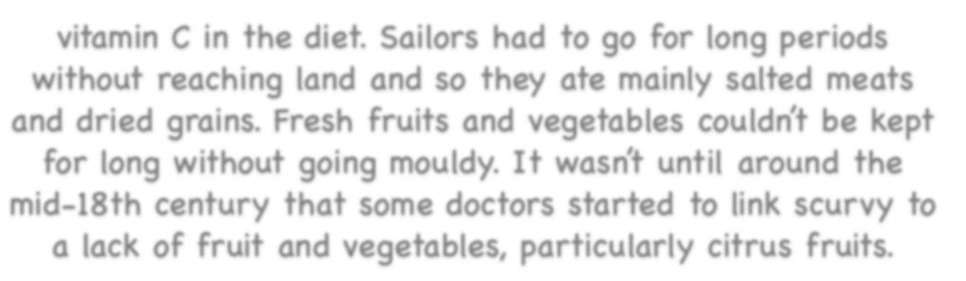
Sailors
In the past, sailors often died from a disease called scurvy. In fact, during the 18th century more British sailors died from scurvy than they did in battle.
Scurvy is caused by a lack of vitamin C in the diet. Sailors had to go for long periods
without reaching land and so they ate mainly salted meats and dried grains. Fresh fruits and vegetables couldn’t be kept for long without going mouldy. It wasn’t until around the
mid-18th century that some doctors started to link scurvy to a lack of fruit and vegetables, particularly citrus fruits.
BACK
NEXT
www.planbee.com

Slide 5
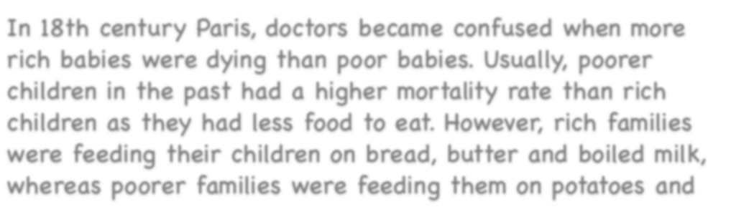
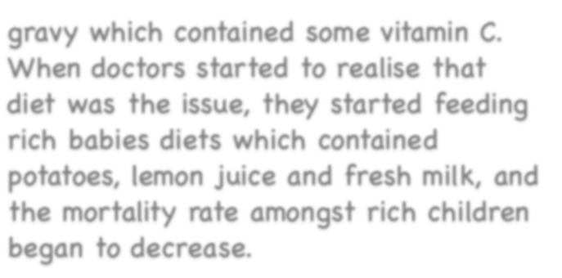

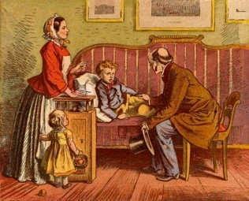

Rich and Poor Babies
In 18th century Paris, doctors became confused when more rich babies were dying than poor babies. Usually, poorer children in the past had a higher mortality rate than rich children as they had less food to eat. However, rich families were feeding their children on bread, butter and boiled milk,
whereas poorer families were feeding them on potatoes and gravy which contained some vitamin C.
When doctors started to realise that diet was the issue, they started feeding rich babies diets which contained potatoes, lemon juice and fresh milk, and the mortality rate amongst rich children began to decrease.
BACK
NEXT
www.planbee.com

Slide 6
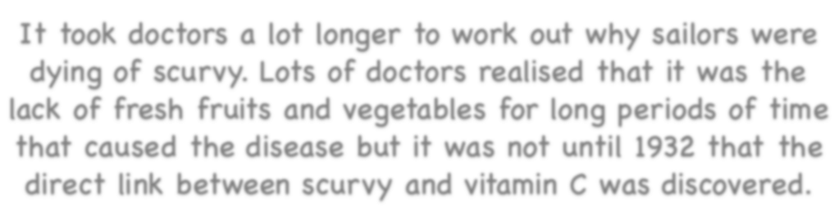
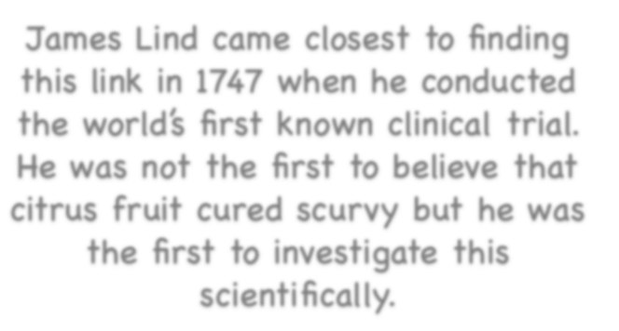

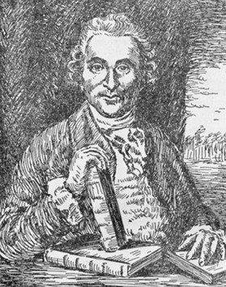

It took doctors a lot longer to work out why sailors were dying of scurvy. Lots of doctors realised that it was the lack of fresh fruits and vegetables for long periods of time that caused the disease but it was not until 1932 that the direct link between scurvy and vitamin C was discovered.
James Lind came closest to finding this link in 1747 when he conducted the world’s first known clinical trial. He was not the first to believe that citrus fruit cured scurvy but he was the first to investigate this scientifically.
BACK
NEXT
www.planbee.com

Slide 7
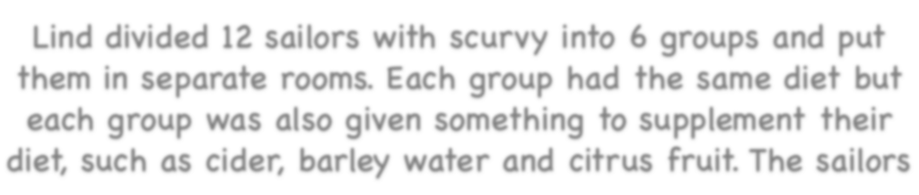
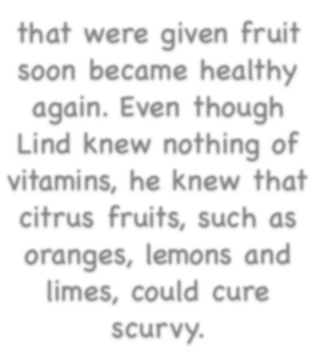


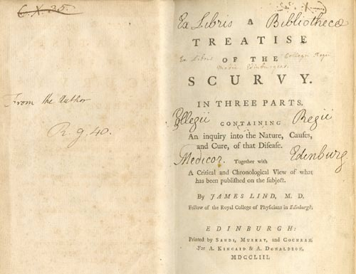







Lind divided 12 sailors with scurvy into 6 groups and put them in separate rooms. Each group had the same diet but each group was also given something to supplement their diet, such as cider, barley water and citrus fruit. The sailors
that were given fruit soon became healthy again. Even though Lind knew nothing of vitamins, he knew that citrus fruits, such as oranges, lemons and limes, could cure
scurvy.
BACK
NEXT
www.planbee.com

Slide 8
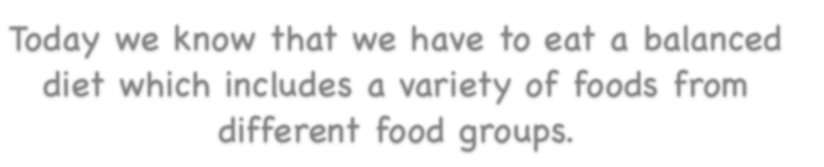


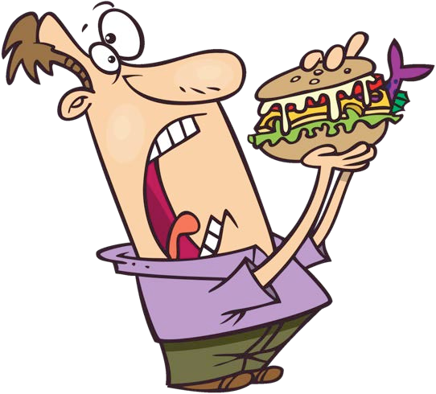











Can you name any of the food groups?
Today we know that we have to eat a balanced diet which includes a variety of foods from different food groups.
What would your definition of a healthy diet be?
BACK PLENARY
www.planbee.com

Slide 9


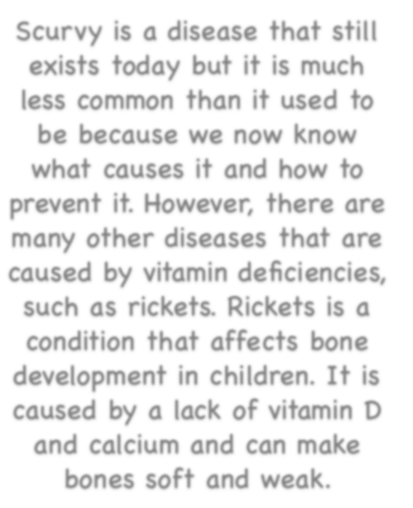


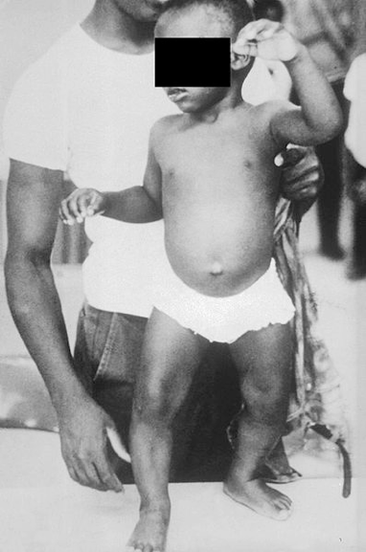

Plenary:
Scurvy is a disease that still exists today but it is much less common than it used to be because we now know
what causes it and how to prevent it. However, there are many other diseases that are caused by vitamin deficiencies, such as rickets. Rickets is a condition that affects bone development in children. It is caused by a lack of vitamin D and calcium and can make bones soft and weak.
A child suffering from rickets
BACK
NEXT
www.planbee.com

Slide 10
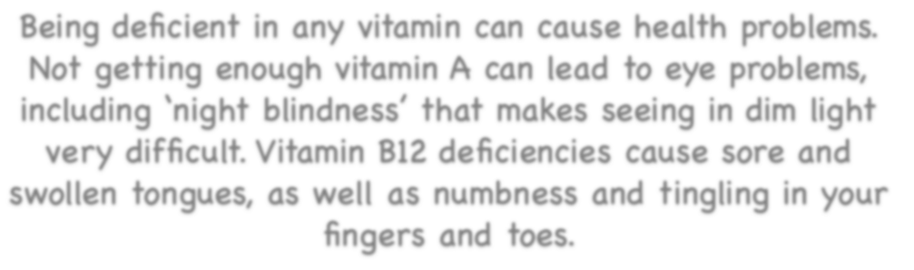
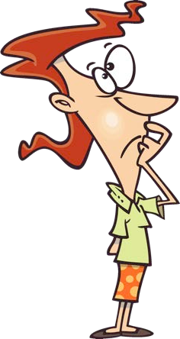









Being deficient in any vitamin can cause health problems.
Not getting enough vitamin A can lead to eye problems, including ‘night blindness’ that makes seeing in dim light very difficult. Vitamin B12 deficiencies cause sore and swollen tongues, as well as numbness and tingling in your fingers and toes.
What do you think we can do to ensure that
we don’t develop any diseases caused by vitamin deficiencies?
BACK
NEXT
www.planbee.com

