Slide 1

Poetry
Mountains

Slide 2
What do you know about poetry?
Does poetry have to rhyme?
Is it written like normal sentences?
How long is a poem?

Slide 3
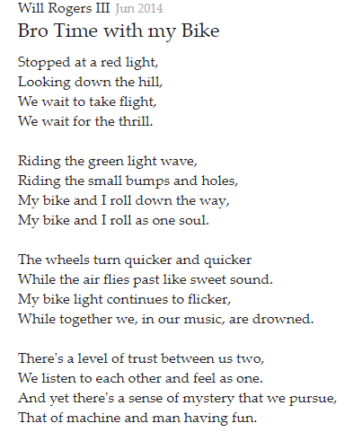
Bike Riding Poems

Slide 4
Bike Riding Poems
Rewatch the film The Ridge
http://vimeo.com/125896742

Slide 5
Bike Riding Poems
Now it is your turn to write a poem about riding the bike in The Ridge.

