Slide 1









Healthy Bodies
Learning Objective:
To investigate some different food groups and find out why a variety of foods is important for a healthy diet.
NEXT
www.planbee.com

Slide 2











protein
Do you know what these different food groups are and why they are important for our bodies?
?
carbohydrate
fat
minerals
fibre
BACK
NEXT
www.planbee.com

Slide 3



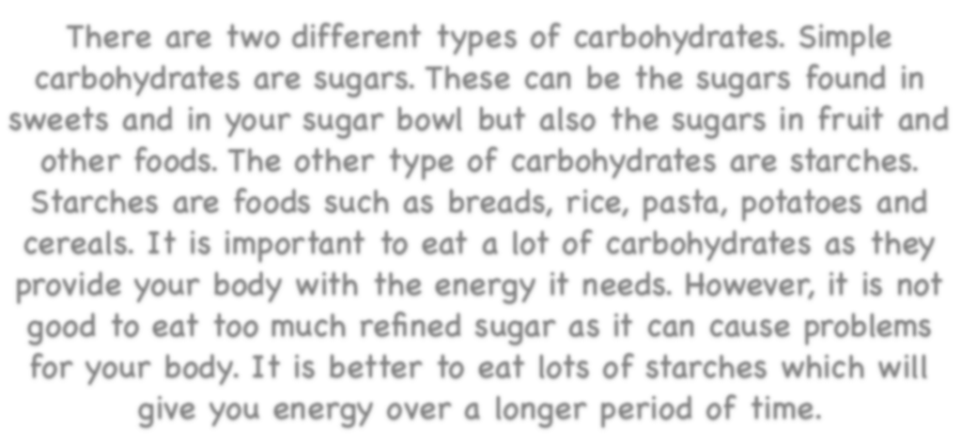

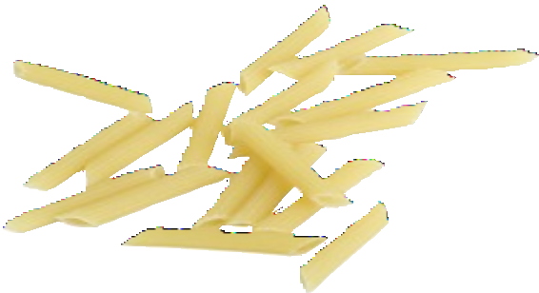


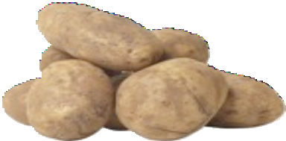
Carbohydrate
There are two different types of carbohydrates. Simple carbohydrates are sugars. These can be the sugars found in sweets and in your sugar bowl but also the sugars in fruit and other foods. The other type of carbohydrates are starches.
Starches are foods such as breads, rice, pasta, potatoes and cereals. It is important to eat a lot of carbohydrates as they provide your body with the energy it needs. However, it is not good to eat too much refined sugar as it can cause problems for your body. It is better to eat lots of starches which will give you energy over a longer period of time.
BACK
NEXT
www.planbee.com

Slide 4

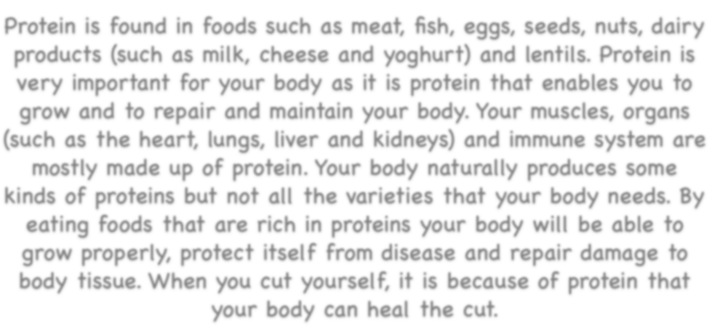
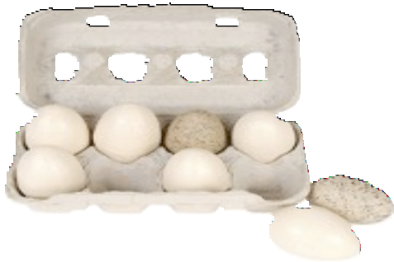
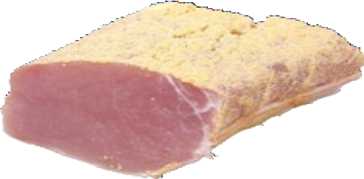

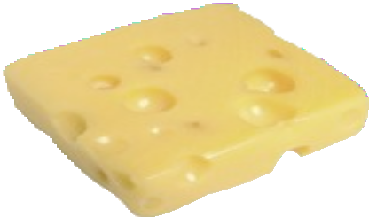
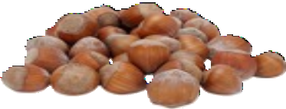
Protein
Protein is found in foods such as meat, fish, eggs, seeds, nuts, dairy products (such as milk, cheese and yoghurt) and lentils. Protein is very important for your body as it is protein that enables you to grow and to repair and maintain your body. Your muscles, organs (such as the heart, lungs, liver and kidneys) and immune system are mostly made up of protein. Your body naturally produces some kinds of proteins but not all the varieties that your body needs. By eating foods that are rich in proteins your body will be able to grow properly, protect itself from disease and repair damage to body tissue. When you cut yourself, it is because of protein that your body can heal the cut.
BACK
NEXT
www.planbee.com

Slide 5

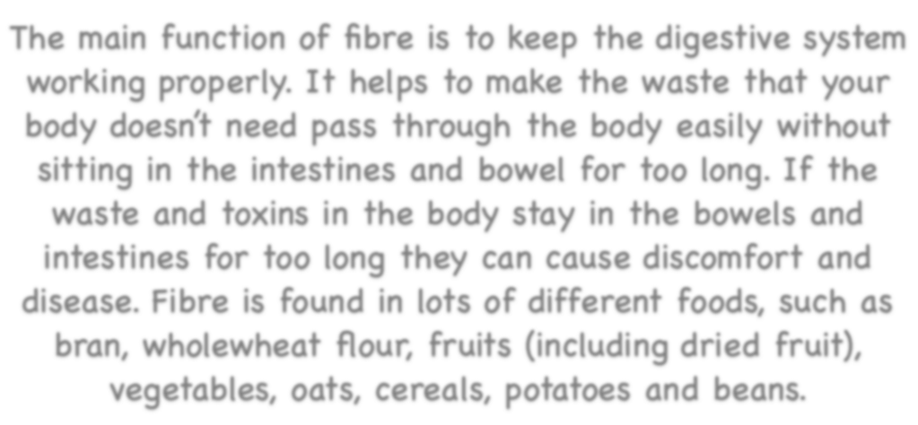
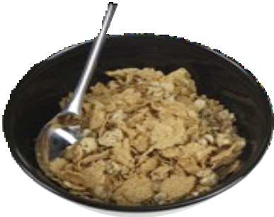
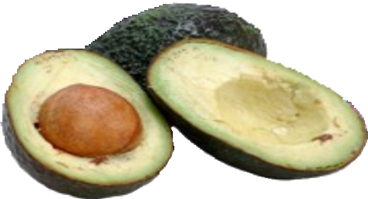
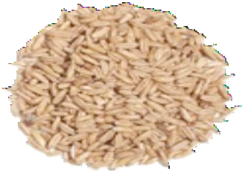

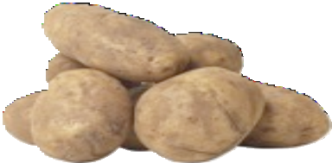
Fibre
The main function of fibre is to keep the digestive system working properly. It helps to make the waste that your body doesn’t need pass through the body easily without sitting in the intestines and bowel for too long. If the waste and toxins in the body stay in the bowels and intestines for too long they can cause discomfort and disease. Fibre is found in lots of different foods, such as bran, wholewheat flour, fruits (including dried fruit), vegetables, oats, cereals, potatoes and beans.
BACK
NEXT
www.planbee.com

Slide 6


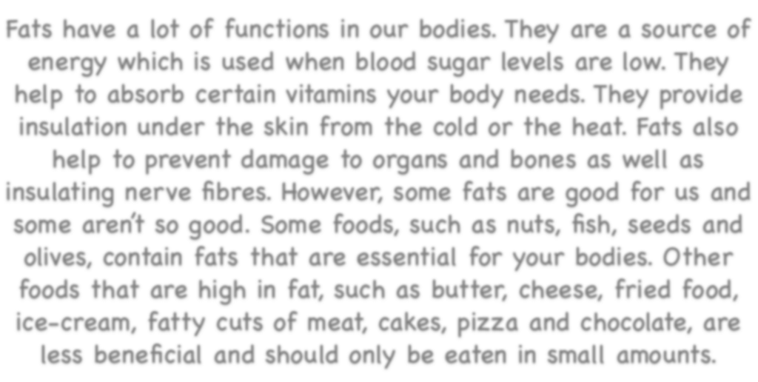



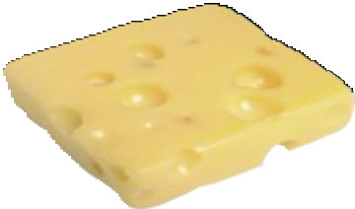



Fat
Fats have a lot of functions in our bodies. They are a source of energy which is used when blood sugar levels are low. They help to absorb certain vitamins your body needs. They provide insulation under the skin from the cold or the heat. Fats also help to prevent damage to organs and bones as well as insulating nerve fibres. However, some fats are good for us and some aren’t so good. Some foods, such as nuts, fish, seeds and olives, contain fats that are essential for your bodies. Other foods that are high in fat, such as butter, cheese, fried food, ice-cream, fatty cuts of meat, cakes, pizza and chocolate, are less beneficial and should only be eaten in small amounts.
BACK
NEXT
www.planbee.com

Slide 7


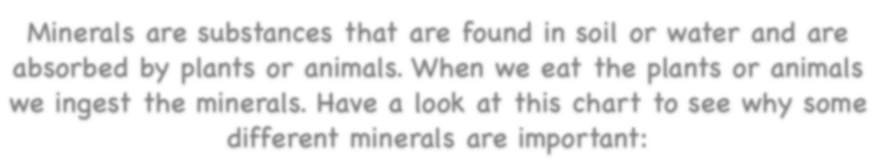
Minerals
Minerals are substances that are found in soil or water and are absorbed by plants or animals. When we eat the plants or animals we ingest the minerals. Have a look at this chart to see why some different minerals are important:
Iron | Iron is important as it helps the blood to carry oxygen to the different parts of the body. Without enough iron you will feel very tired. Iron is found in foods such as red meat, fish, lentils, beans, spinach and raisins.
Calcium | You need calcium to grow strong, healthy bones and teeth. It is important to have lots of calcium particularly when you are young and your bones and teeth are still growing. Calcium is found in dairy products such as milk, cheese and butter.
Magnesium | Magnesium has lots of functions in the body. It helps the muscles and nervous system to function properly as well as keeping your heart beating steadily. Magnesium is mainly found in wholegrain foods, nuts, seeds, bananas and avocados.
Zinc | Zinc helps your body and its organs to grow and repair themselves properly. Without zinc your body would have difficulty in healing cuts and scrapes. Zinc is found in meat, fish, nuts and dairy products.
Potassium | Potassium helps your body to regulate the level of blood and water in body tissue. Potassium is found in citrus fruits (such as oranges and lemons), broccoli, bananas, potatoes, peas and leafy vegetables.
BACK
NEXT
www.planbee.com

Slide 8




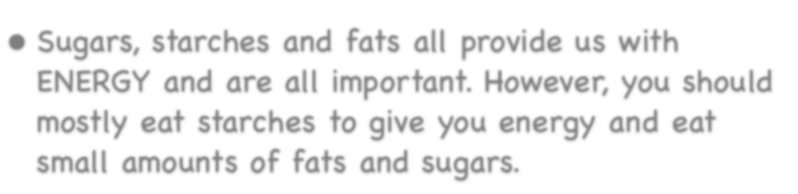
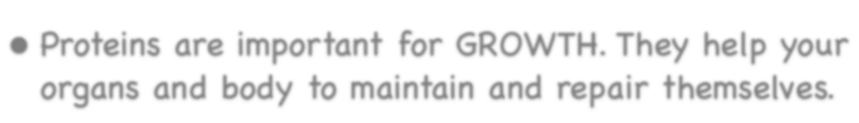
Let’s recap. .
Sugars, starches and fats all provide us with ENERGY and are all important. However, you should mostly eat starches to give you energy and eat small amounts of fats and sugars.
Proteins are important for GROWTH. They help your organs and body to maintain and repair themselves.
BACK
NEXT
www.planbee.com

Slide 9




Can you think of any foods that would go in each of these food groups? | Carbohydrates
Fats | Proteins
Fibre | Minerals
BACK
NEXT
www.planbee.com

Slide 10




You can find out how much of the different nutrients are in different foods by looking at food labels. Have a look at the three food labels on the next slide and see if you can match the correct food to the correct label. .
BACK
NEXT
www.planbee.com

Slide 11
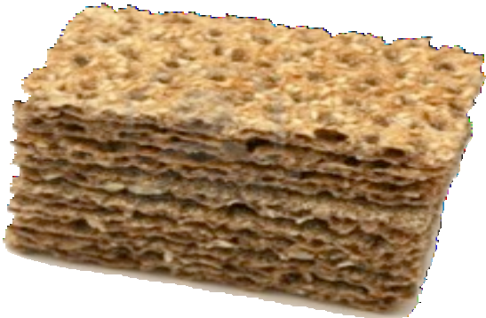




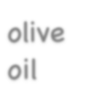





crackers
per 100g
Energy | 47kcal
Protein | 2.8g
Carbohydrate of which sugars | 8.0g 8.0g
Fat of which saturates | 0.4g trace
Fibre | 1.8g
Sodium | trace
per 100g
Energy | 823kcal
Protein | trace
Carbohydrate of which sugars | 0g 0g
Fat of which saturates | 91.4g 13.1g
Fibre | 0g
Sodium | trace
per 100g
Energy | 356kcal
Protein | 9.0g
Carbohydrate of which sugars | 70.6g 5.1g
Fat of which saturates | 1.4g 0.2g
Fibre | 12.6g
Sodium | 0.27g
olive oil
tinned tomatoes
BACK
NEXT
www.planbee.com

Slide 12


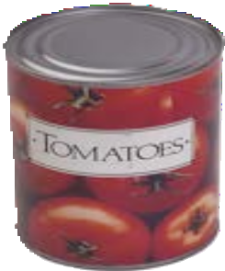
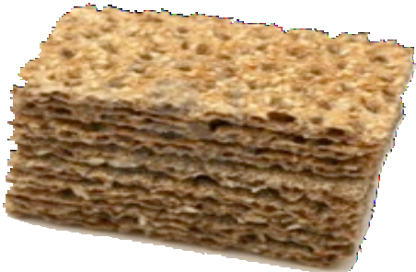


Did you get each of those right?
 | TINNED TOMATOES
per 100g
Energy |  | 47kcal
Protein |  | 2.8g
Carbohydrate of which sugars |  | 8.0g 8.0g
Fat of which saturates |  | 0.4g trace
Fibre |  | 1.8g
Sodium |  | trace
 | CRACKERS
per 100g
Energy |  | 356kcal
Protein |  | 9.0g
Carbohydrate of which sugars |  | 70.6g 5.1g
Fat of which saturates |  | 1.4g 0.2g
Fibre |  | 12.6g
Sodium |  | 0.27g
 | OLIVE OIL
per 100g
Energy |  | 823kcal
Protein |  | trace
Carbohydrate of which sugars |  | 0g 0g
Fat of which saturates |  | 91.4g 13.1g
Fibre |  | 0g
Sodium |  | trace
per 100g
per 100g
per 100g
Energy 47kcal
Protein 2.8g Carbohydrate 8.0g
of which sugar 8.0g
Fat 0.4g
of which trace
Fibre 1.8g
Sodium trace
_{Energy} 356kca l
Protein 9.0g
Carbohydrate 70.6g of which sugar 5.1g Fat 1.4g
of which 0.2g
Fibre 12.6g
Sodium 0.27g
Energy ^{823kc} al
Protein trace
Carbohydrate 0g
of which sugar 0g
Fat 91.4g
of which 13.1g
Fibre 0g
Sodium trace
BACK
PLENARY
www.planbee.com

Slide 13





Plenary:
White rice
per 100g
Energy | 115kcal
Protein | 2.6g
Carbohydrate of which sugars | 24.8g nil
Fat of which saturates | 0.3g 0.1g
Fibre | 1.2g
Sodium | nil
Brown rice
per 100g
Energy | 110kcal
Protein | 3g
Carbohydrate of which sugars | 19.3g 0.2g
Fat of which saturates | 1.3g 0.3g
Fibre | 4.7g
Sodium | nil
Which of these foods do you think is healthiest and why?
BACK
NEXT
www.planbee.com

Slide 14
Pork chops
per 100g
Energy | 199kcal
Protein | 15.6g
Carbohydrate of which sugars | nil nil
Fat of which saturates | 15.2g 5.6g
Fibre | nil
Sodium | trace
Prawns
per 100g
Energy | 59kcal
Protein | 14.2g
Carbohydrate of which sugars | 0.3g <0.1g
Fat of which saturates | 0.1g <0.1g
Fibre | nil
Sodium | 0.75g
Which of these foods do you think is healthiest and why?
BACK
NEXT
www.planbee.com

Slide 15
Digestive biscuits
per 100g
Energy | 496kcal
Protein | 7g
Carbohydrate of which sugars | 63.4g 18.4g
Fat of which saturates | 23.3g 9.4g
Fibre | 2.3g
Sodium | 0.5g
Ready salted crisps
per 100g
Energy | 437kcal
Protein | 6.8g
Carbohydrate of which sugars | 59.8g 0.5g
Fat of which saturates | 21.8g 1.8g
Fibre | 5g
Sodium | 0.61g
Which of these foods do you think is healthiest and why?
BACK
NEXT
www.planbee.com

