Slide 1



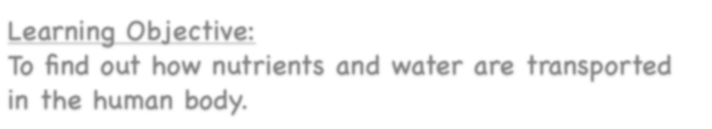






Healthy Bodies
Learning Objective:
To find out how nutrients and water are transported in the human body.
NEXT
www.planbee.com

Slide 2













We know that we need to eat and
drink in order to survive but how does our body
transport nutrients from our digestive systems to the rest of our body?
BACK
NEXT
www.planbee.com

Slide 3

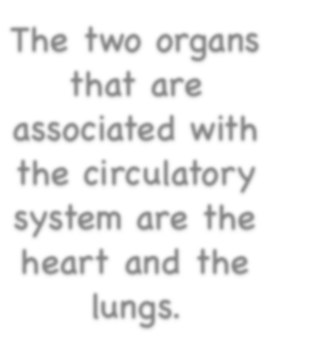













The two organs
It is our circulatory system that transports water and nutrients to the rest of our body. This is a system of tubes which carry blood around the body. When you digest food, your small intestine absorbs the nutrients from your food and passes them into the blood stream. The circulatory system then carries the blood, and therefore the nutrients, to all the parts of the body it is needed.
that are
associated with the circulatory system are the heart and the lungs.
Let’s have a look at these two organs to see how
they work!
BACK
NEXT
www.planbee.com

Slide 4



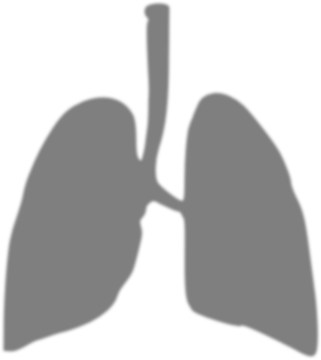
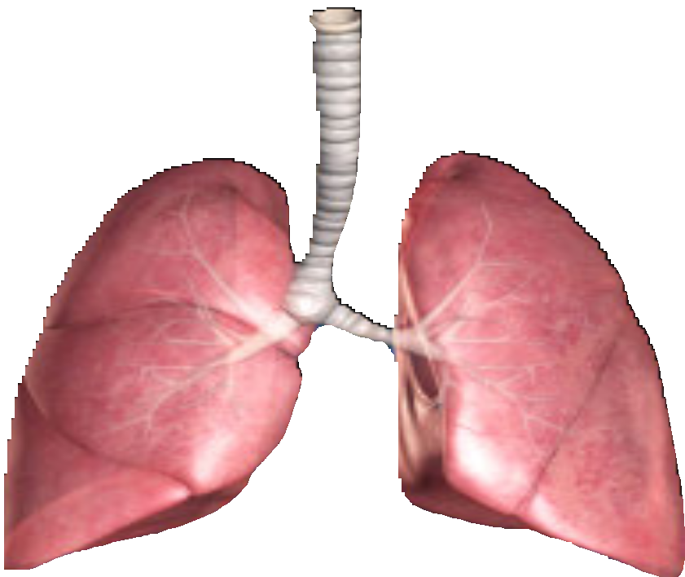
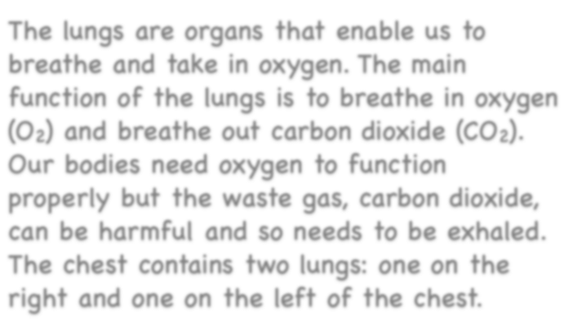

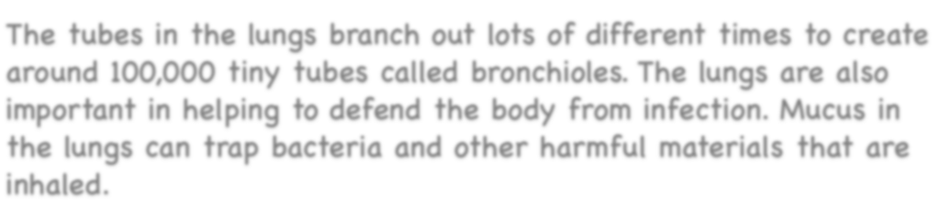
The Lungs
The lungs are organs that enable us to breathe and take in oxygen. The main function of the lungs is to breathe in oxygen (O2) and breathe out carbon dioxide (CO2).
Our bodies need oxygen to function properly but the waste gas, carbon dioxide, can be harmful and so needs to be exhaled. The chest contains two lungs: one on the right and one on the left of the chest.
The tubes in the lungs branch out lots of different times to create around 100,000 tiny tubes called bronchioles. The lungs are also important in helping to defend the body from infection. Mucus in the lungs can trap bacteria and other harmful materials that are inhaled.
BACK
NEXT
www.planbee.com

Slide 5
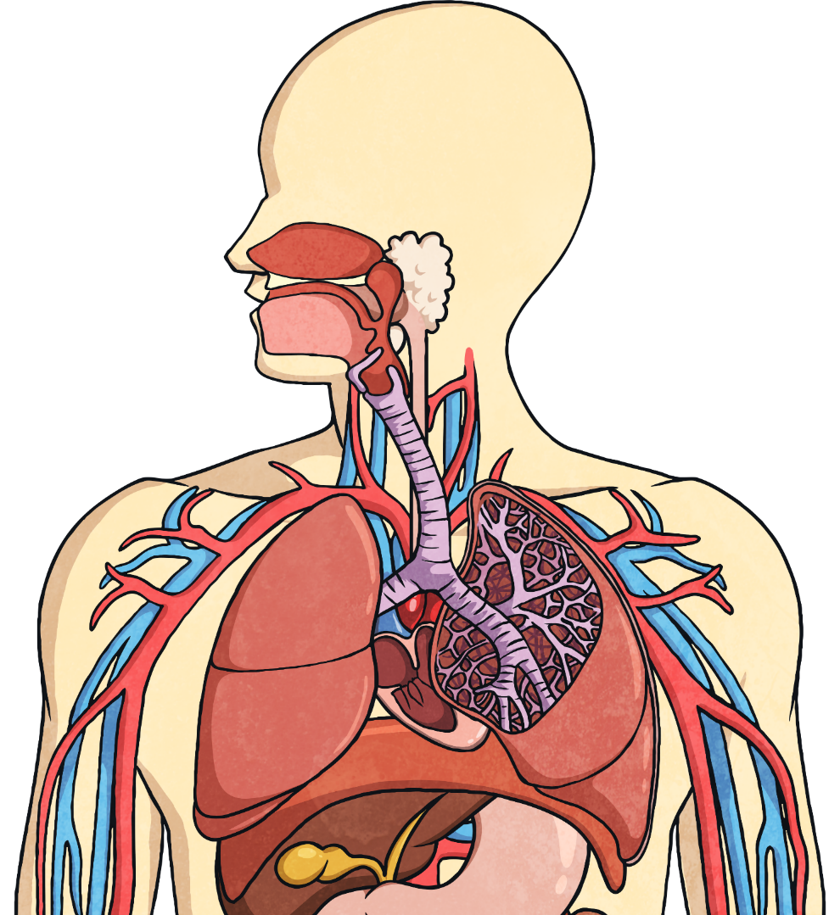
The Function of the Lungs
Air breathed in through the mouth or nose travels down the trachea, through the bronchi into one of the lungs. The air travels into the bronchioles and into the air sacs (alveoli).
trachea
intercostal muscles and ribs
bronchus
bronchiole
heart
diaphragm
air sacs (alveoli)

Slide 6



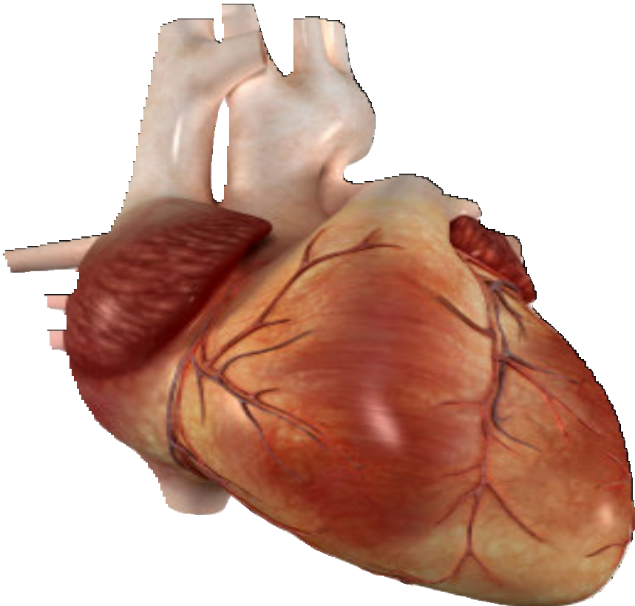
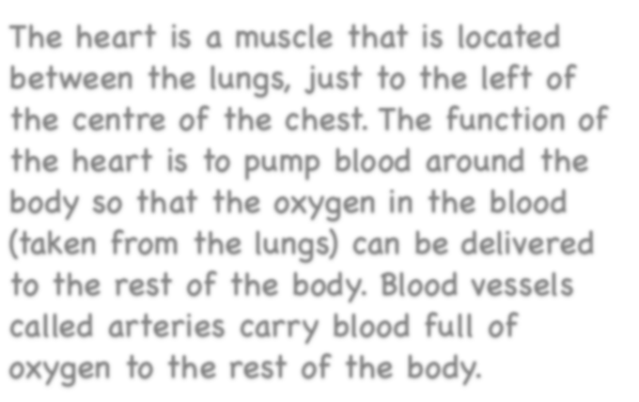
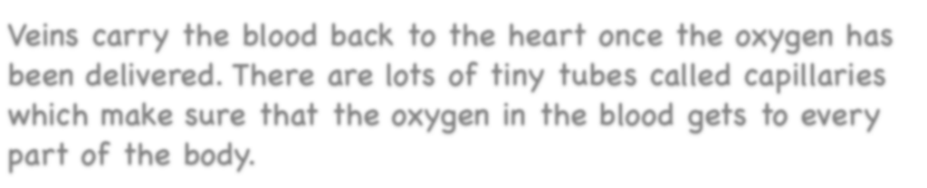

The Heart
The heart is a muscle that is located between the lungs, just to the left of the centre of the chest. The function of the heart is to pump blood around the body so that the oxygen in the blood (taken from the lungs) can be delivered to the rest of the body. Blood vessels called arteries carry blood full of oxygen to the rest of the body.
Veins carry the blood back to the heart once the oxygen has been delivered. There are lots of tiny tubes called capillaries which make sure that the oxygen in the blood gets to every part of the body.
BACK
NEXT
www.planbee.com

Slide 7
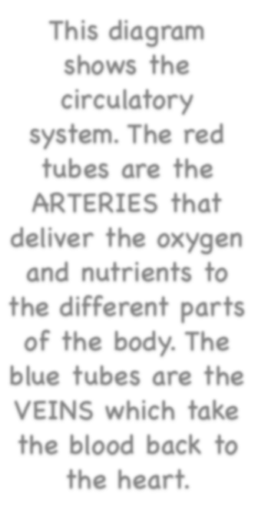
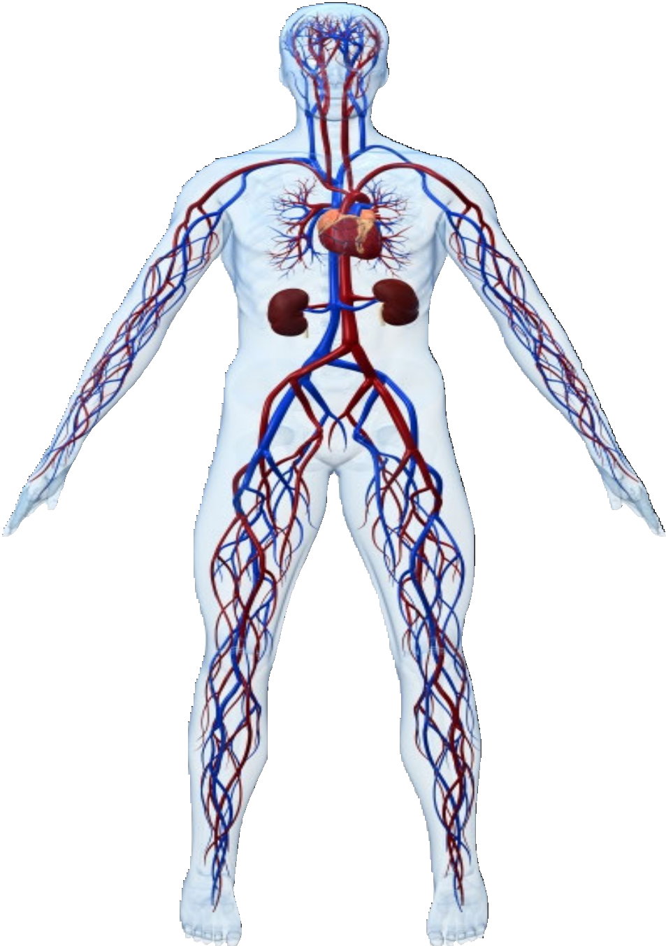
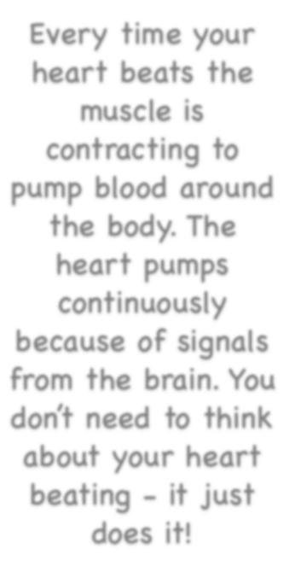




























This diagram shows the circulatory system. The red tubes are the ARTERIES that deliver the oxygen and nutrients to
the different parts of the body. The blue tubes are the VEINS which take the blood back to the heart.
Every time your heart beats the muscle is
contracting to pump blood around the body. The heart pumps
continuously because of signals from the brain. You don’t need to think about your heart beating - it just does it!
BACK
NEXT
www.planbee.com

Slide 8
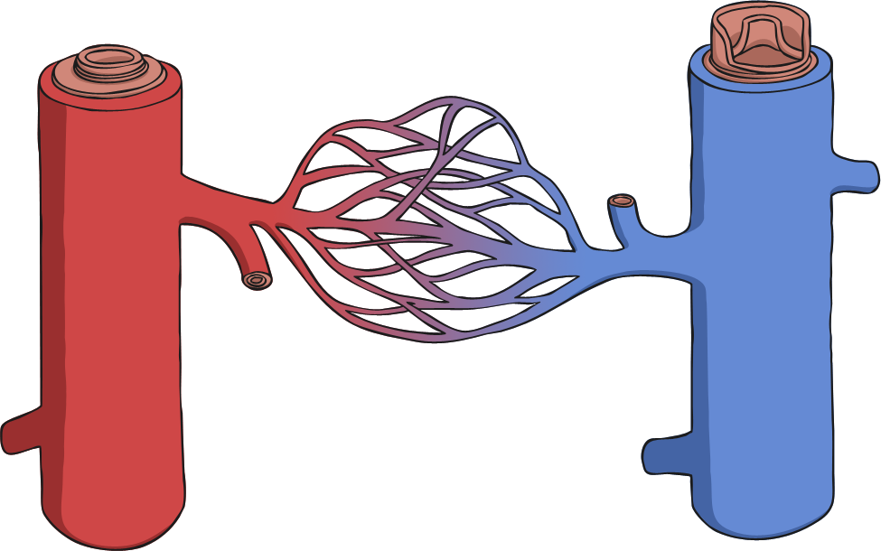
What Blood Vessels Do
Arteries – carries oxygenated blood away from the heart
Capillaries – enable exchange of oxygen with body
Veins – carries blood from capillaries back to the heart to be pumped to the lungs to be re-oxygenated.
capillaries
vein
artery

Slide 9




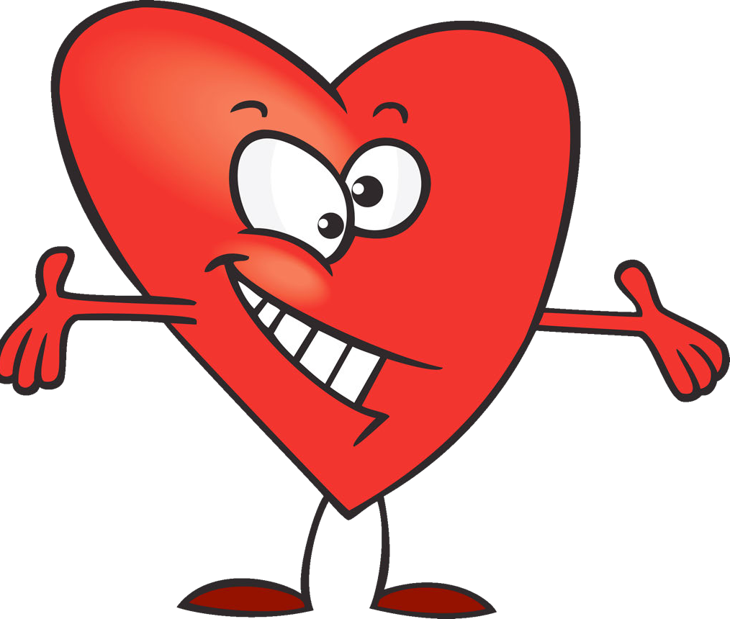





Have a look at the diagram of a human heart on the next slide.
What does this diagram tell you about the heart?
BACK
NEXT
www.planbee.com

Slide 10















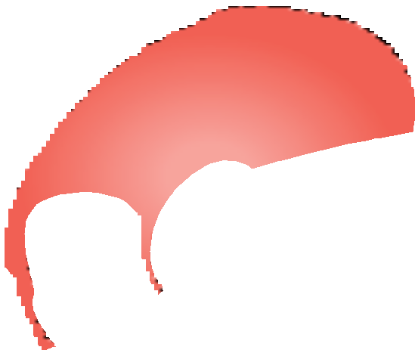












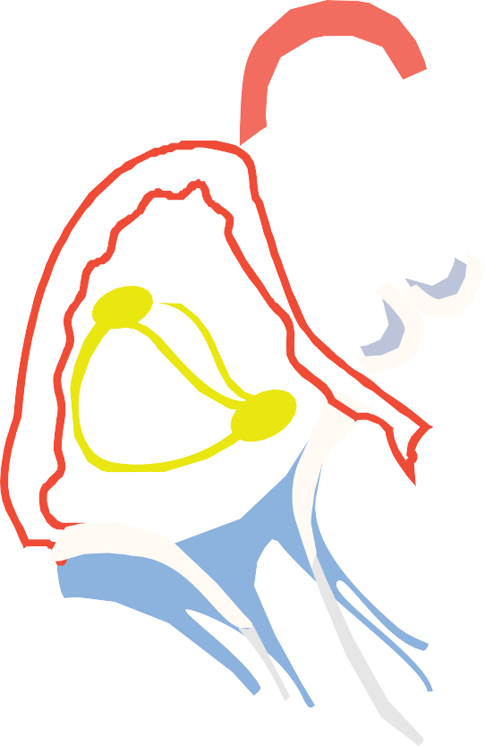

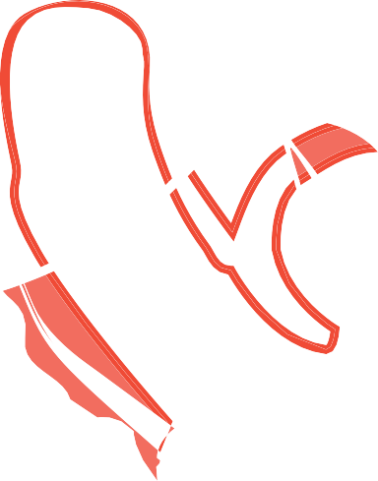





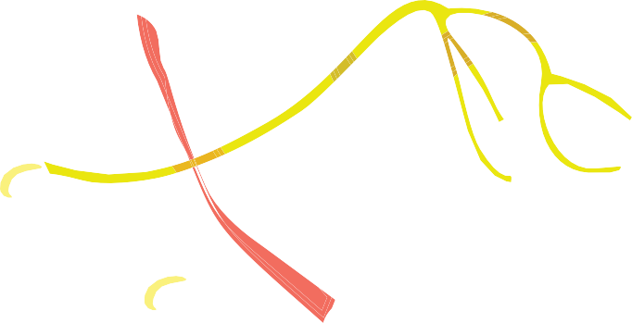

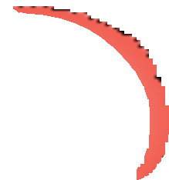











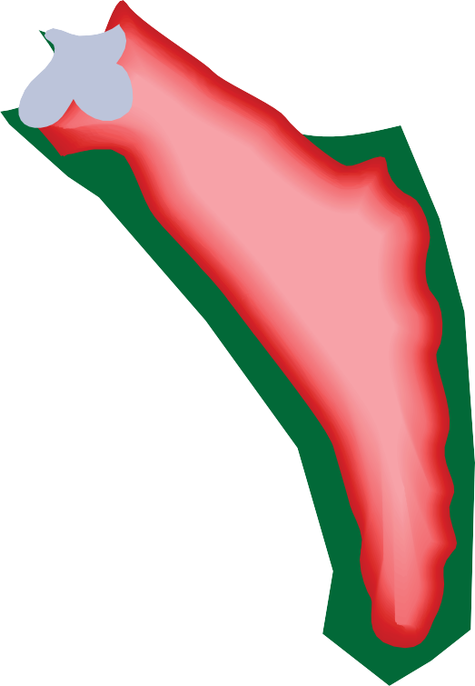



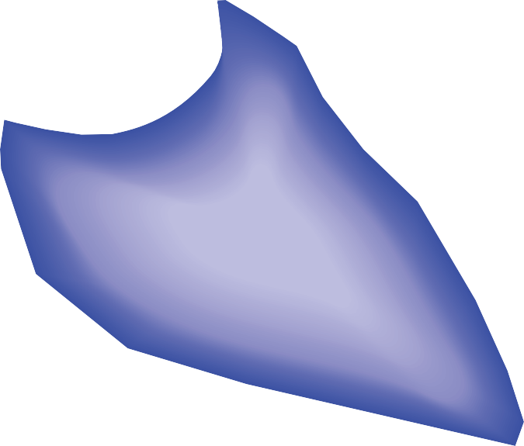
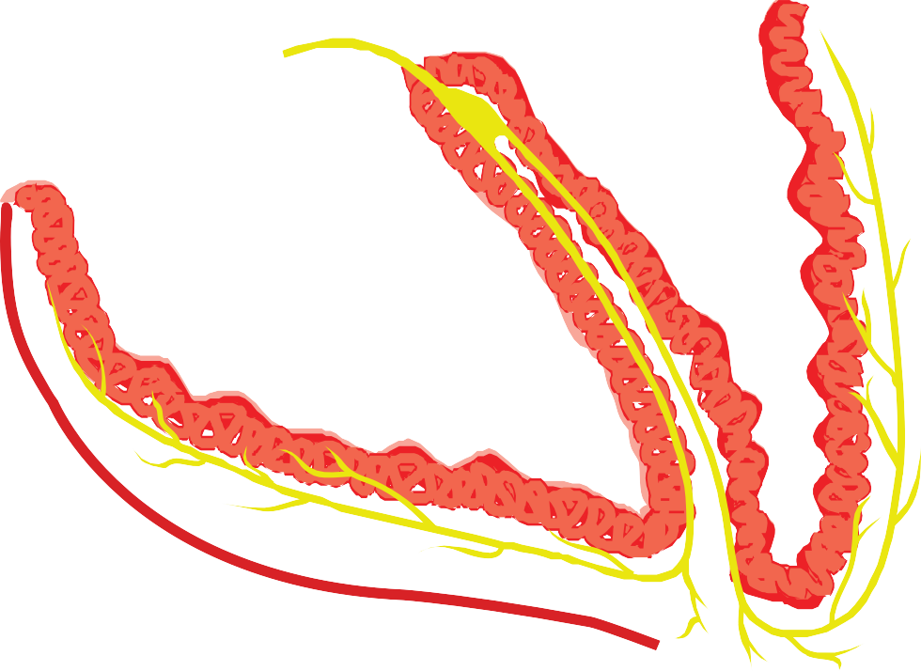




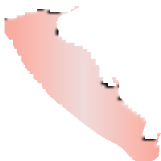




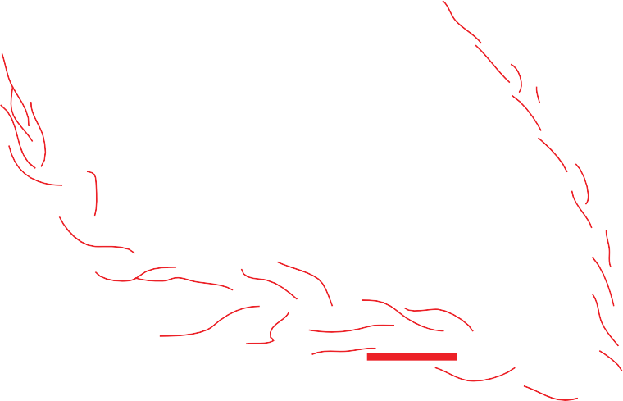



































BACK
NEXT
www.planbee.com

Slide 11
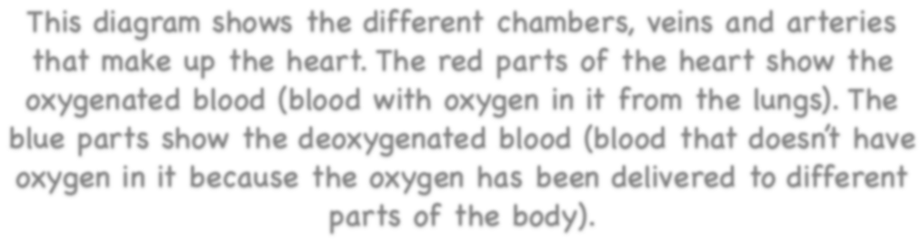




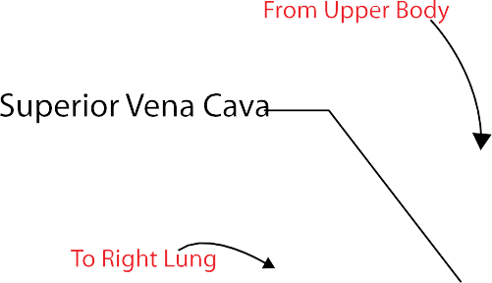





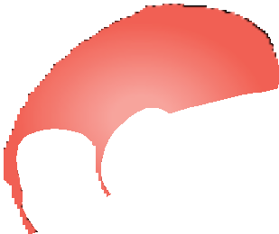
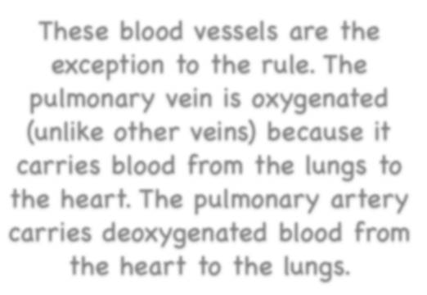



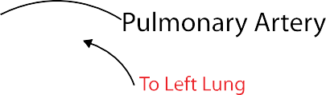
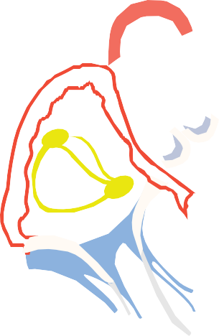


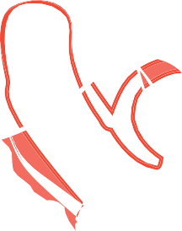


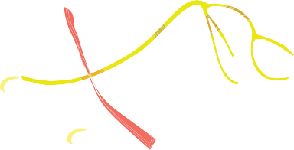







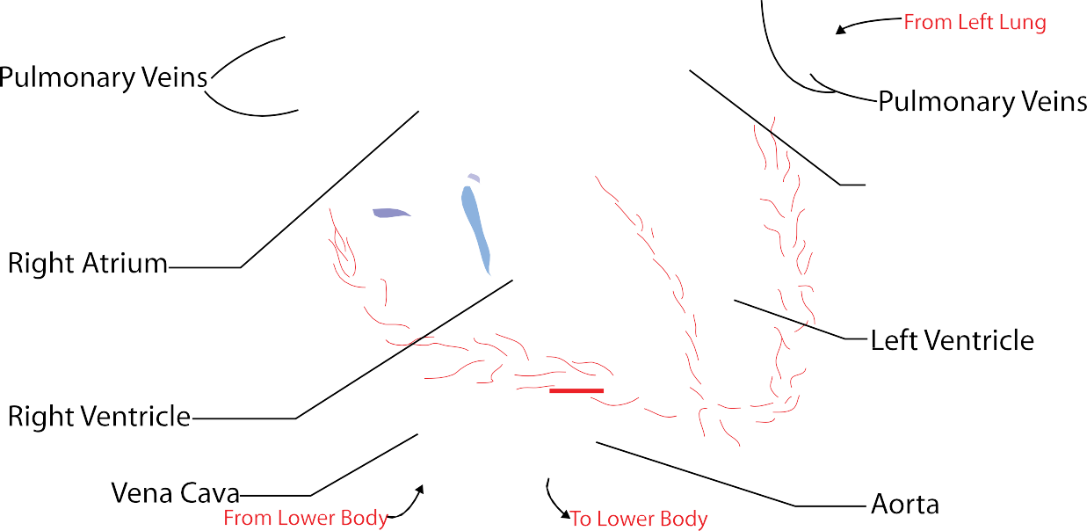





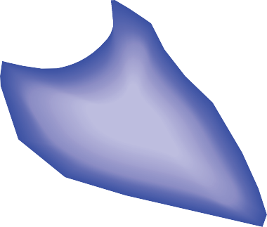



















This diagram shows the different chambers, veins and arteries that make up the heart. The red parts of the heart show the oxygenated blood (blood with oxygen in it from the lungs). The blue parts show the deoxygenated blood (blood that doesn’t have oxygen in it because the oxygen has been delivered to different
parts of the body).
Did you notice that there are blue arteries and red veins?
These blood vessels are the exception to the rule. The pulmonary vein is oxygenated (unlike other veins) because it carries blood from the lungs to the heart. The pulmonary artery carries deoxygenated blood from the heart to the lungs.
BACK
NEXT
www.planbee.com

Slide 12
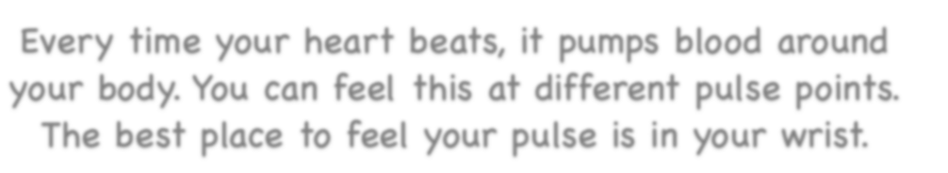



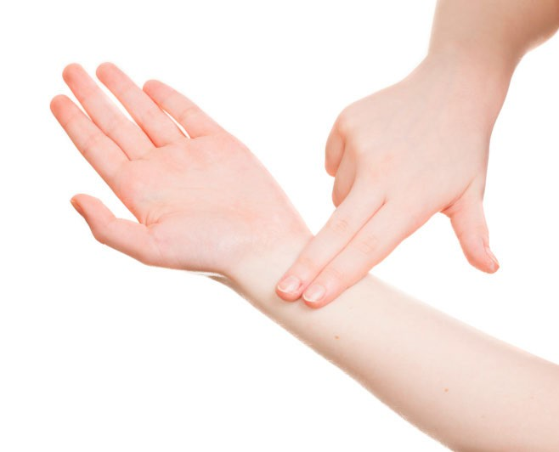








Every time your heart beats, it pumps blood around your body. You can feel this at different pulse points.
The best place to feel your pulse is in your wrist.
Can you find your pulse? Count how many times per minute your heart beats.
BACK
PLENARY
www.planbee.com

Slide 13

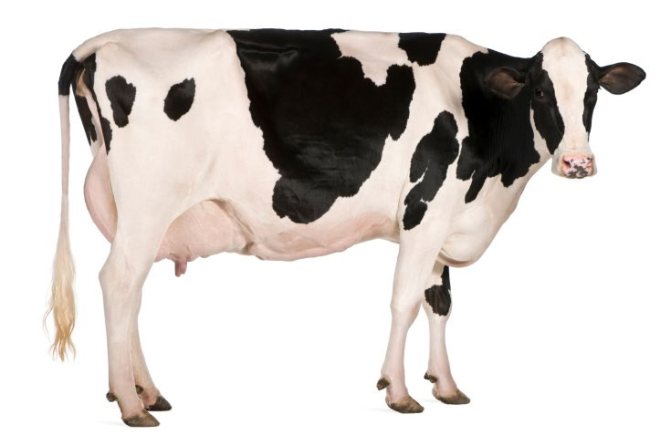
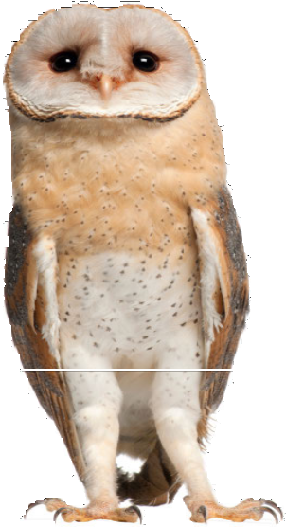
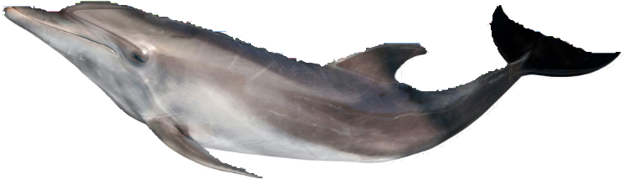
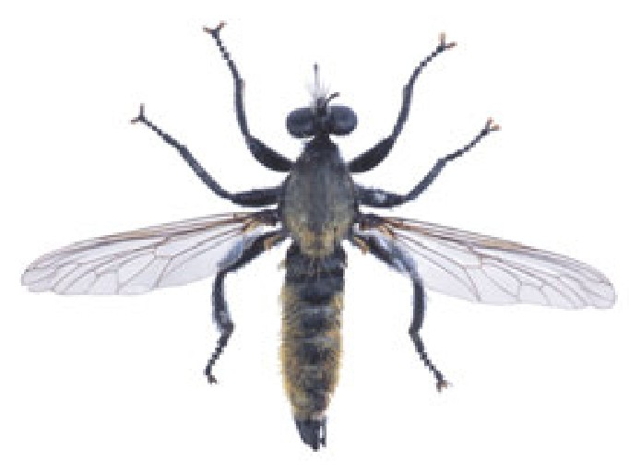
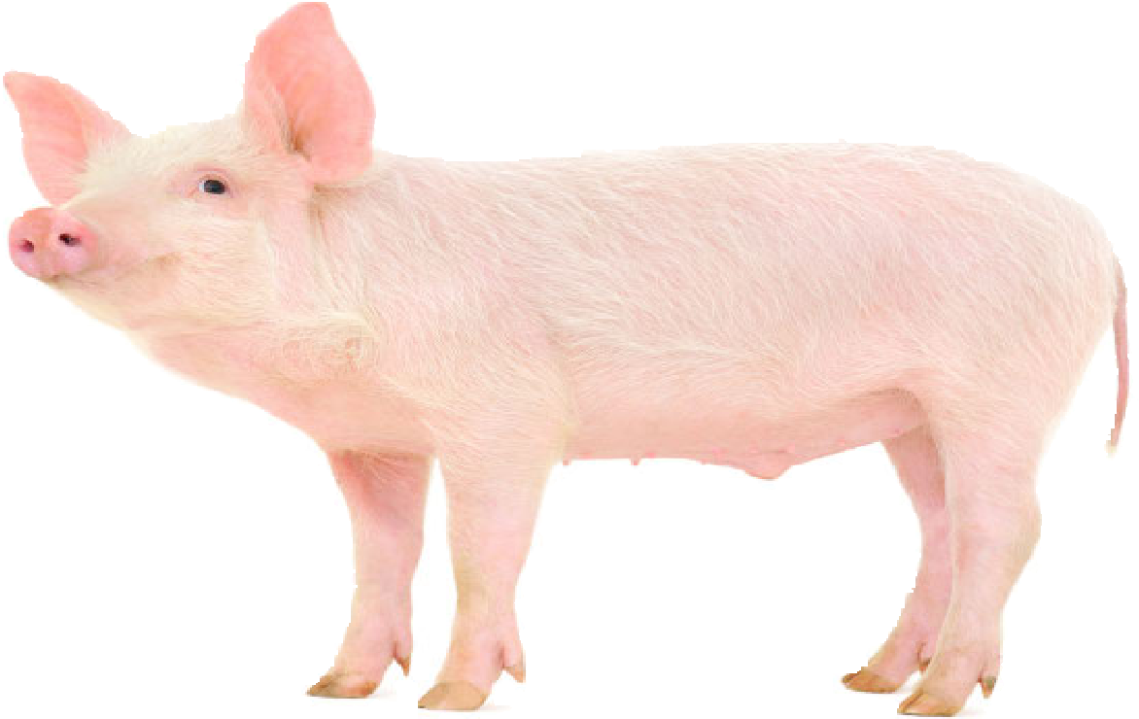
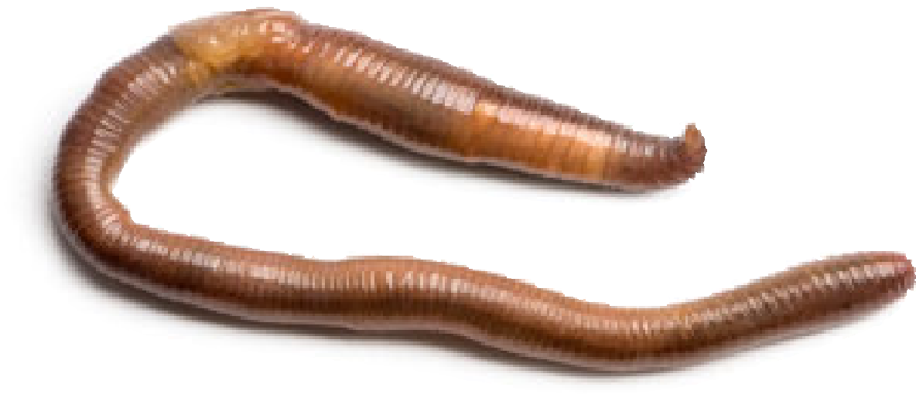
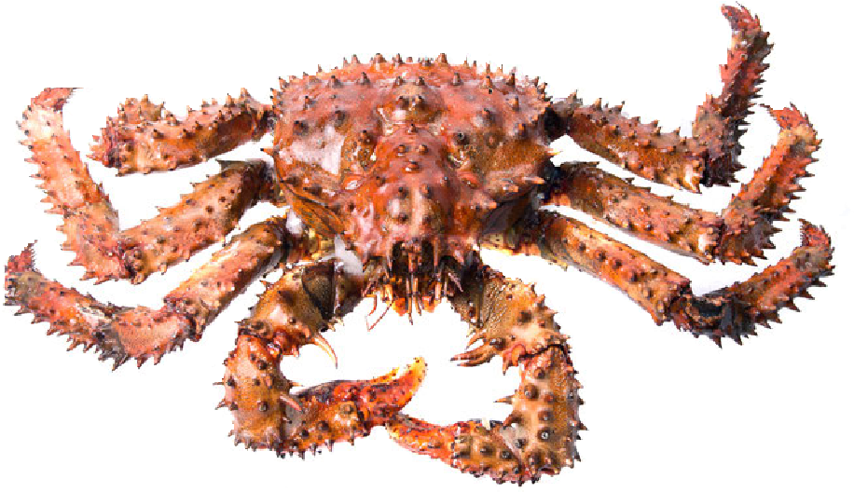
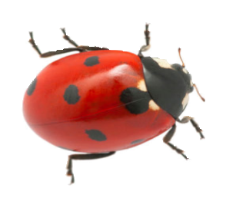
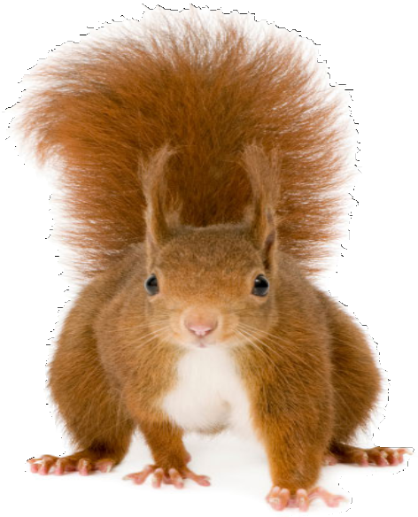
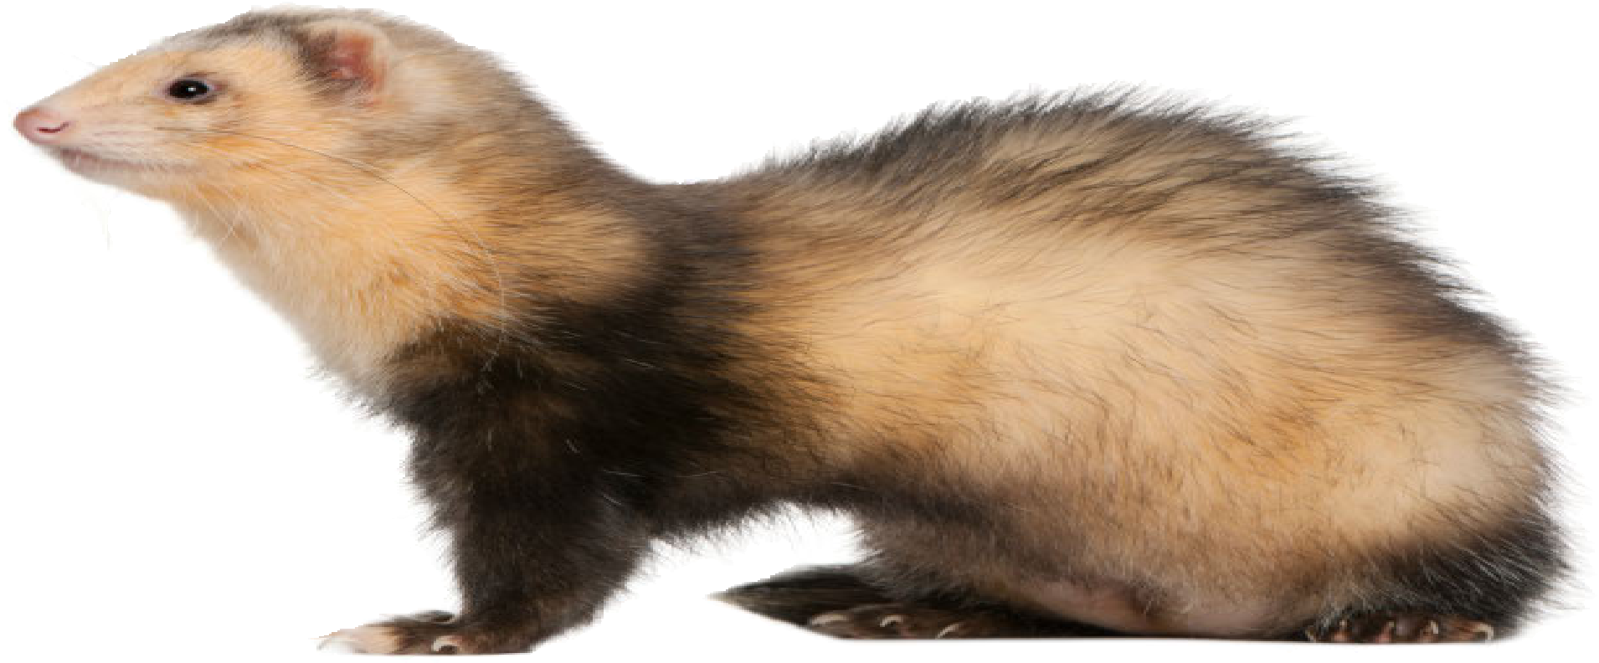
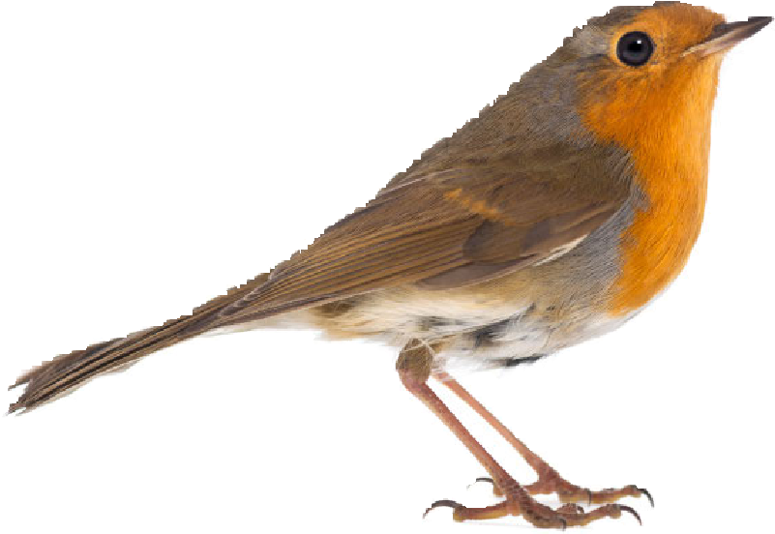
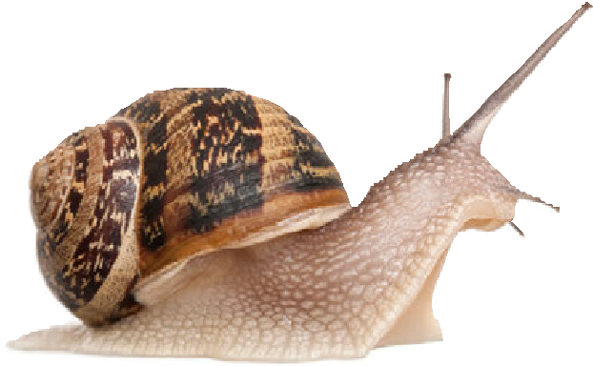
Plenary:
Do you think all animals have a circulatory system like ours with a heart, veins and arteries?
BACK
NEXT
www.planbee.com

Slide 14
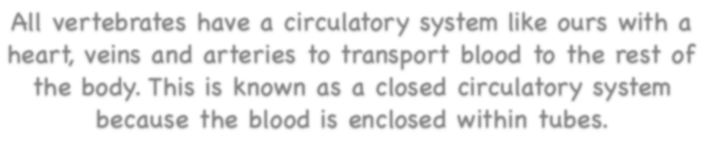









All vertebrates have a circulatory system like ours with a heart, veins and arteries to transport blood to the rest of the body. This is known as a closed circulatory system because the blood is enclosed within tubes.
Other animals, such as insects,
Insects do have hearts but they are different to human hearts. They pump blood to the insect’s
have an open circulatory system. This means that their blood flows freely around their
bodies and is not contained in
head where the blood
tubes. The nutrients in the blood _{then exits the heart and}
are taken directly to the cells where they are needed. These animals absorb oxygen through tiny tubes that open to the air.
flows around the body.
BACK
NEXT
www.planbee.com

